Slide 1

PENNDOT
DDSG FALL WORKSHOP
Data Interoperability
Workshop 1B: State Implementation Experience
September 29, 2026

Slide 2
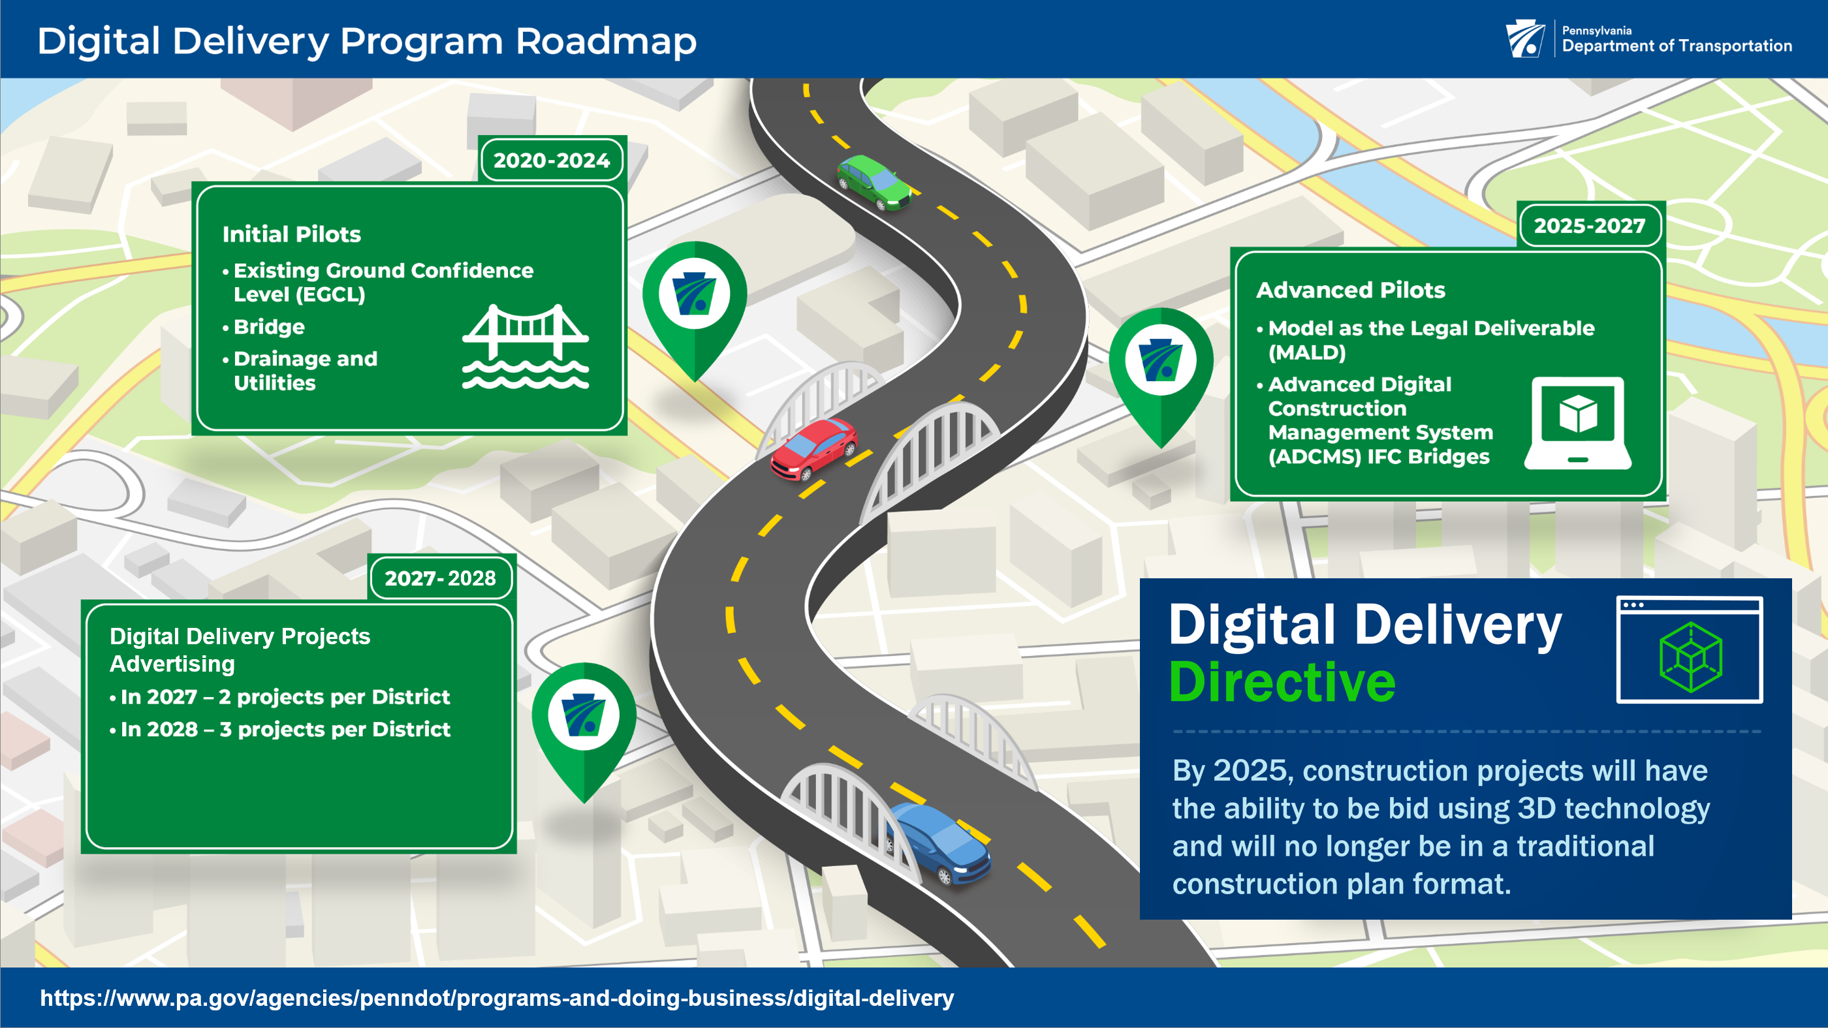
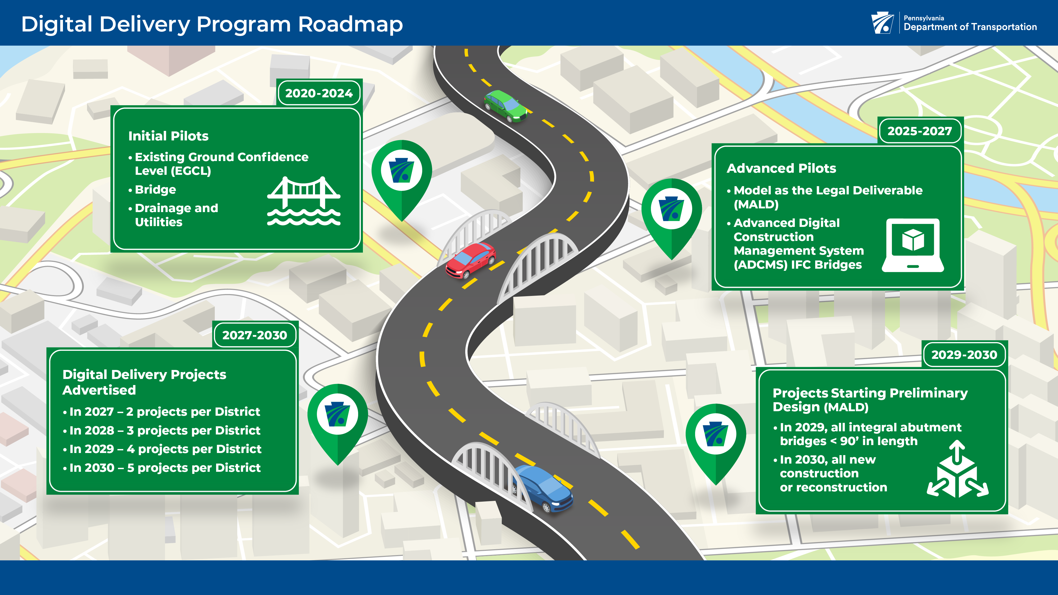
  https://www.pa.gov/agencies/penndot/programs-and-doing-business/digital-delivery
Notes:
Project Objectives:
Improve data interoperability
Improve export and quality of Industry Foundation Classes (IFC) models
Enable Contractor use
Develop training and best practices

Slide 3

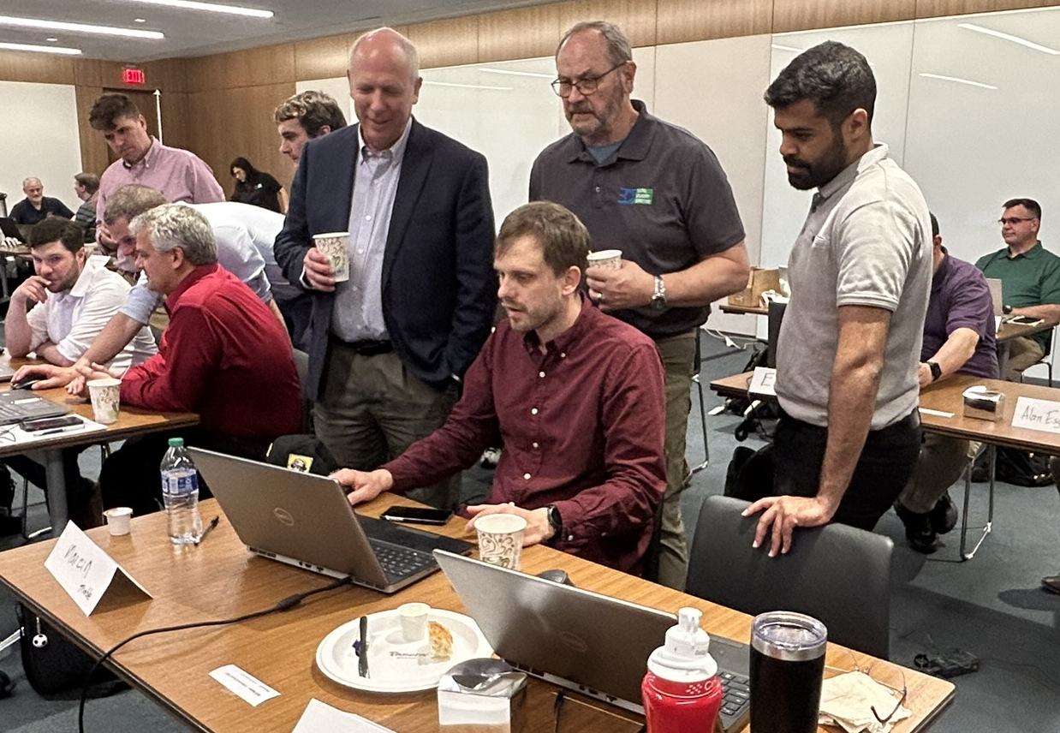
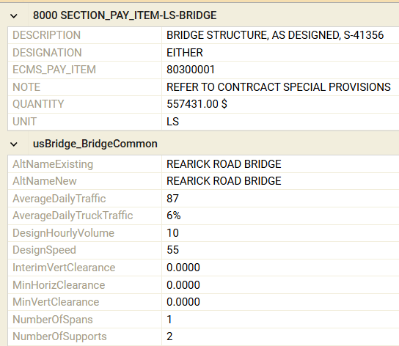
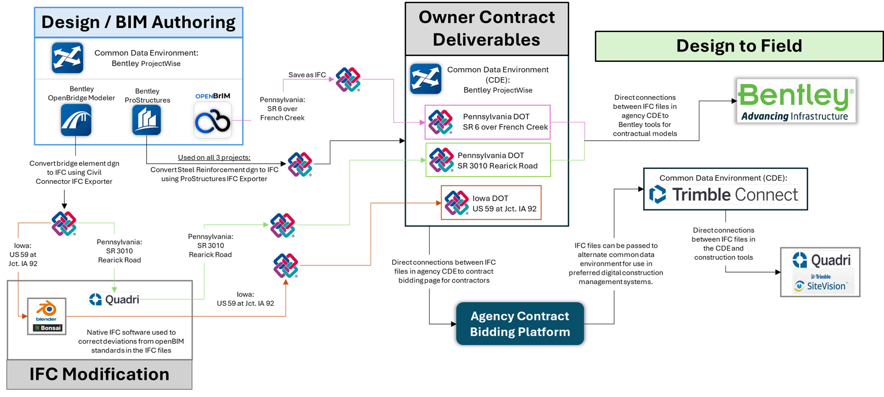
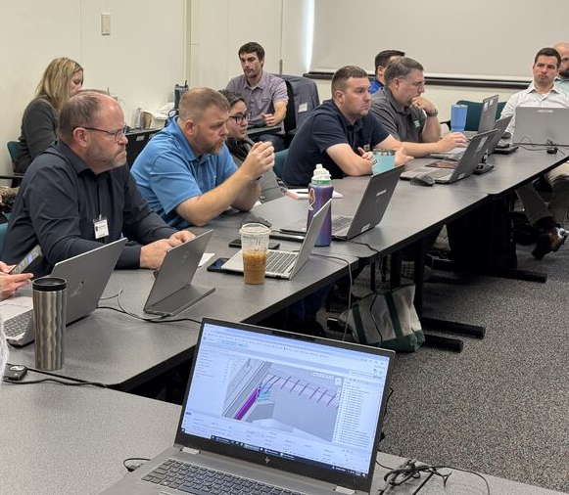
ADCMS Grant
The purpose of the project is to pilot the use of open BIM standards to produce model-based deliverables and collect digital as-built models for bridge projects.
Webinars and Workshops
Model Information Requirements
Open Data Workflows by Project Phase
Outreach Activities
Fundamentals of open data and standards, application of workflows
PennDOT specific project requirements and configuration of OBD to support IFC exports
Design, advertisement, construction, and digital as-builts
PennDOT project teams, consultants, contractors, and peer State DOTs
Notes:
As part of the grant, the team will complete task in four core areas
Webinars and workshops on open data standards, such as fundamental concepts, overview of the standards. We hosted three webinars in 2024 and one in-person workshop with the project teams.
Development of model information requirements specific to PennDOT, and necessary updates to the configuration of the OBD workspace to support the export of IFC files. This has been an on-going effort that you will hear more about from Marcia and Joe later in the presentation.
Application of open data workflows by project phase, starting in design, through advertisement and construction, and ending with the delivery of digital as-builts. Today, you will hear about the efforts to-date by the design team to enable the share of IFC files for advertisement in construction. Developing the requirements for digital as-builts will be tackled in 2026.
Outreach activities – with various stakeholders, including PennDOT staff and project design and construction teams, industry, and peer state DOTs.
PennDOT aims to raise existing processes and standards from the Digital Delivery Directive (3D2025) initiative to the next level.
This pilot project seeks to apply the use of an open data standard that will enable PennDOT and other State DOTs to free themselves from expensive proprietary technologies that make it difficult to exchange information between design and construction teams.
This project builds upon the efforts of the TPF-5(372) BIM for Bridges and Structures Transportation Pooled Fund, a multi-year collaborative effort to develop the first open data standards for the digital exchange of 3D models for conventional workhorse bridges in the U.S. using the Industry Foundation Classes (IFC) standard.
This standard has been adopted by AASHTO but has never been used on a U.S. highway construction project. PennDOT will use the products from this national effort to demonstrate the value of open data standards and its practical application to replace conventional bridge plans with advanced 3D models - a practice that improves design accuracy and visualization that also streamlines bidding processes, adopting transparency and competitiveness among contractors.
This shift not only enhances the sharing of information between stakeholders, but it provides the framework for small and disadvantaged businesses to access construction technology that until now has been out of reach due to the expensive nature of proprietary systems.
The key objectives of the project are to
Establish trust in 3D models with the construction industry
Develop structure models accurate enough to represent most of the information provided on traditional structural plan sets
Evaluate tools appropriate for construction inspection staff to view and access information from the digital design models (both in 2D and 3D).

Slide 4
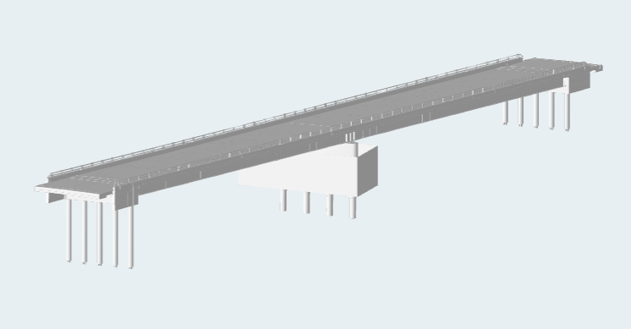
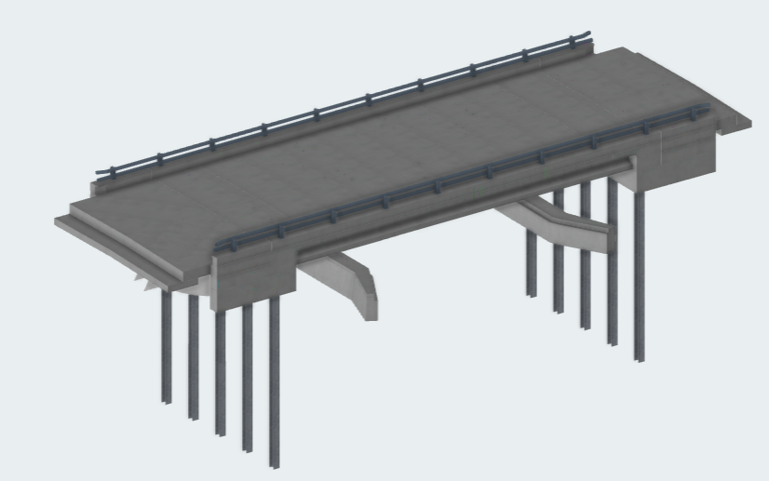
Current Tasks
Advertisement through Construction workflows that meet needs of bidders, fabricators, layout and location, interoperability with construction systems, inspection, and as-built documentation.
Summer 2025 Advertisement
  Separate PW Folder for IFCs
  Pre-Bid meetings to prepare Bidders
Partnering & Engagement with IFC
  Survey / Geolocation
  Fabrication
  Estimating
  Inspection
As-Built Workflows
  Trimble for packaging as-built
  Open source tool to revise OBM exports
SR 6 Over French Creek
2-Span Steel Plate Girders
Integral Abutments
Lead Designer: Michael Baker
Deliverable: Contractual
SR 3010 Rearick Road
1-Span PS Bulb Tee Beams
Integral Abutments
Lead Designer: JMT
Deliverable: For Information Only
Notes:
Engagements look at
Potential IFC Use Cases
Data Integrity Issues
Standards for calibration files
Improved workflows on future projects
Summer 2025 Advertisement
Separate PW Folder for IFCs
Pre-Bid meetings to prepare Bidders
Winter 2025 Partnering Begins
Engagement with IFC
Survey / Geolocation
Fabrication – Steel Girders
Fabrication – PC Beams
Reinforcement Information
Estimating
Inspection
As-Built Workflows
Tools for updating model information

Slide 5
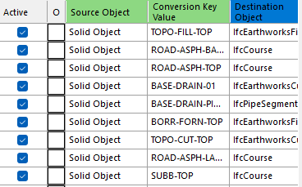
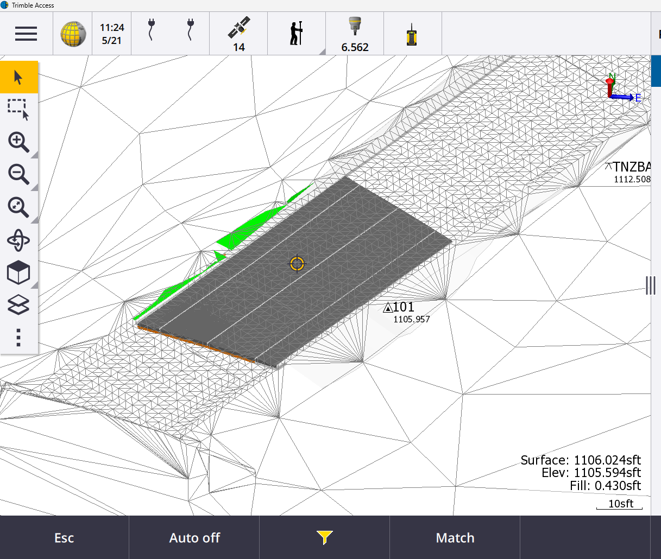
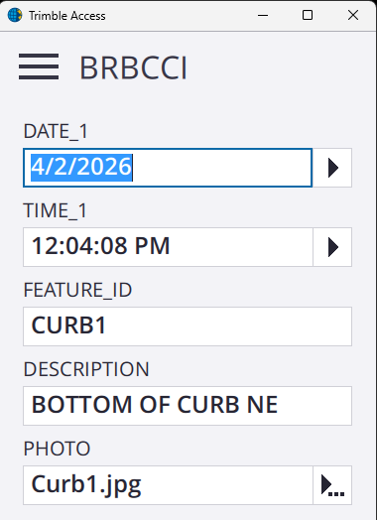
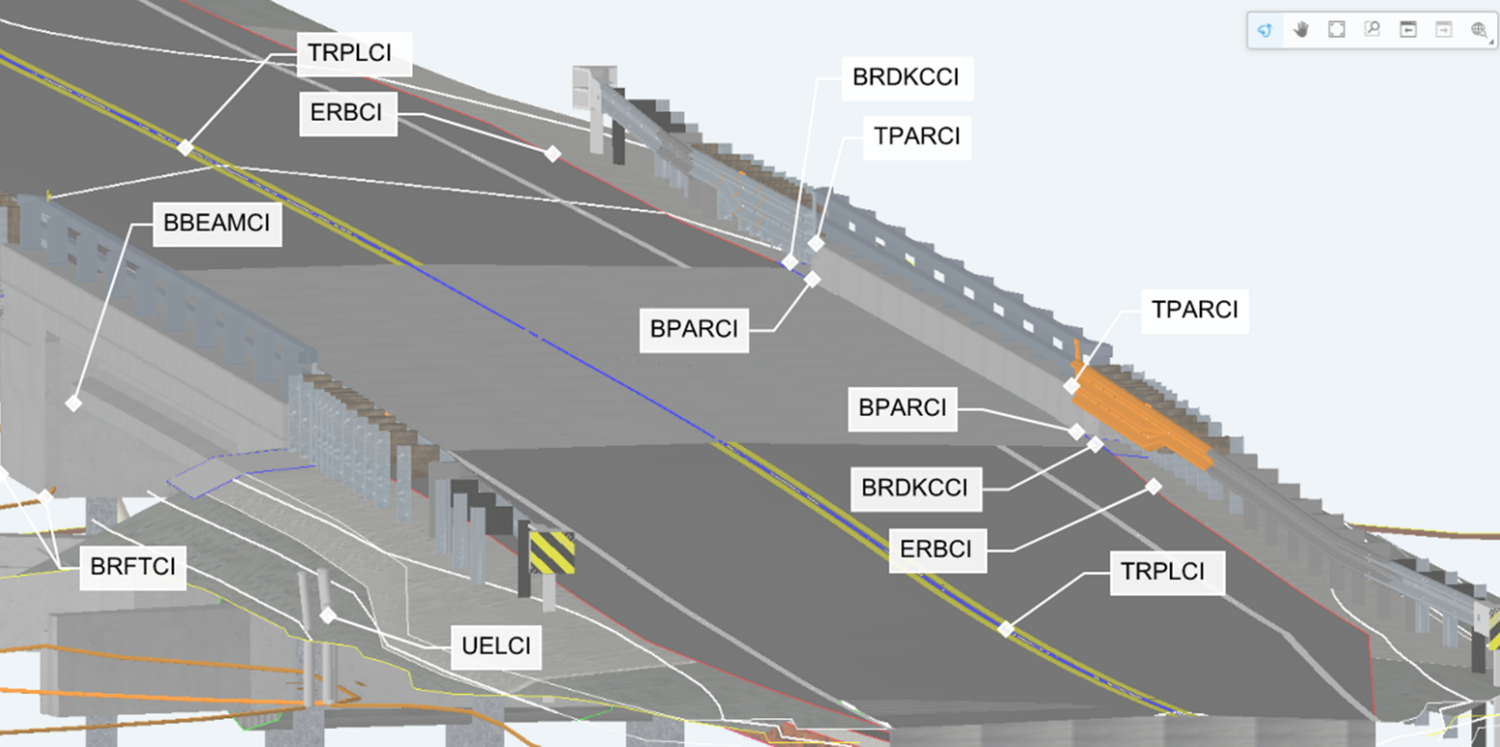
Design → Inspection → As-Built
Trimble Business Center and Quadri/Connect Processes Data
Conversion rules map CAD feature definitions to IFC objects
Converted contractual dgn data for road, drainage, utilities, and erosion control to IFC
Rules are available for PennDOT on future projects (set once and repeat)
Trimble Access for Field Activities
Contractual bridge IFC files and converted road/utility data loaded to SD card and into data collector
Inspectors use models to locate design elements and points
  View custom model attributes from contractual model
  Generate stake out points
  Take measurements for verification and quantities
  Use field codes to populate attributes and observations/photos
Trimble Business Center and Quadri/Connect for Packaging As-Builts
Combine field, survey, and design data to produce as-built IFC

Slide 6
Design
Advertisement - MALD
Construction
Contractor A
Designer A
Contractor B
Designer B
Contractor C
Designer C
Digital Workflows – Proprietary Formats
Notes:
One technology stack – design authoring technology specified, construction technology specified, (Autodesk, Bentley, …)

Slide 7


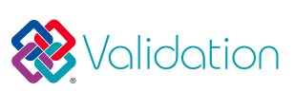
Design
Advertisement - MALD
Construction
Designer Selected Technology
National Standards
Construction Selected Technology
Digital Workflows – openBIM
Notes:
Flexible technology stacks – designer chooses best tool for project and owner needs, design deliverable is openBIM per national standard with focus on the data ((note the technology), construction technology is flexible based on contractor and inspector needs - openBIM deliverable for DAB
Approach is software agnostic and focused on seamless lifecycle data exchanges (not the technology)

Slide 8

Why Interoperability Matters:
Designers

Slide 9
WHY INTEROPERABILITY MATTERS
One project. Multiple participants. Different tools.
DESIGNERS
CONTRACTORS
INSPECTORS
OWNERS
• Use specialized authoring tools
• Combine discipline models through IFC
• Validate a coordinated deliverable
• Use estimating, layout, coordination, and fabrication tools
• Consume information without the design authoring software
• Access contractual information in field tools
• Capture measurements, observations, and photos
• Define consistent requirements
• Preserve usable information across the lifecycle
The goal is not one software platform. The goal is dependable information exchange.
Notes:
Open standards let each participant use the right tool for the job while preserving reliable information across exchanges.

Slide 10
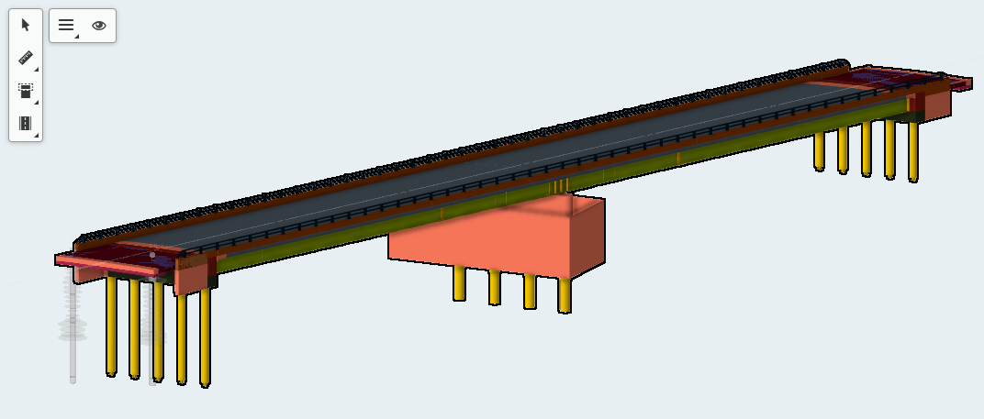
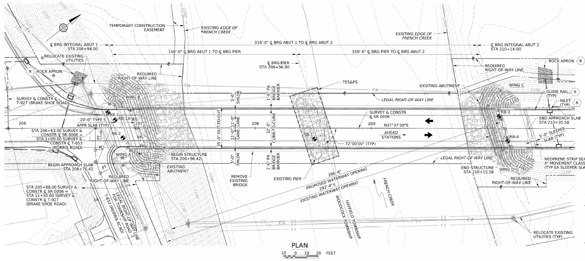
Designer Strategy: Deliverables and Tools
Our deliverables include a federated model and supporting 2D plans.
Deliverable | Tool | Components
Federated IFC Model | Bentley OBM / ProStructures | Reinforcement
 | OpenBrIM | Bridge geometry, materials, and detailed components
2D Plans | Bentley OpenBridge Modeler (OBM) | General notes, detail views, etc.
IFC Model
Supplemental 2D Plans
+

Slide 11
PennDOT ADCMS Bridge Pilot
Approach
TPF-5(372) IDS
TPF-5(372) IDM
OpenBrIM
(Soilds)
OpenBrIM Incorporating IDM
IFC 4x3 Deliverable
Third-Party Construction Software
OBM/ProStructures
(Rebar)
bSI Validation Service
Notes:
Targeting LOD400 for most elements

Slide 12
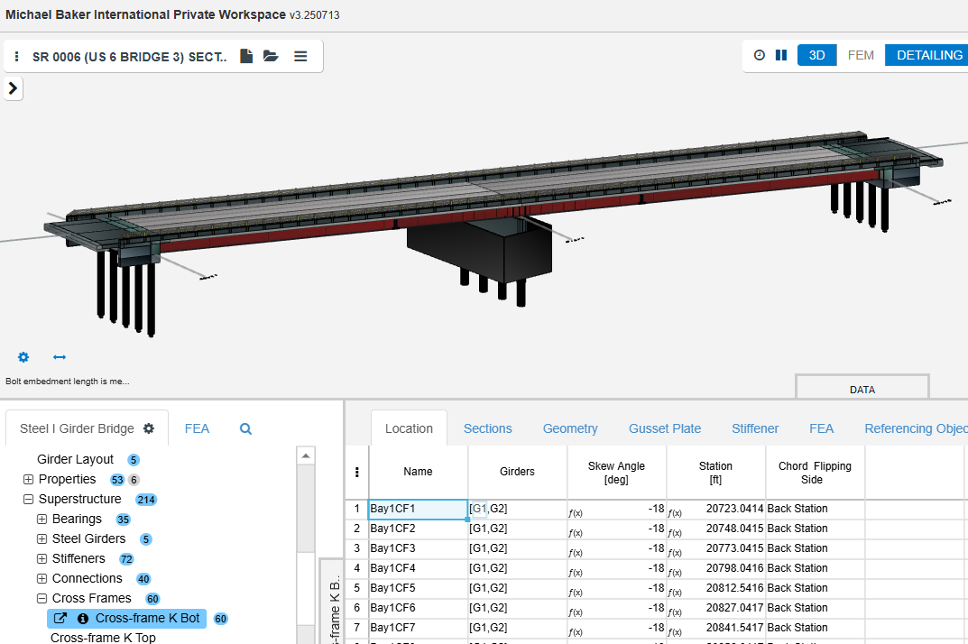
Bridge Modeling: Authoring Tools support Exchange
OpenBrIM used to model and export the bridge “solids” to IFC
Key Features
  Parametric modeling
  Built-in IFC export based on IDM and IDS
Collaboration with OpenBrIM developer:
  Feature enhancements
  Quick turnaround for IFC export improvements
Bridge Modeling with OpenBrIM
12
Notes:
Targeting LOD400 for most elements

Slide 13
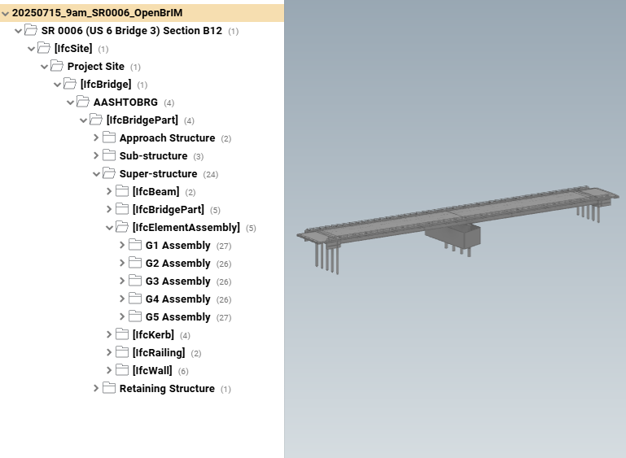
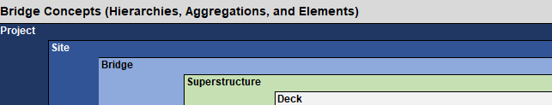
Bridge Modeling: Authoring Tools support Exchange
Observations – OpenBrIM
  IFC4x3 export capabilities
  Incorporated IDM elements and properties
  Incorporated spatial hierarchy from early engagements
  Minimal support for reinforcement modeling
  Flexible and nimble approach to updating cloud-based software
Spatial Heirarchy Implemented

Slide 14
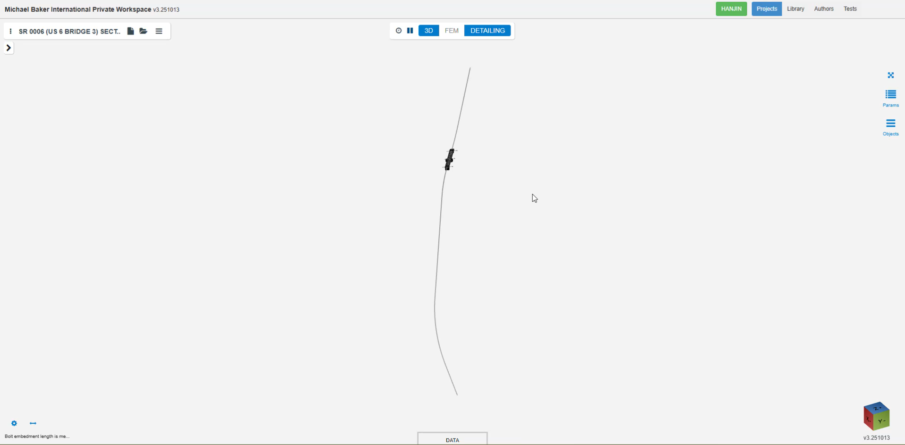
14
Notes:
Targeting LOD400 for most elements

Slide 15
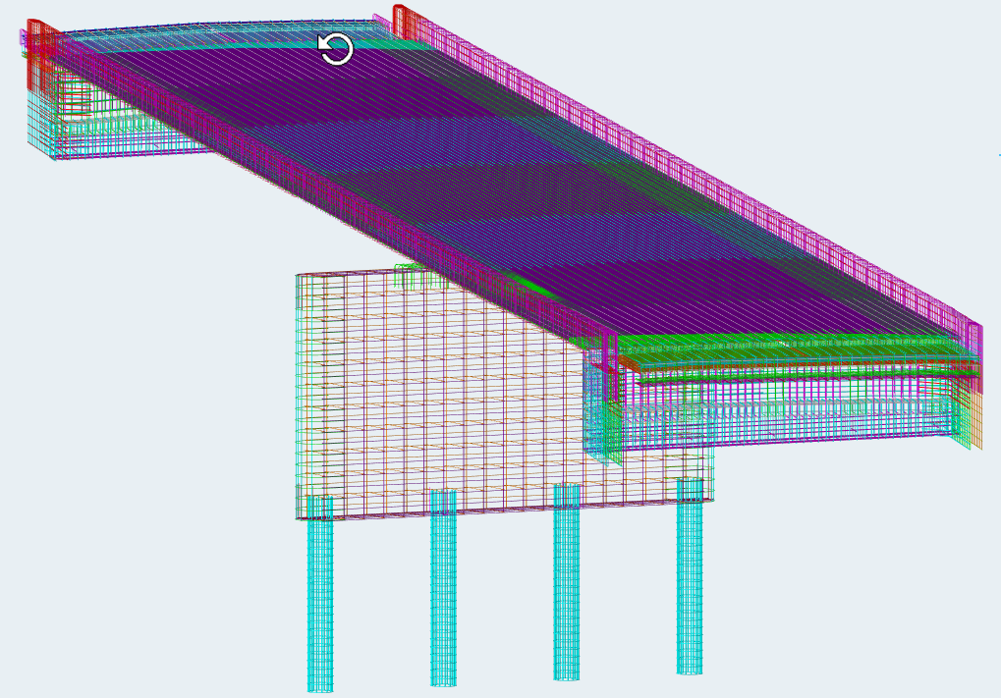
Bridge Modeling: Authoring Tools support Exchange
Bentley OpenBridge: used to model and export the reinforcement to IFC
Key Features
  Mature reinforcement modeling tools
  Built-in IFC export (2x3 & 4x3)
Collaboration with Bentley developers:
  Previously developed workflows with PennDOT
Rebar Modeling with OBM
15
Notes:
Targeting LOD400 for most elements

Slide 16
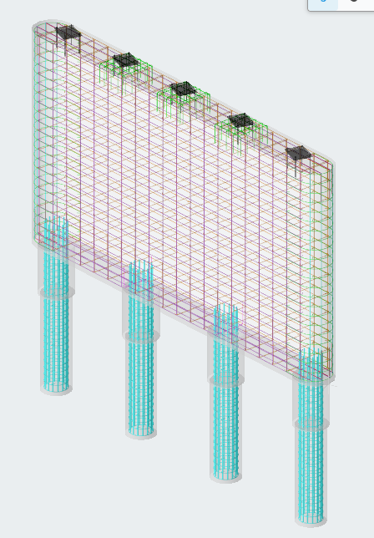
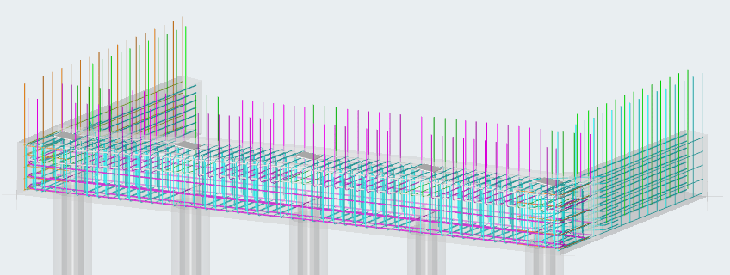
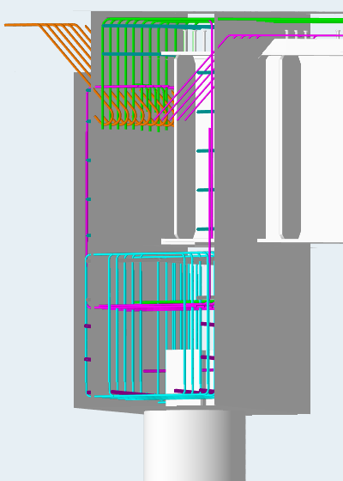
Bridge Modeling: Authoring Tools support Exchange
Observations – OBM
  IFC2x3 and 4x3 export capabilities
  Workflows developed for PennDOT
  Custom properties through Item Types
  ProStructures tools within OBM
Rebar Implemented

Slide 17
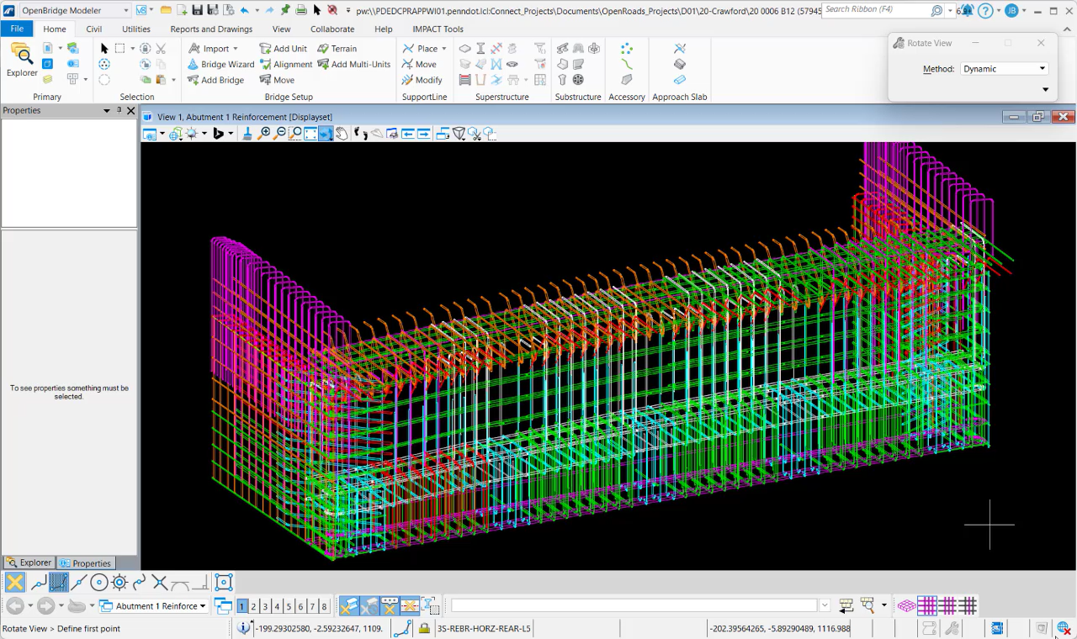
17
Notes:
Targeting LOD400 for most elements

Slide 18

Bridge Demo – open Standards

Slide 19
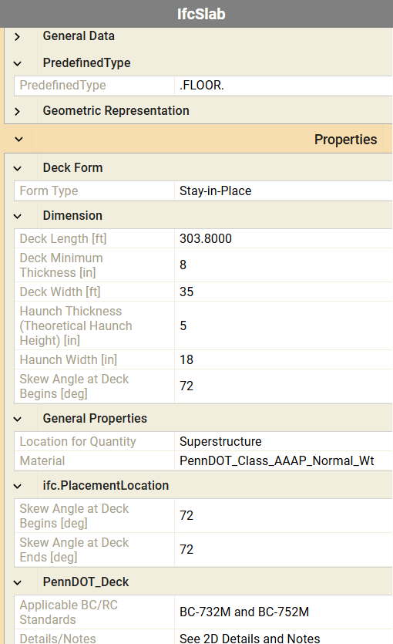
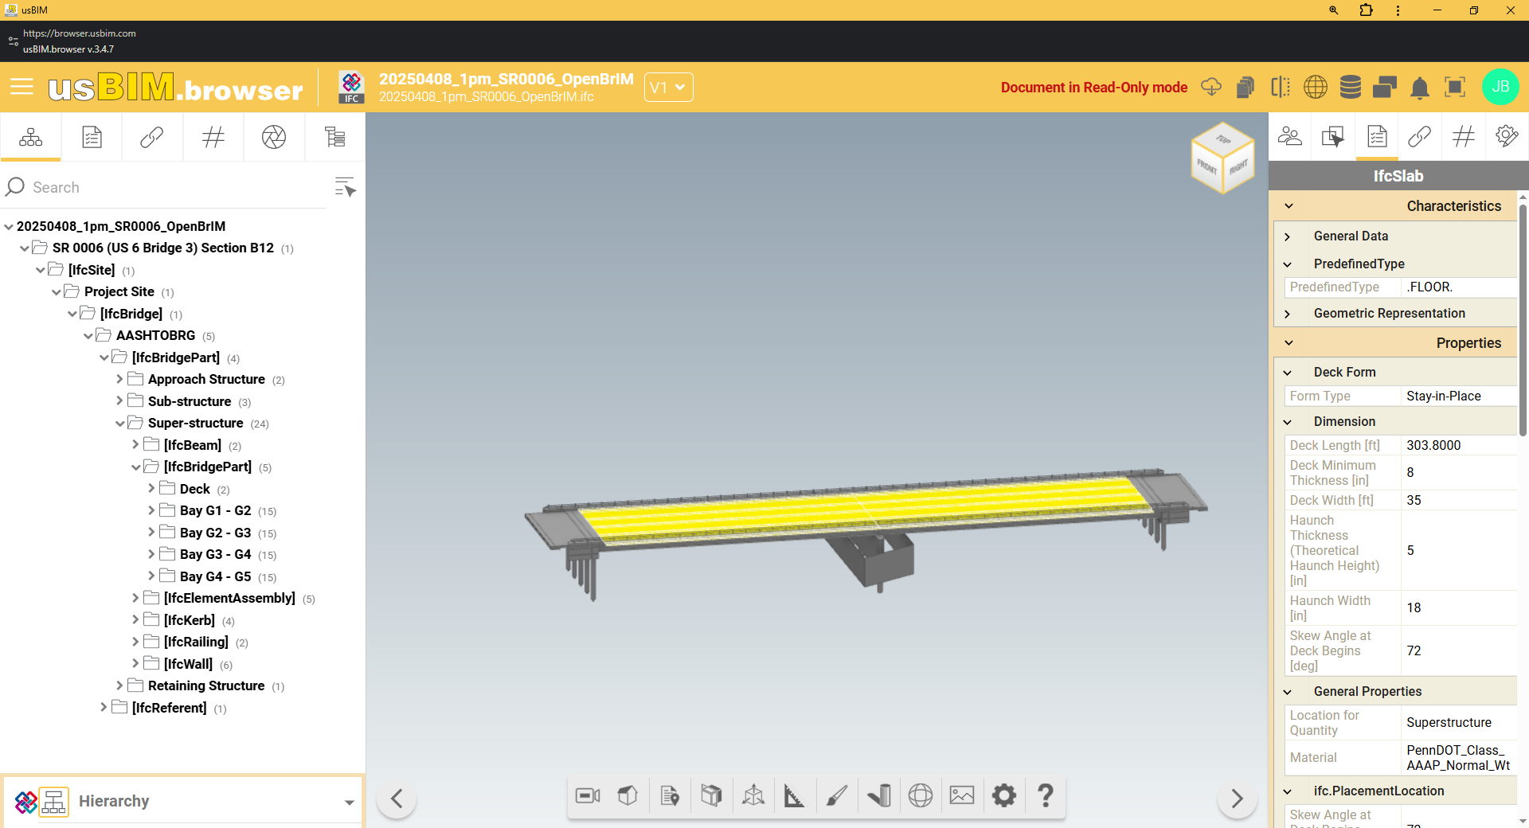
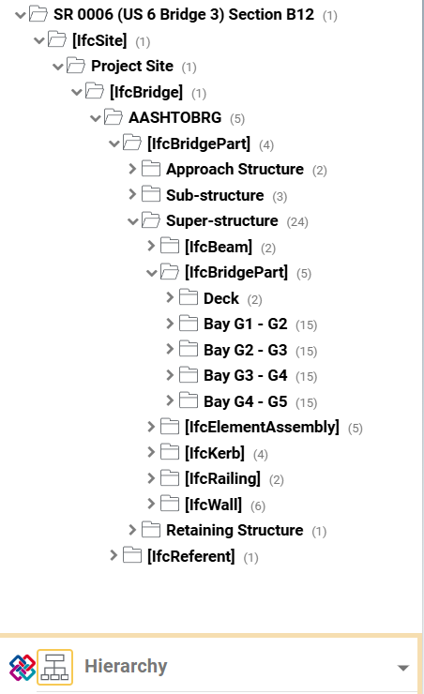
IFC Pilot Project Delivery

Slide 20
Why Interoperability Matters:
Contractors/Fabricators

Slide 21
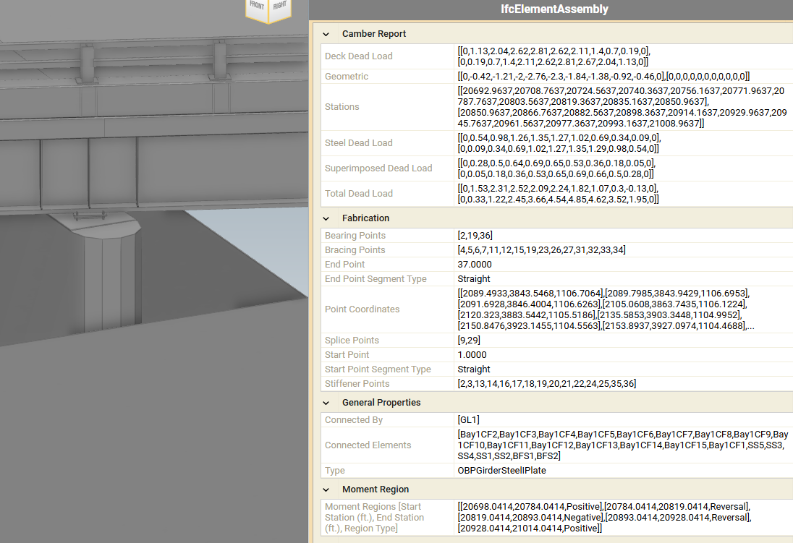
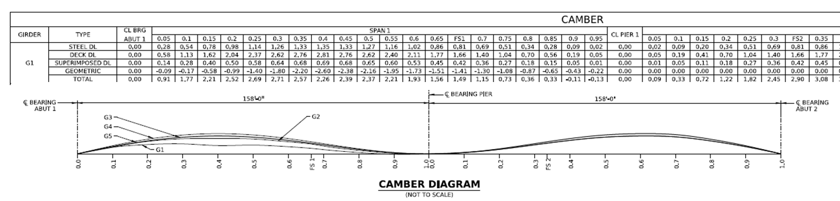
INTEROPERABILITY FOR Fabrication
To support fabrication, key data were embedded in the IFC model based on fabricator requirements.
  Data Provided
  Control point coordinates
  Camber values
  Girder transitions
  Additional fabrication details

Slide 22
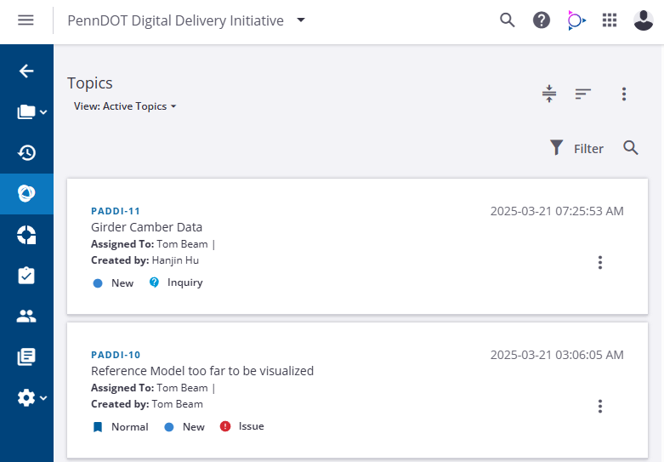
Coordinating with Fabricator
Coordination with fabricator was managed through Trimble Connect using BCF for issue tracking and resolution.
  Communication
  Trimble Connect platform
  BIM Collaboration Format (BCF) threads
  Issue lifecycle

Slide 23
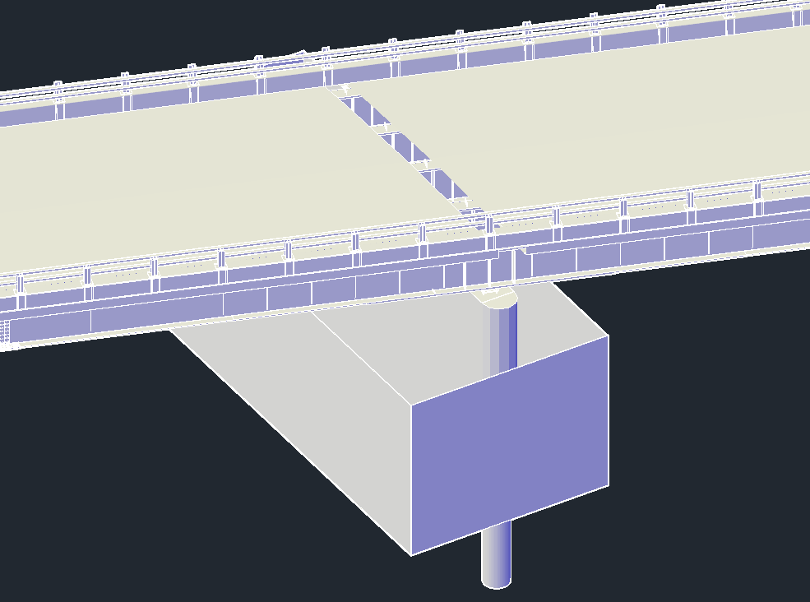
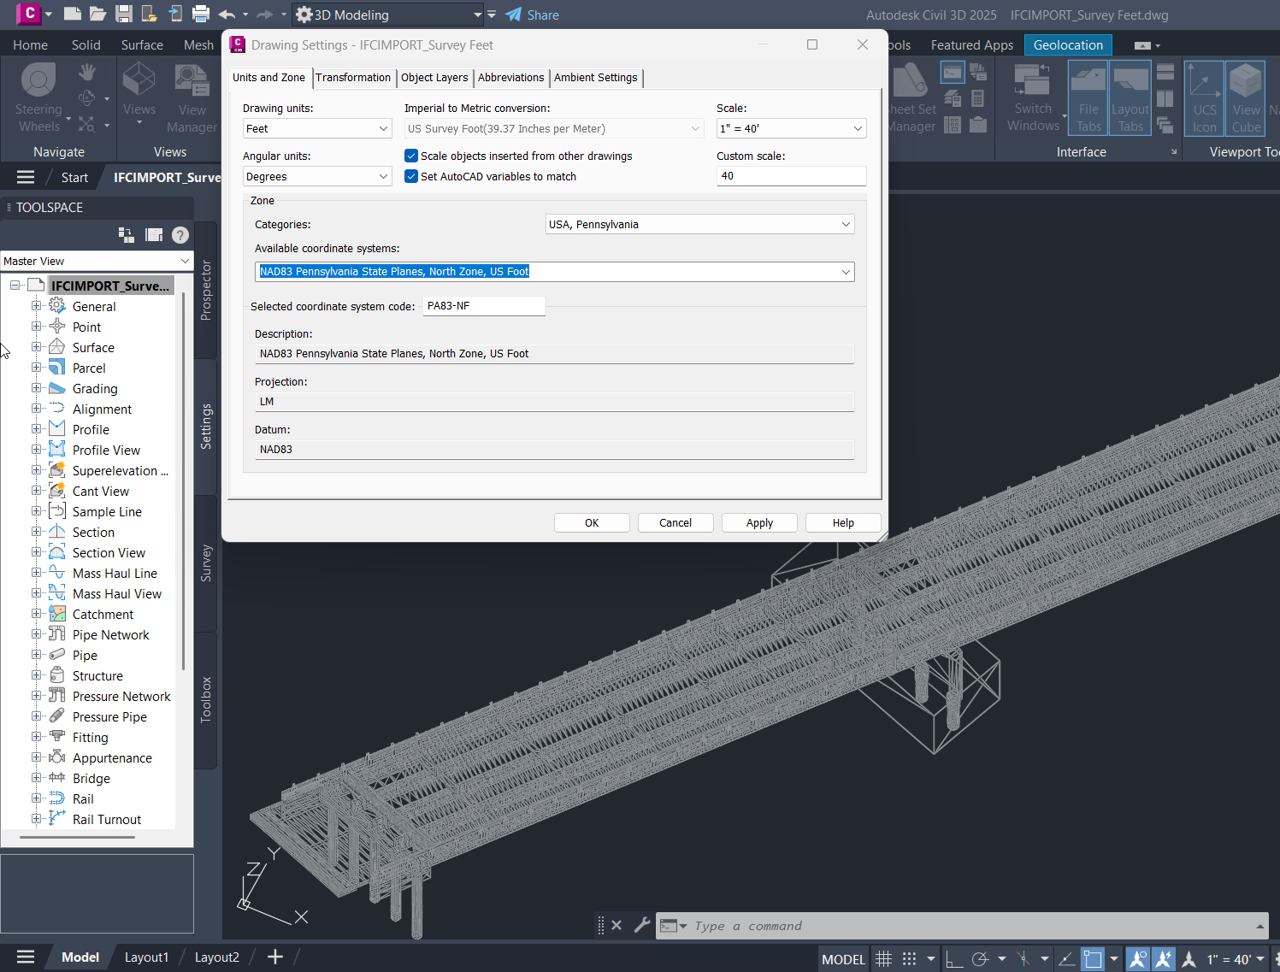
Interoperability
When the contractor consumed the IFC model in Autodesk Civil 3D, we identified two interoperability challenges that required resolution.
Vertex Limit Constraint in Civil 3D Resulting in Partial Deck Import
Unit Mismatch (US Survey Foot vs. International Foot) Caused Geolocation Shift

Slide 24
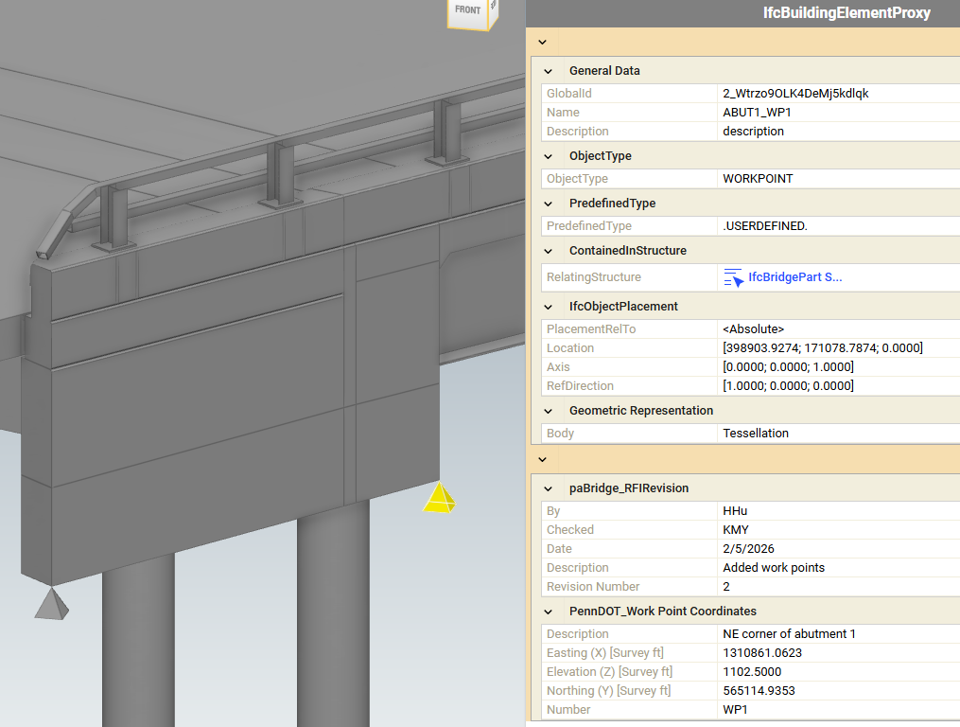
Locating Across Applications
Construction use of the IFC model led to a contractor request to explicitly model critical work points for layout and field verification.
  Work Points
Modeled explicit 3D work points
Embedded XYZ coordinates
Supported field layout and location verification
Work Point Object with Embedded Coordinate and Revision Tracking Properties

Slide 25
Why Interoperability Matters:
Construction Inspectors

Slide 26

Digital As-Builts

Slide 27
INSPECTION TO DIGITAL AS-BUILT
Use standardized design information in the field, then return verified construction information to the owner.
START WITH TRUSTED INFORMATION
VERIFY AND DOCUMENT IN THE FIELD
PACKAGE THE DIGITAL RECORD
• Contractual bridge IFC model
• Converted roadway, drainage, utility, and erosion-control information
• Defined objects, attributes, coordinates, and control points
• Locate design elements and points
• View contractual model attributes
• Capture measurements, quantities, observations, and photographs
• Associate field records with the applicable information
• Combine design, survey, and verified field information
• Preserve the constructed condition in an open deliverable
• Provide a reusable foundation for owner systems and future workflows
Interoperability closes the loop: information moves from design to inspection and returns as a usable digital as-built.

Slide 28
Why Interoperability Matters:
Owners

Slide 29
WHY INTEROPERABILITY MATTERS FOR OWNERS
Owners standardize the information they need while allowing project teams to select the right technology.
TECHNOLOGY FLEXIBILITY
DEPENDABLE EXCHANGE
Designers, contractors, fabricators, and inspectors can use fit-for-purpose applications.
Information remains understandable and usable when it moves between software environments.
OWNER-DEFINED
INFORMATION
REQUIREMENTS
CONSISTENT ACCEPTANCE
LIFECYCLE VALUE
Defined requirements and validation provide a repeatable basis for reviewing deliverables.
Design and verified field information can support digital as-builts and future owner workflows.
Own the requirements, not the software. Preserve information that remains valuable beyond the project.

Slide 30
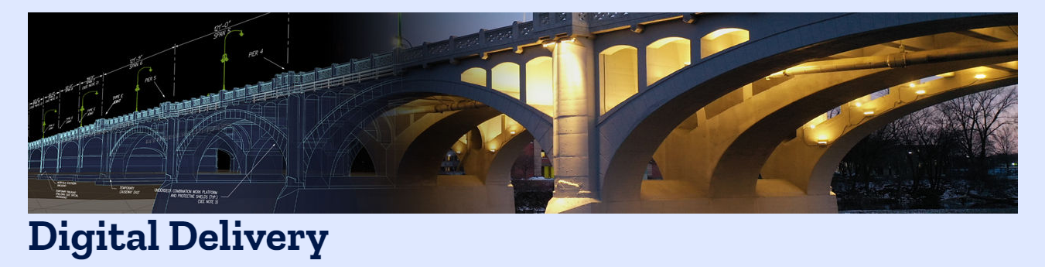

Learn More
Allen S. Melley, P.E.
Chief of Digital Delivery
amelley@pa.gov
Joe Brenner, P.E.
Director of Bridge Technology
joseph.brenner@mbakerintl.com
PennDOT Digital
Delivery Website
Digital Delivery Email:
RA-PDDigitalDelivery@pa.gov
Recordings of ADCMS Webinar Series: https://www.penndot.pa.gov/ProjectAndPrograms/3D2025/Pages/Digital-Delivery-Resources.aspx
Notes:
Allen to do this slide

Slide 31
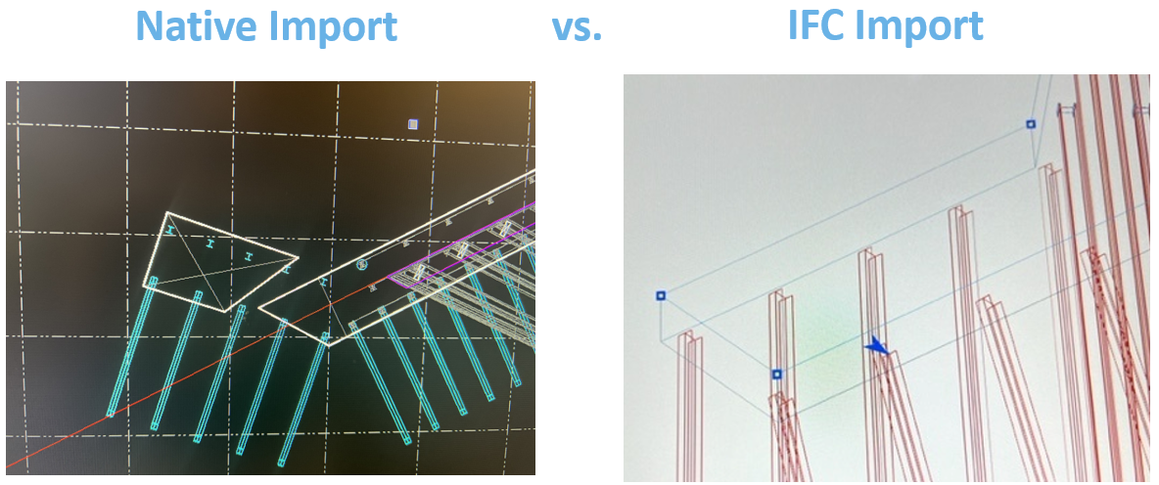
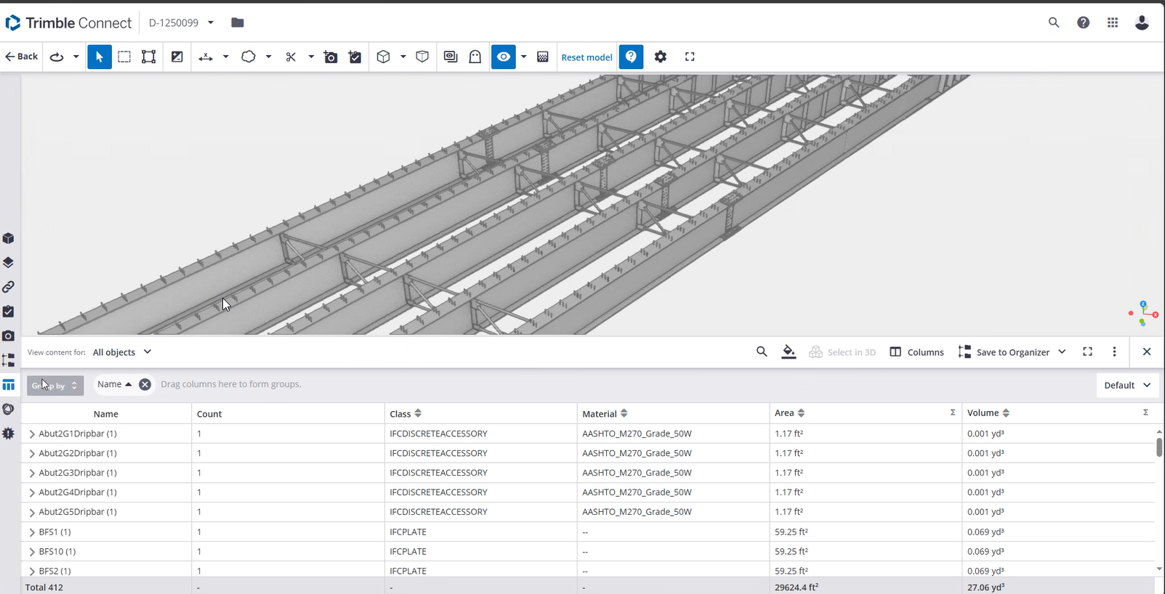
Why interoperability matters
  Ability to use multiple model authoring/viewing platforms
  Testing and expanding a national standard & validation tools
  Learning how to customize for state-specific needs
  Ability to work directly with software from contractors, fabricators, and surveyors

