Slide 1


FHWA Digital Delivery
Stakeholder Group (DDSG)
Fall In-Person and Virtual Meeting
FHWA National Highway Institute | Vienna, Virginia
Tuesday, September 29 | 8:00 a.m. – 4:00 p.m. ET
Wednesday, September 30 | 8:30 a.m. – 3:45 p.m. ET
A joint program of NIBS and the Federal Highway Administration

Slide 2

Disclaimer
This presentation was created and is being presented by a contractor. The views and opinions expressed in this presentation are the presenters’ and do not necessarily reflect those of FHWA or the U.S. Department of Transportation (USDOT). The contents do not necessarily reflect the official policy of the USDOT.
The U.S. Government does not endorse products or manufacturers. Trademarks or manufacturers’ names appear in this presentation only because they are considered essential to the objective of the presentation. They are included for informational purposes only and are not intended to reflect a preference, approval, or endorsement of any one product or entity.
FHWA DDSG FALL MEETING | SEPTEMBER 29, 2026

Slide 3
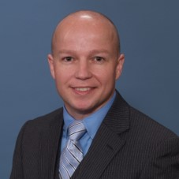
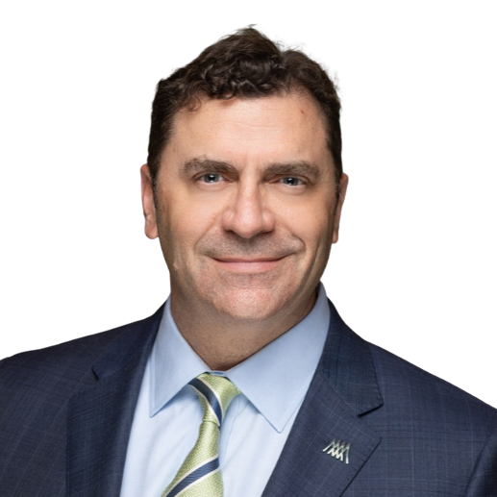
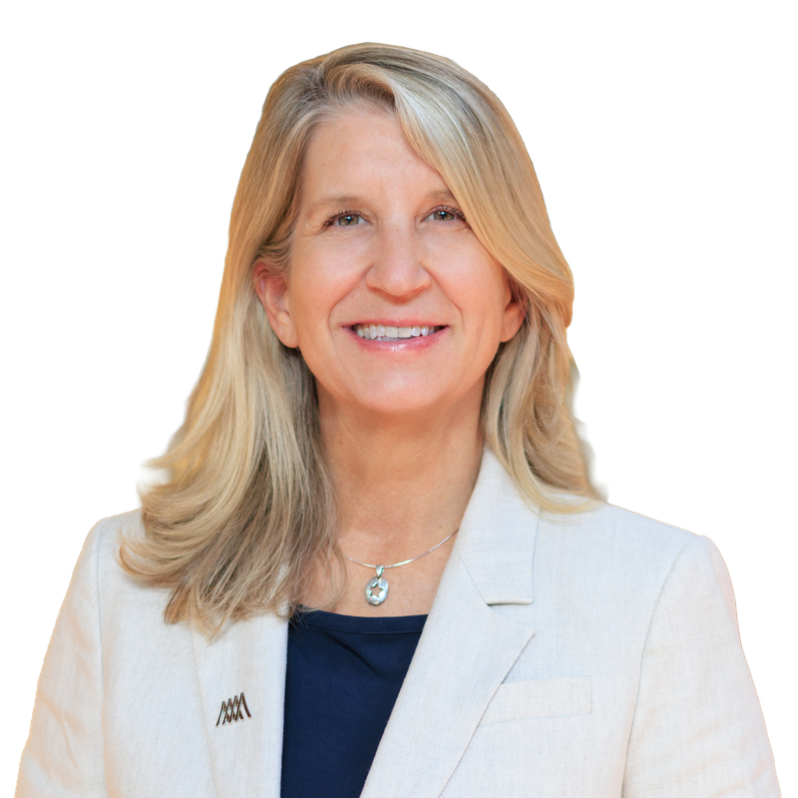
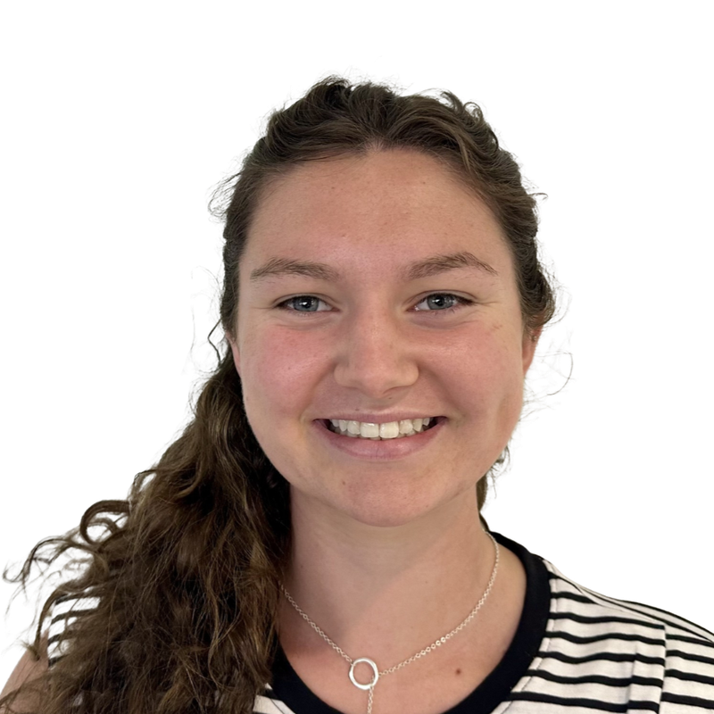
Welcome, Introductions, and Logistics
Tuesday, September 29 | DDSG program leadership and meeting team
Matthew Corrigan
Co-Chair, DDSG
FHWA | Construction Research Engineer
Jade Rung, PE
Project Lead, DDSG
NIBS | Chief Growth Officer
Cheryl Foley
Project Manager, DDSG
NIBS | Director of Marketing and Communications
Isabel Butler
Marketing Manager, DDSG
NIBS | Marketing Coordinator
FHWA DDSG FALL MEETING | SEPTEMBER 29, 2026

Slide 4
DDSG Members
Member | Organization
Cassidy Blowers | DelDOT
Rick Brice | WSDOT
Katie Brown | Oklahoma DOT
Bryan Cawley | FHWA
Matthew Corrigan | FHWA
James Gray | FHWA
Cyndee Hoagland | Trimble
Will Holmes | Kentucky Transportation Cabinet
Carrie Lavallee | MassDOT
Jennifer Lloyd | Tennessee DOT
Kevin Marshia | AASHTO
Member | Organization
Allen Melley | PennDOT
Katherine Petros | FHWA
Devin Porr | Caltrans
Jonathan Porter | AGC
Charlie Purcell | Iowa DOT
Dan Reinke | GFT Inc.
Will Sharp | HDR
Trisha Stefanski | MnDOT
Jacob Tambunga | Texas DOT
Brad Wieferich | Michigan DOT
FHWA DDSG FALL MEETING | SEPTEMBER 29, 2026

Slide 5
Meeting Purpose and Focus
Purpose
Participation
The Digital Delivery Stakeholder Group (DDSG) is a collaborative initiative led by FHWA to coordinate and integrate various digital delivery efforts across the transportation sector.
The DDSG is an open group that brings together representatives from State Agencies, AASHTO Technical Committees, and Industry.
FHWA DDSG FALL MEETING | SEPTEMBER 29, 2026

Slide 6
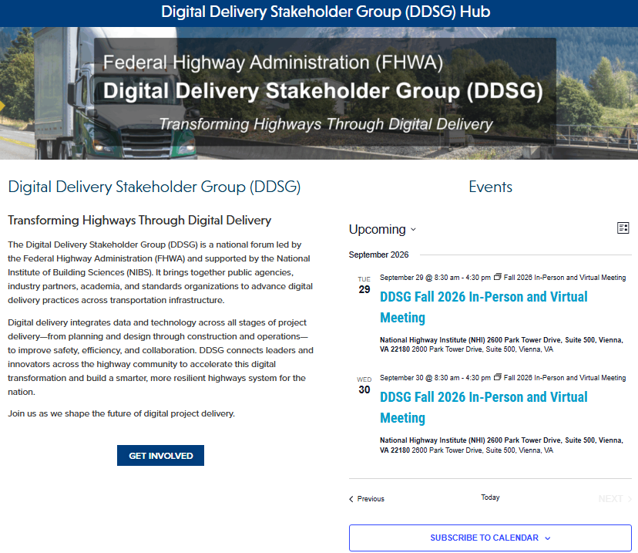
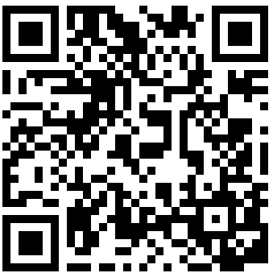
FHWA DDSG Hub
Meeting materials, agendas, and updates in one place
VISIT THE HUB
nibs.org/solutions/fhwa-digital-delivery
Agendas, presentations, and meeting summaries are posted after each meeting.
QR CODE
Insert Hub QR code here
FHWA DDSG FALL MEETING | SEPTEMBER 29, 2026

Slide 7
Agenda – Day 1
Tuesday, September 29, 2026 | 8:00 a.m. – 4:00 p.m. ET | Alignment, updates, and Information Management Process
Time | Agenda Item | Presenter(s) / Facilitator(s)
8:00–8:30 a.m. | Welcome, introductions, workshop objectives, logistics, and opening poll | Matthew Corrigan (FHWA); Jade Rung (NIBS)
8:30–9:00 a.m. | DDSG Status and Priority Updates | Matthew Corrigan (FHWA); NIBS
9:00–10:15 a.m. | Member, Partner, Pooled-Fund, and Research Updates | Jonathon Porter (AGC); Thomas Hamski (Iowa DOT); Cyndee Hoagland (ARTBA / Trimble)
10:15–10:45 a.m. | Open discussion and break
10:45–11:15 a.m. | Workshop Block 1A: Digital Delivery Technology Spotlight | Wally Ballou (Bentley Systems); Andrew Poszich (RS&H)
11:15 a.m.–12:00 p.m. | Mentimeter poll and discussion | Matthew Corrigan (FHWA); Jade Rung (NIBS)
12:00–1:00 p.m. | Lunch | On your own
1:00–2:00 p.m. | Workshop Block 1B: State Implementation Experience | Allen Melley (PennDOT); Joe Brenner (MB, Bridge Technology)
2:00–2:15 p.m. | Break
2:15–3:45 p.m. | Closing Poll and Facilitated Working Discussion | Facilitator; all participants
3:45–4:00 p.m. | Day 1 recap and Day 2 preview | FHWA / NIBS
FHWA DDSG FALL MEETING | SEPTEMBER 29, 2026

Slide 8




Mentimeter​
DDSG Logo Options
Please vote and give feedback on these logo options
Option 1
Option 2
Option 3
FHWA DDSG FALL MEETING | SEPTEMBER 29, 2026

Slide 9
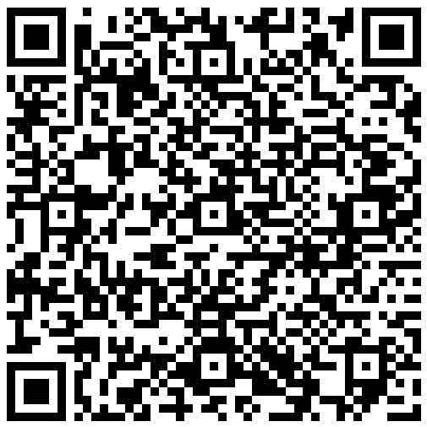

OPENING POLL
Mural Overview and Mentimeter Opening Poll
Scan a QR code or use the link below to join
Mural
Mentimeter
QR CODE
Insert Mural QR code here
QR CODE
Insert Mentimeter QR code here
https://app.mural.co/t/nibs5298/m/nibs5298/1790086130374/c63e1329476cabf050d0831b01989903c1522eed?sender=u333df7e6d5f6b2c25cc40441%E2%80%8B
https://www.menti.com/alvee3shyrqv%20%E2%80%8B
FHWA DDSG FALL MEETING | SEPTEMBER 29, 2026
9

Slide 10
DDSG Status and Priority Updates
Matthew Corrigan (FHWA) and NIBS
FHWA DDSG FALL MEETING | SEPTEMBER 29, 2026
10

Slide 11
Annual Planning: 2026–2027 Calendar
Proposed future schedule
Dec 2026
Mar 2027
Ongoing
Virtual Meeting
In-Person and Virtual Meeting
Industry Events
Week of December 14
Washington, D.C. | Date suggestions welcome
Add upcoming industry events to the Mural board
FHWA DDSG FALL MEETING | SEPTEMBER 29, 2026

Slide 12

SPEAKER INTEREST
Speak at Future DDSG Meetings
Have a project, pilot, or lesson learned to share? Scan the QR code to submit a topic you would like to present.
Google Form
Interest in Speaking at a Future DDSG Meeting – Fill out form​​
FHWA DDSG FALL MEETING | SEPTEMBER 29, 2026
12

Slide 13
Questions and Discussion
Open floor for all participants
FHWA DDSG FALL MEETING | SEPTEMBER 29, 2026
13

Slide 14
Member, Partner, Pooled-Fund, and Research Updates
Jonathon Porter (AGC)
Update from AGC
Thomas Hamski (Iowa DOT)
Update and ADCMS pilot updates
Cyndee Hoagland (ARTBA / Trimble)
Update regarding ADCMS and Federal Funding activities
FHWA DDSG FALL MEETING | SEPTEMBER 29, 2026
14

Slide 15

Open Discussion and Break
10:15–10:45 a.m.
FHWA DDSG FALL MEETING | SEPTEMBER 29, 2026
15

Slide 16
WORKSHOP BLOCK 1A
Digital Delivery Technology Spotlight
Wally Ballou (Bentley Systems) and Andrew Poszich (RS&H)
Bridge Project, I-4 Moving Florida Forward, Cloud Collaboration, and NCDOT DD
FHWA DDSG FALL MEETING | SEPTEMBER 29, 2026
16

Slide 17

MENTIMETER POLL
Mentimeter Poll and Discussion
11:15 a.m.–12:00 p.m. | Scan the QR code or use the link below to join
Mentimeter
QR CODE
Insert Mentimeter QR code here
https://www.menti.com/alr7fh3yos31%E2%80%8B
FHWA DDSG FALL MEETING | SEPTEMBER 29, 2026
17

Slide 18
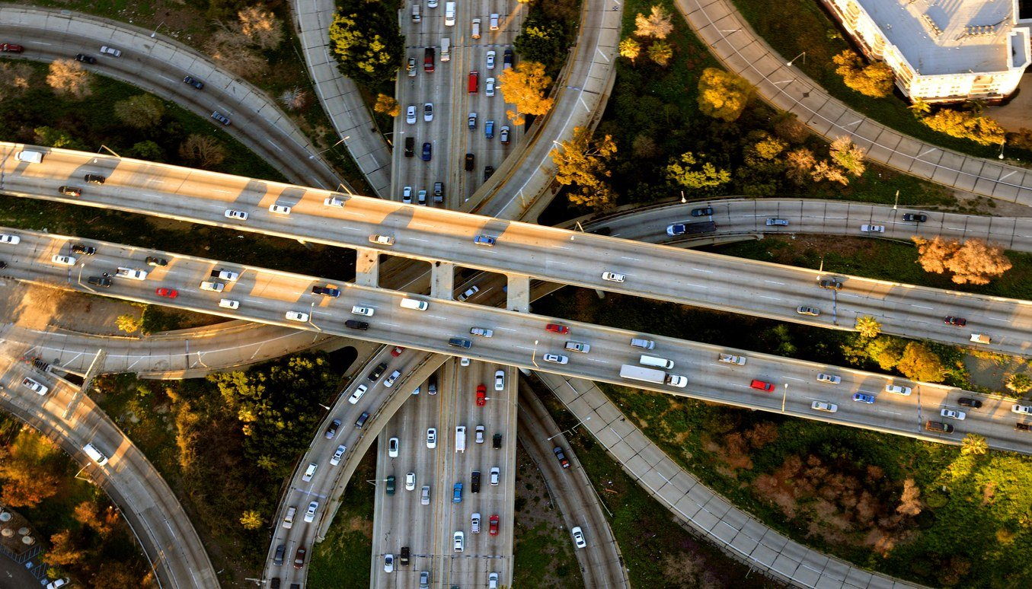
Lunch
12:00–1:00 p.m. | On your own
FHWA DDSG FALL MEETING | SEPTEMBER 29, 2026
18

Slide 19
WORKSHOP BLOCK 1B
State Implementation Experience
Allen Melley (PennDOT) and Joe Brenner (MB, Bridge Technology)
Data interoperability
FHWA DDSG FALL MEETING | SEPTEMBER 29, 2026
19

Slide 20

Break
2:00–2:15 p.m.
FHWA DDSG FALL MEETING | SEPTEMBER 29, 2026
20

Slide 21

CLOSING POLL
Mural Link and Mentimeter Closing Poll
Closing poll and facilitated working discussion
Mural
Mentimeter
QR CODE
Insert Mural QR code here
QR CODE
Insert Mentimeter QR code here
https://app.mural.co/t/nibs5298/m/nibs5298/1790086130374/c63e1329476cabf050d0831b01989903c1522eed?sender=u333df7e6d5f6b2c25cc40441%E2%80%8B
https://www.menti.com/al6zdoq12wdn%20%E2%80%8B
FHWA DDSG FALL MEETING | SEPTEMBER 29, 2026
21

Slide 22
SPEAKER INTEREST
Speak at Future DDSG Meetings
Have a project, pilot, or lesson learned to share? Scan the QR code to submit a topic you would like to present.
Google Form
Interest in Speaking at a Future DDSG Meeting – Fill out form​
FHWA DDSG FALL MEETING | SEPTEMBER 29, 2026
22

Slide 23
Day 2 Preview
Wednesday, September 30, 2026 | 8:30 a.m. – 3:45 p.m. ET | Applications, shared information resources, and next steps
Time | Agenda Item | Presenter(s) / Facilitator(s)
8:30–9:15 a.m. | Welcome, Day 1 recap, Day 2 objectives, and opening poll | FHWA / NIBS
9:15–9:45 a.m. | Workshop Block 2A: Digital Delivery Applications | Richard Brice (WSDOT)
9:45–10:00 a.m. | Break
10:00–11:30 a.m. | Workshop Block 2B: Applications Panel and Facilitated Discussion | Thomas Hamski (Iowa DOT); Cyndee Hoagland (Trimble); Jim Mahugh (WSDOT)
11:30–11:45 a.m. | Education Session | Aaron Costin (NIBS / S3 BIM)
11:45 a.m.–1:00 p.m. | Lunch | On your own
1:00–2:00 p.m. | Workshop Block 3A: Libraries and Data Dictionaries | Abhishek Bhargava (WSP); John Wilkerson (MBI)
2:00–2:30 p.m. | Open discussion, break, and closing poll
2:30–3:15 p.m. | Workshop Block 3B: Collective Priorities and Proposed Work | Facilitator; all participants
3:15–3:45 p.m. | Decisions, Action Items, Next Meeting, and Adjournment | Matthew Corrigan (FHWA); NIBS
FHWA DDSG FALL MEETING | SEPTEMBER 29, 2026

Slide 24
Wrap Up Day 1
Adjourn | See you tomorrow at 8:30 a.m. ET
FHWA DDSG FALL MEETING | SEPTEMBER 29, 2026
24

Slide 25
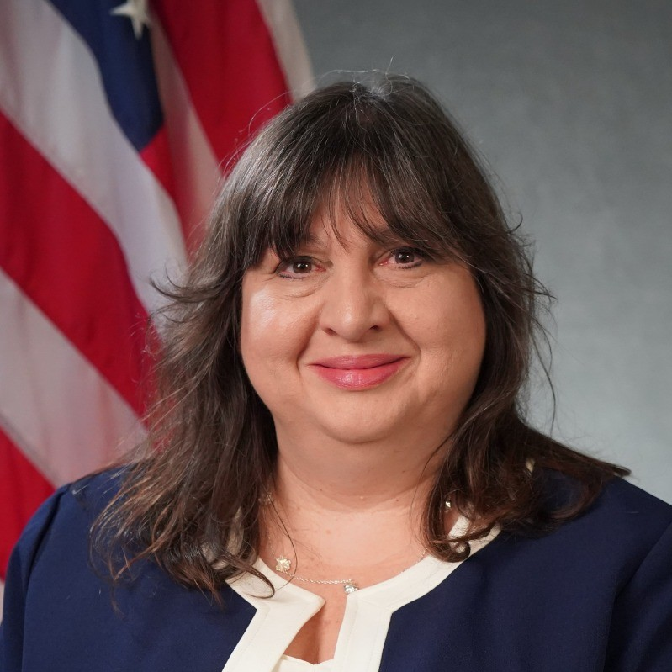
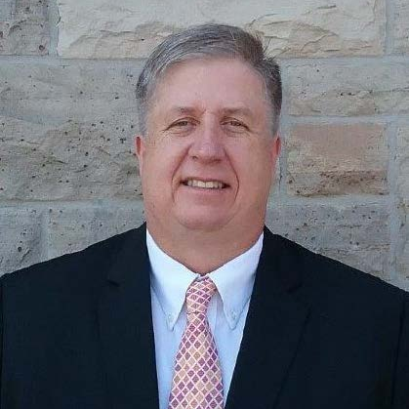
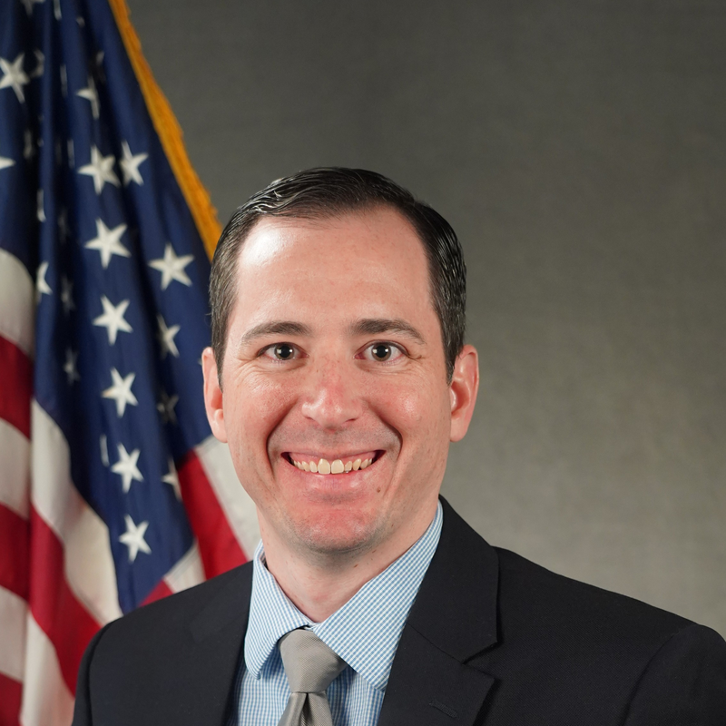
FHWA Team
Federal Highway Administration program staff supporting the DDSG
Matthew Corrigan
Co-Chair, DDSG
Construction Research Engineer
Katherine Petros
Team Leader
Infrastructure Analysis and Construction Team
Bryan Cawley, PE
Construction & Maintenance Engineer
James Gray
Construction Technology Program Manager
FHWA DDSG FALL MEETING | SEPTEMBER 29, 2026

