Slide 1


FHWA Digital Delivery
Stakeholder Group (DDSG)
Fall In-Person and Virtual Meeting
FHWA National Highway Institute | Vienna, Virginia
Tuesday, September 29 | 8:00 a.m. – 4:00 p.m. ET
Wednesday, September 30 | 8:30 a.m. – 3:45 p.m. ET
A joint program of NIBS and the Federal Highway Administration

Slide 2

Disclaimer
Required notice for contractor-presented material
This presentation was created and is being presented by a contractor. The views and opinions expressed in this presentation are the presenters’ and do not necessarily reflect those of FHWA or the U.S. Department of Transportation (USDOT). The contents do not necessarily reflect the official policy of the USDOT.
The U.S. Government does not endorse products or manufacturers. Trademarks or manufacturers’ names appear in this presentation only because they are considered essential to the objective of the presentation. They are included for informational purposes only and are not intended to reflect a preference, approval, or endorsement of any one product or entity.
FHWA DDSG FALL MEETING | SEPTEMBER 30, 2026

Slide 3
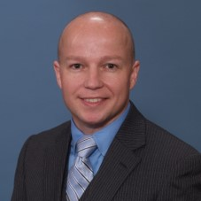
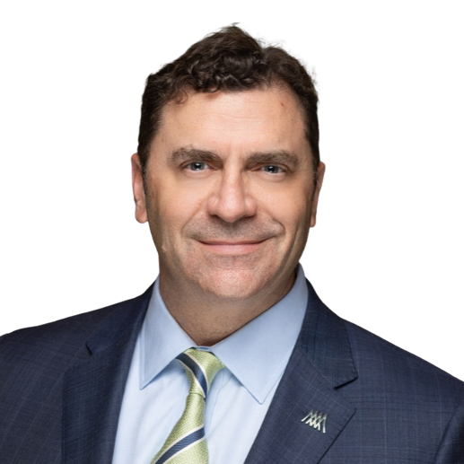
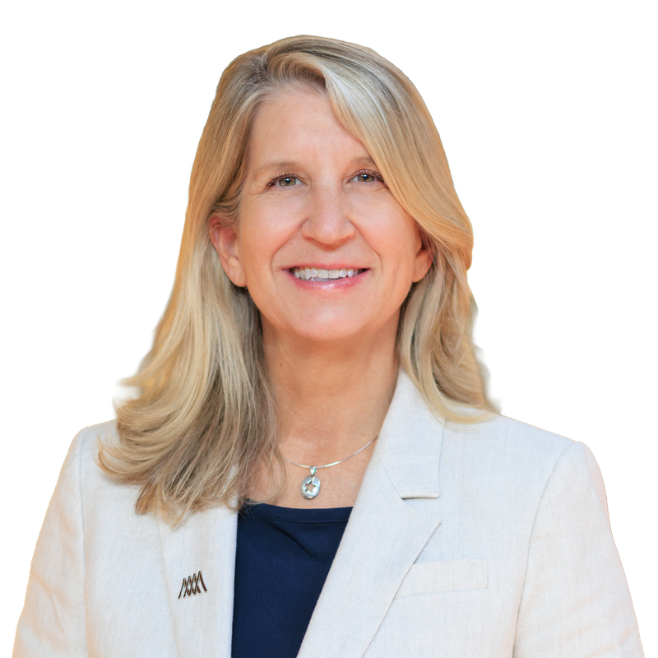
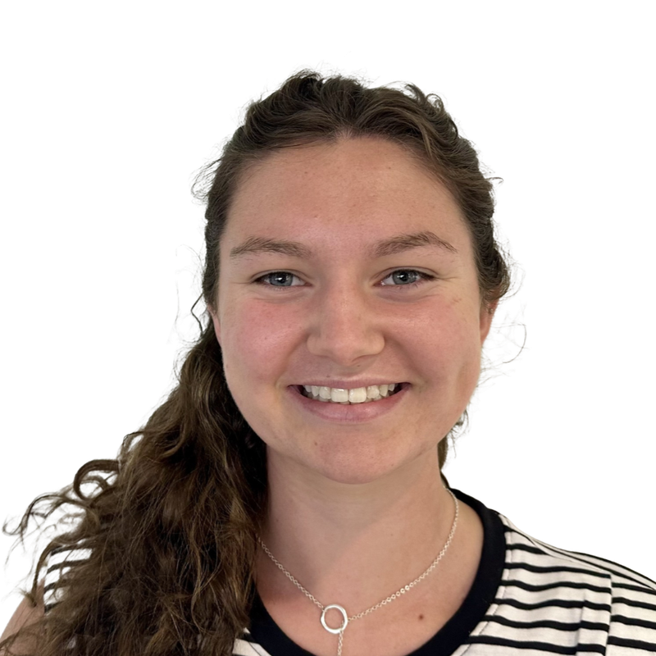
Welcome, Introductions, and Logistics
Wednesday, September 30 | DDSG program leadership and meeting team
Matthew Corrigan
Co-Chair, DDSG
FHWA | Construction Research Engineer
Jade Rung, PE
Project Lead, DDSG
NIBS | Chief Growth Officer
Cheryl Foley
Project Manager, DDSG
NIBS | Director of Marketing and Communications
Isabel Butler
Marketing Manager, DDSG
NIBS | Marketing Coordinator
FHWA DDSG FALL MEETING | SEPTEMBER 30, 2026

Slide 4
Day 1 Recap
FHWA / NIBS
FHWA DDSG FALL MEETING | SEPTEMBER 30, 2026
4
Notes:
Add Day 1 recap points (key takeaways, poll results, open items) after Day 1 closes.

Slide 5
DDSG Members
Current membership, alphabetical by last name
Member | Organization
Cassidy Blowers | DelDOT
Rick Brice | WSDOT
Katie Brown | Oklahoma DOT
Bryan Cawley | FHWA
Matthew Corrigan | FHWA
James Gray | FHWA
Cyndee Hoagland | Trimble
Will Holmes | Kentucky Transportation Cabinet
Carrie Lavallee | MassDOT
Jennifer Lloyd | Tennessee DOT
Kevin Marshia | AASHTO
Member | Organization
Allen Melley | PennDOT
Katherine Petros | FHWA
Devin Porr | Caltrans
Jonathan Porter | AGC
Charlie Purcell | Iowa DOT
Dan Reinke | GFT Inc.
Will Sharp | HDR
Trisha Stefanski | MnDOT
Jacob Tambunga | Texas DOT
Brad Wieferich | Michigan DOT
FHWA DDSG FALL MEETING | SEPTEMBER 30, 2026

Slide 6
Meeting Purpose and Focus
Why the DDSG convenes
Purpose
Participation
The Digital Delivery Stakeholder Group (DDSG) is a collaborative initiative led by FHWA to coordinate and integrate various digital delivery efforts across the transportation sector.
The DDSG is an open group that brings together representatives from State Agencies, AASHTO Technical Committees, and Industry.
FHWA DDSG FALL MEETING | SEPTEMBER 30, 2026

Slide 7
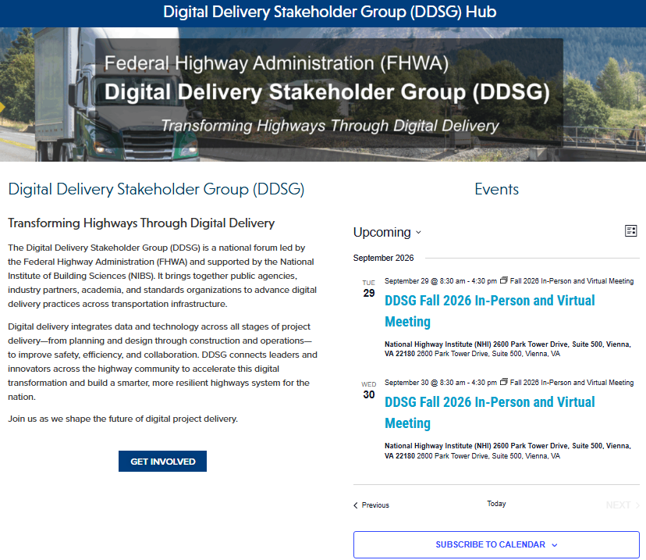
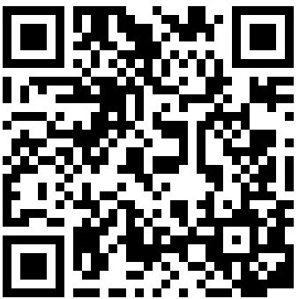
FHWA DDSG Hub
Meeting materials, agendas, and updates in one place
VISIT THE HUB
nibs.org/solutions/fhwa-digital-delivery
Agendas, presentations, and meeting summaries are posted after each meeting.
QR CODE
Insert Hub QR code here
FHWA DDSG FALL MEETING | SEPTEMBER 30, 2026

Slide 8
Agenda – Day 2
Wednesday, September 30, 2026 | 8:30 a.m. – 3:45 p.m. ET | Applications, shared information resources, and next steps
Time | Agenda Item | Presenter(s) / Facilitator(s)
8:30–9:15 a.m. | Welcome, Day 1 recap, Day 2 objectives, and opening poll | FHWA / NIBS
9:15–9:45 a.m. | Workshop Block 2A: Digital Delivery Applications | Richard Brice (WSDOT)
9:45–10:00 a.m. | Break
10:00–11:30 a.m. | Workshop Block 2B: Applications Panel and Facilitated Discussion | Thomas Hamski (Iowa DOT); Cyndee Hoagland (Trimble); Jim Mahugh (WSDOT)
11:30–11:45 a.m. | Education Session | Aaron Costin (NIBS / S3 BIM)
11:45 a.m.–1:00 p.m. | Lunch | On your own
1:00–2:00 p.m. | Workshop Block 3A: Libraries and Data Dictionaries | Abhishek Bhargava (WSP); John Wilkerson (MBI)
2:00–2:30 p.m. | Open discussion, break, and closing poll
2:30–3:15 p.m. | Workshop Block 3B: Collective Priorities and Proposed Work | Facilitator; all participants
3:15–3:45 p.m. | Decisions, Action Items, Next Meeting, and Adjournment | Matthew Corrigan (FHWA); NIBS
FHWA DDSG FALL MEETING | SEPTEMBER 30, 2026

Slide 9
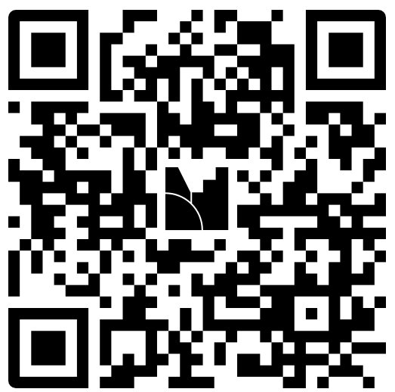



Mentimeter​
DDSG Logo Options
Three candidate designs for the group identity
Option 1
Option 2
Option 3
FHWA DDSG FALL MEETING | SEPTEMBER 30, 2026

Slide 10
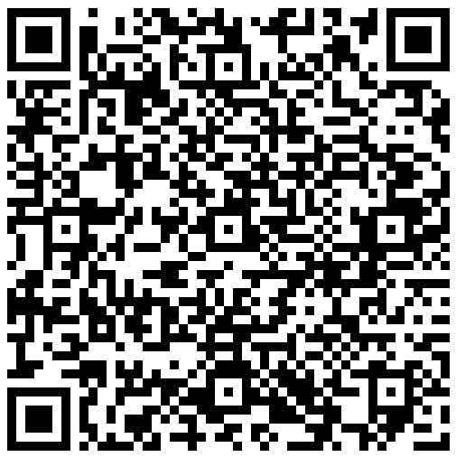

OPENING POLL
Mural Overview and Mentimeter Opening Poll
Scan a QR code or use the link below to join
Mural
Mentimeter
QR CODE
Insert Mural QR code here
QR CODE
Insert Mentimeter QR code here
https://app.mural.co/t/nibs5298/m/nibs5298/1790086130374/c63e1329476cabf050d0831b01989903c1522eed?sender=u333df7e6d5f6b2c25cc40441%E2%80%8B
https://www.menti.com/al93r11gbojp
FHWA DDSG FALL MEETING | SEPTEMBER 30, 2026
10

Slide 11
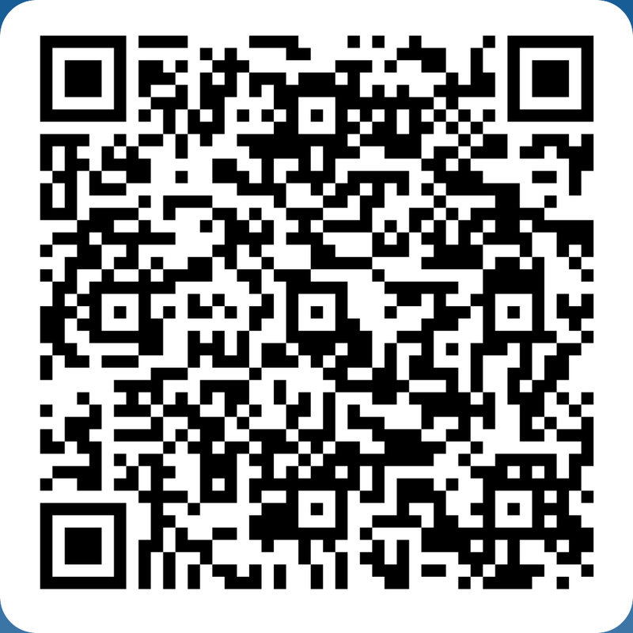
SPEAKER INTEREST
Speak at Future DDSG Meetings
Have a project, pilot, or lesson learned to share? Scan the QR code to submit a topic you would like to present.
Google Form
Interest in Speaking at a Future DDSG Meeting – Fill out form​​
FHWA DDSG FALL MEETING | SEPTEMBER 30, 2026
11

Slide 12
Questions and Discussion
Open floor for all participants
FHWA DDSG FALL MEETING | SEPTEMBER 30, 2026
12

Slide 13
WORKSHOP BLOCK 2A
Digital Delivery Applications
Richard Brice (WSDOT)
Open-source IFC tools and applications
FHWA DDSG FALL MEETING | SEPTEMBER 30, 2026
13

Slide 14

Break
9:45–10:00 a.m.
FHWA DDSG FALL MEETING | SEPTEMBER 30, 2026
14

Slide 15
WORKSHOP BLOCK 2B
Applications Panel and Facilitated Discussion
Thomas Hamski (Iowa DOT)
ADCMS pilot software experience
Cyndee Hoagland (Trimble)
Update regarding ADCMS and Federal Funding activities
Jim Mahugh (WSDOT)
WSDOT's ADCMS pilot experience
FHWA DDSG FALL MEETING | SEPTEMBER 30, 2026
15

Slide 16
Education Session
Aaron Costin (NIBS / S3 BIM)
BIM for Transportation Handbook update
FHWA DDSG FALL MEETING | SEPTEMBER 30, 2026
16

Slide 17

Lunch
11:45 a.m.–1:00 p.m. | On your own
FHWA DDSG FALL MEETING | SEPTEMBER 30, 2026
17

Slide 18
WORKSHOP BLOCK 3A
Libraries and Data Dictionaries
Abhishek Bhargava (WSP) and John Wilkerson (MBI)
BIM for Infrastructure data dictionary efforts/CBTL
FHWA DDSG FALL MEETING | SEPTEMBER 30, 2026
18
Notes:
CBTL portion is tentative pending FHWA approval (per agenda). Confirm status before presenting.

Slide 19
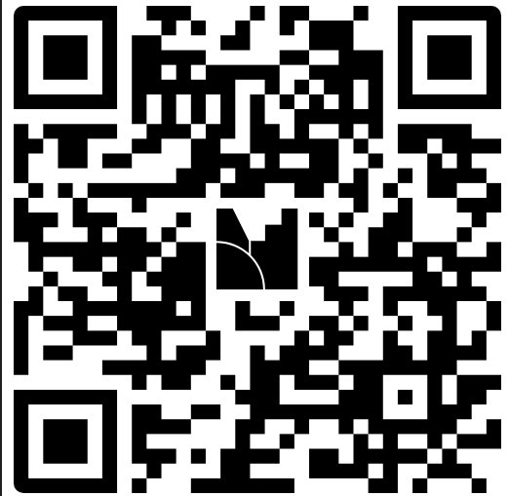
CLOSING POLL
Mural Link and Mentimeter Closing Poll
Open discussion, break, and closing poll
Mural
Mentimeter
QR CODE
Insert Mural QR code here
QR CODE
Insert Mentimeter QR code here
https://app.mural.co/t/nibs5298/m/nibs5298/1790086130374/c63e1329476cabf050d0831b01989903c1522eed?sender=u333df7e6d5f6b2c25cc40441
https://www.menti.com/al77p4xohy92%20%E2%80%8B
FHWA DDSG FALL MEETING | SEPTEMBER 30, 2026
19

Slide 20
WORKSHOP BLOCK 3B
Collective Priorities and Proposed Work
Facilitated discussion
All participants
FHWA DDSG FALL MEETING | SEPTEMBER 30, 2026
20

Slide 21
Decisions, Action Items, and Next Meeting
Matthew Corrigan (FHWA) and NIBS
FHWA DDSG FALL MEETING | SEPTEMBER 30, 2026
21
Notes:
Capture decisions and action items live during the session. Next-meeting calendar follows on the next slide.

Slide 22
Annual Planning: 2026–2027 Calendar
Proposed future schedule
Dec 2026
Mar 2027
Ongoing
Virtual Meeting
In-Person and Virtual Meeting
Industry Events
Week of December 14
Washington, D.C. | Date suggestions welcome
Add upcoming industry events to the Mural board
FHWA DDSG FALL MEETING | SEPTEMBER 30, 2026

Slide 23
SPEAKER INTEREST
Speak at Future DDSG Meetings
Have a project, pilot, or lesson learned to share? Scan the QR code to submit a topic you would like to present.
Google Form
Interest in Speaking at a Future DDSG Meeting – Fill out form​​
FHWA DDSG FALL MEETING | SEPTEMBER 30, 2026
23

Slide 24
Wrap Up Day 2
Adjourn | Thank you for joining us
FHWA DDSG FALL MEETING | SEPTEMBER 30, 2026
24

Slide 25
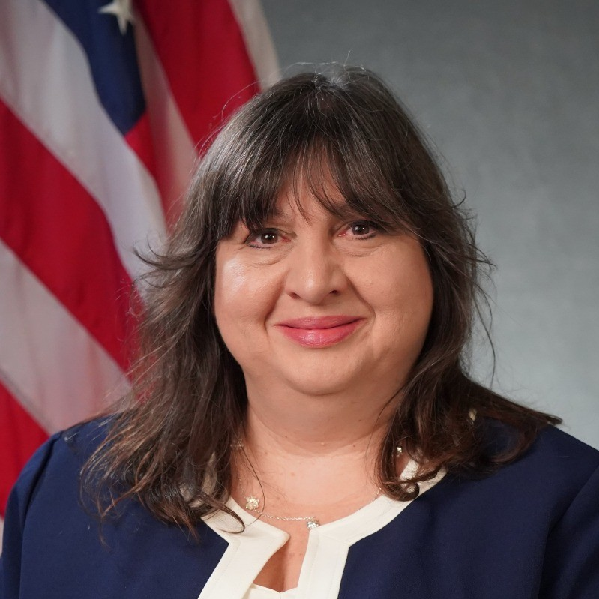
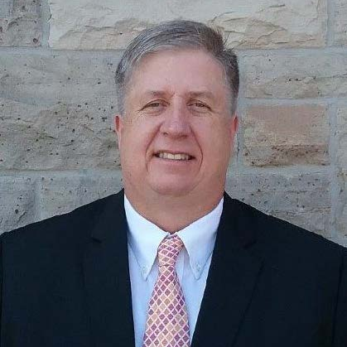
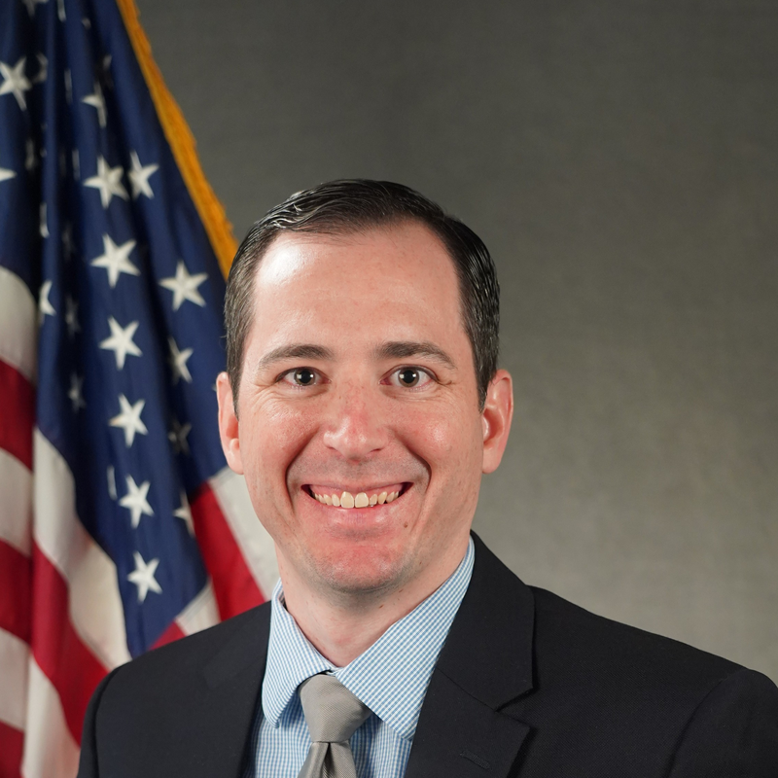
FHWA Team
Federal Highway Administration program staff supporting the DDSG
Matthew Corrigan
Co-Chair, DDSG
Construction Research Engineer
Katherine Petros
Team Leader
Infrastructure Analysis and Construction Team
Bryan Cawley, PE
Construction & Maintenance Engineer
James Gray
Construction Technology Program Manager
FHWA DDSG FALL MEETING | SEPTEMBER 30, 2026

