Slide 1
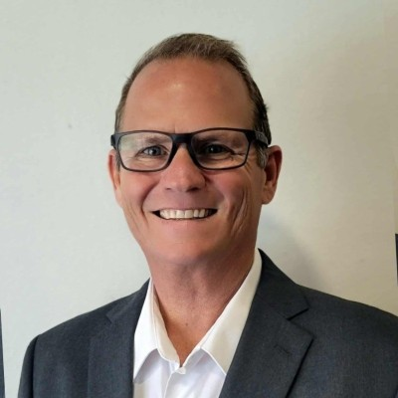

FHWA DDSG FALL 2026 MEETING | WORKSHOP BLOCK 1A
Tuesday, September 29, 2026 | Vienna, VA
Digital Delivery Technology Spotlight
From Bridge Sequencing to Interstate Cloud CDEs and Standardized Digital Quantities
TECHNOLOGY & SOLUTION PROVIDER
CONSULTANT & PROGRAM DELIVERY
Wally Ballou
Technical Account Manager | Bentley Systems
Leading Spotlight 1:
GDOT Talmadge Memorial Bridge
Andrew Poszich, PE
Director of Digital Delivery | RS&H
Leading Spotlight 2 & 3:
FDOT MI-4 & NCDOT Item Types

Slide 2
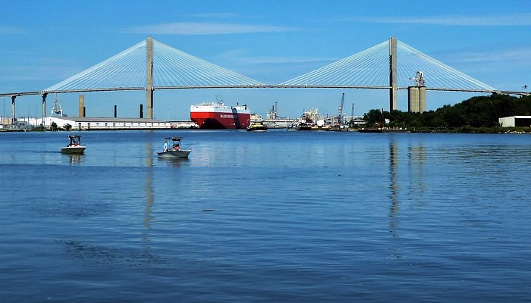


SPOTLIGHT 1: CASE STUDY PRESENTATION
FHWA DDSG Fall 2026 Meeting
GEORGIA DEPARTMENT OF TRANSPORTATION
Talmadge Memorial Bridge Modernization
Cable Replacement & 20-Foot Elevation Project: Advanced 3D Modeling under GDOT's Inaugural CMGC Contract
Wally Ballou
Technical Account Manager | Bentley Systems
Co-Presenting with Andrew Poszich, PE (Director of Digital Delivery, RS&H)
Original content sources for Bentley’s Year in Infrastructure Awards:
Parsons, Kiewit, HNTB, DSL
US 17 / SR 404 | over the Savannah River

Slide 3
Economic Drivers: Elevating Savannah's Maritime Lifeline
THE ECONOMIC ENGINE
THE MODERNIZATION OPTION
FISCAL STEWARDSHIP
Port of Savannah Expansion
$189M Cable Lift Project
>$800 Million Saved
The Port of Savannah is the nation’s 3rd busiest container gateway, generating billions in regional trade. However, the existing 185-foot clearance restricted modern Neo-Panamax vessels at high tide.
Rather than demolish and replace the 1991 cable-stayed bridge, GDOT opted to replace all 144 stay cables and shorten them to raise the center deck by 20 feet.
Building a brand-new bridge or boring an underwater tunnel would have cost taxpayers between $1.0B and $1.5B and required a decade of severe disruption.
Target Clearance:
206 feet
Global First:
A cable-stayed lift of this scale has never been done
Taxpayer Benefit:
Delivered at a fraction of replacement cost

Slide 4
CRITICAL CONSTRAINTS
Engineering Complexity & Zero-Closure Mandates
Active Corridor Traffic Mandate
Structural Legacy Limits
US 17 / SR 404 is the primary highway link between Savannah, Hutchinson Island, and South Carolina, carrying heavy daily commuter and freight volumes.
Constructed in 1991, the existing bridge presented severe analytical challenges that prohibited standard assumptions:
•
Zero Full Closures: Shutting down the bridge was explicitly prohibited by GDOT contract requirements.
•
Minimal Edge Reinforcement: Legacy deck drawings revealed very low longitudinal reinforcement in the concrete edge girders.
•
Maintained Traffic: At least one lane of live traffic in each direction had to remain active throughout construction.
•
High Crack Risk: Tension adjustments during shortening could easily induce concrete tension cracking under service loads.
•
Dynamic Staging: Crane positions and heavy jacking equipment had to operate within tight, shifting lane closures.
•
Full Replacement: All 144 stay cables required modern replacement conforming to updated PTI DC-45 standards.

Slide 5
CONTRACTUAL INNOVATION
GDOT's Inaugural CMGC Project Delivery
OWNER
DESIGNER OF RECORD
CMGC CONTRACTOR
PROGRAM MANAGER
GDOT
Parsons
Kiewit
HNTB
Pioneering its first CMGC contract to de-risk unprecedented bridge construction.
Leading structural modeling, RM Bridge simulation, and temporary stay engineering.
Integrating equipment staging, crane loads, and physical sequencing into 3D models.
Overseeing multi-agency coordination, independent review, and overall program controls.
The CMGC Advantage in Digital Delivery
• Constructability Before Letting: Kiewit evaluated jacking sequences inside Parsons' 3D analytical models during preconstruction, eliminating field surprises.
• Collaborative CDE Governance: ProjectWise managed model revisions and document control across all stakeholders under GDOT's digital standards.

Slide 6
The Technical Breakthrough: Method 1 vs. Method 2
METHOD 1: CONVENTIONAL LINEAR SUPERPOSITION
METHOD 2: NON-LINEAR STAGED CONSTRUCTION
Crack-Control Violations Identified
Temporary Stay Support System
Initial engineering trials relied on traditional linear superposition. The results proved alarming:
Parsons leveraged Bentley RM Bridge to engineer a groundbreaking staged construction approach:
Tensile stresses during jacking exceeded AASHTO allowable crack-control limits in the edge girders.
Designed custom temporary stay supports to hold equilibrium while primary cables were swapped and tensioned.
High risk of localized concrete cracking around stay anchorages during cable tensioning.
Redistributed forces safely, keeping concrete edge girder stresses strictly within allowable AASHTO limits.
Method 1 proved that traditional static calculation was unsafe.
Method 2 de-risked the physical lift before any cables were touched.

Slide 7




DIGITAL TWIN EXECUTION
RM Bridge: 90,000-Step Precision Sequencing
90,000 Discrete Steps
Extreme Deflections
40% Time Savings
Raising the deck was not a single lift. Parsons simulated a meticulous 90,000-step sequence across 15 cable-shortening cycles.
The mathematical model managed massive geometric movements while preserving structural stability:
Bentley RM Bridge automated the complex staged non-linear calculations that would have taken months in conventional tools.
• 15 inches: Backstay deflection control.
• 16 inches: Center midspan vertical lift.

Slide 8
PROJECT VALUE
Measurable Outcomes & Extended Infrastructure Value
>$800M
40+ Yrs
40%
0
Taxpayer Savings
Life Extension
Analysis Time Saved
Full Roadway Closures
Full stay replacement to modern PTI DC-45 standards
Compared to new bridge or tunnel alternatives
Through automated RM Bridge non-linear scripts
Maintained continuous traffic across US 17
Industry Recognition: 2026 Going Digital Awards Finalist
GDOT and Parsons were recognized as finalists in the Bridges and Tunnels category at the 2026 Year in Infrastructure (YII) awards, establishing a precedent for how public agencies can preserve monumental assets through digital engineering.

Slide 9

Digital Delivery Benefits for State DOTs
Why transportation agencies must advance from 2D sheets to model-centric delivery.
Data Lifecycle Focus
Fiscal Stewardship
Risk Retirement
Administrative Shift
"Collect once, use many times." Eliminates redundant re-drawing and re-calculating across planning, design, construction, and asset maintenance.
Spends taxpayer money wisely by preserving aging assets. Talmadge saved >$800M and extended operational service life by 40+ years.
3D analytical simulations resolve constructability, crane reach, and sequencing before contractor letting, virtually eliminating change orders.
Automating sheet cross-sections and quantity takeoffs frees senior engineers from paper administration to focus on high-value oversight.
Zero handoff data loss
Maximum capital efficiency
De-risked prior to physical work
Overcomes workforce shortages
DDSG Core Alignment: Digital delivery transforms public agency investments from static paper archives into durable, machine-readable digital assets.

Slide 10
NEXT IN SESSION
State DOT Takeaways
LESSONS FOR PEER AGENCIES
What Talmadge Proves for State DOTs
3D Digital Twins De-Risk Complexity:
High-fidelity modeling proves feasible what traditional 2D calculations declare impossible.
CMGC Contracts Bridge Silos:
Bringing the contractor into the 3D model during preconstruction ensures constructability before letting.
Common Data Environments:
Governed cloud repositories keep multi-agency teams aligned without version confusion.

Slide 11
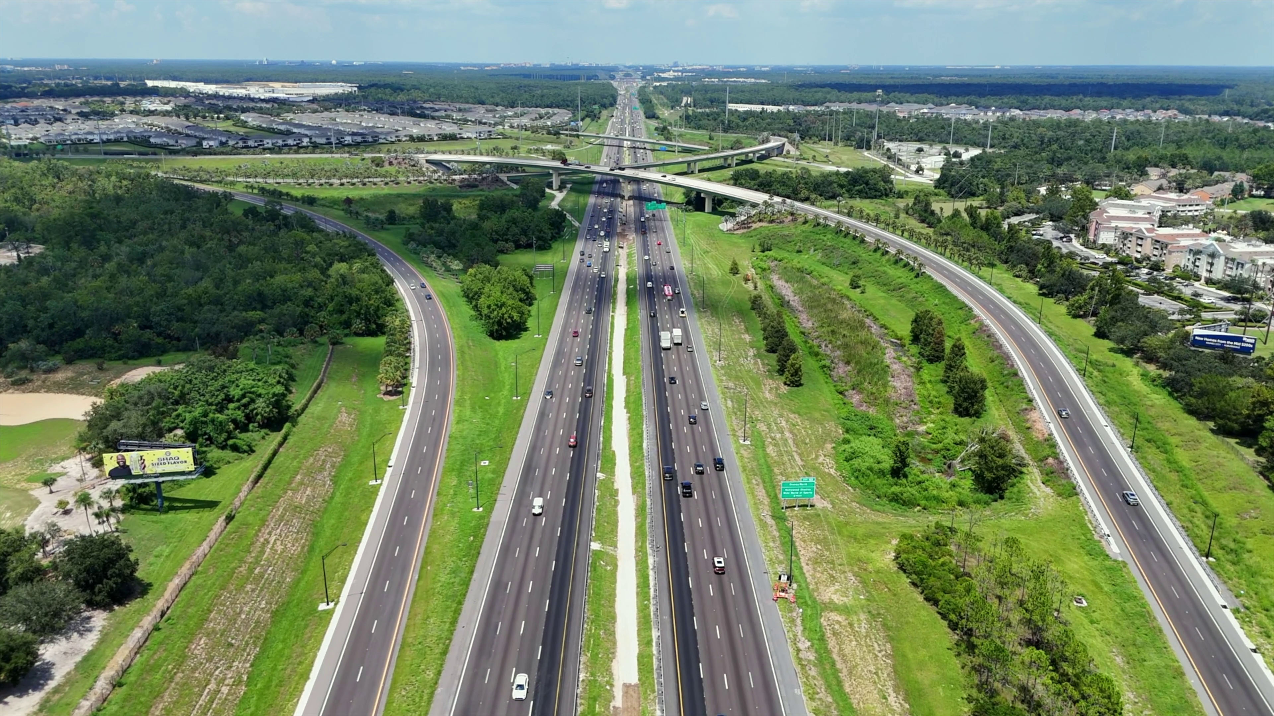
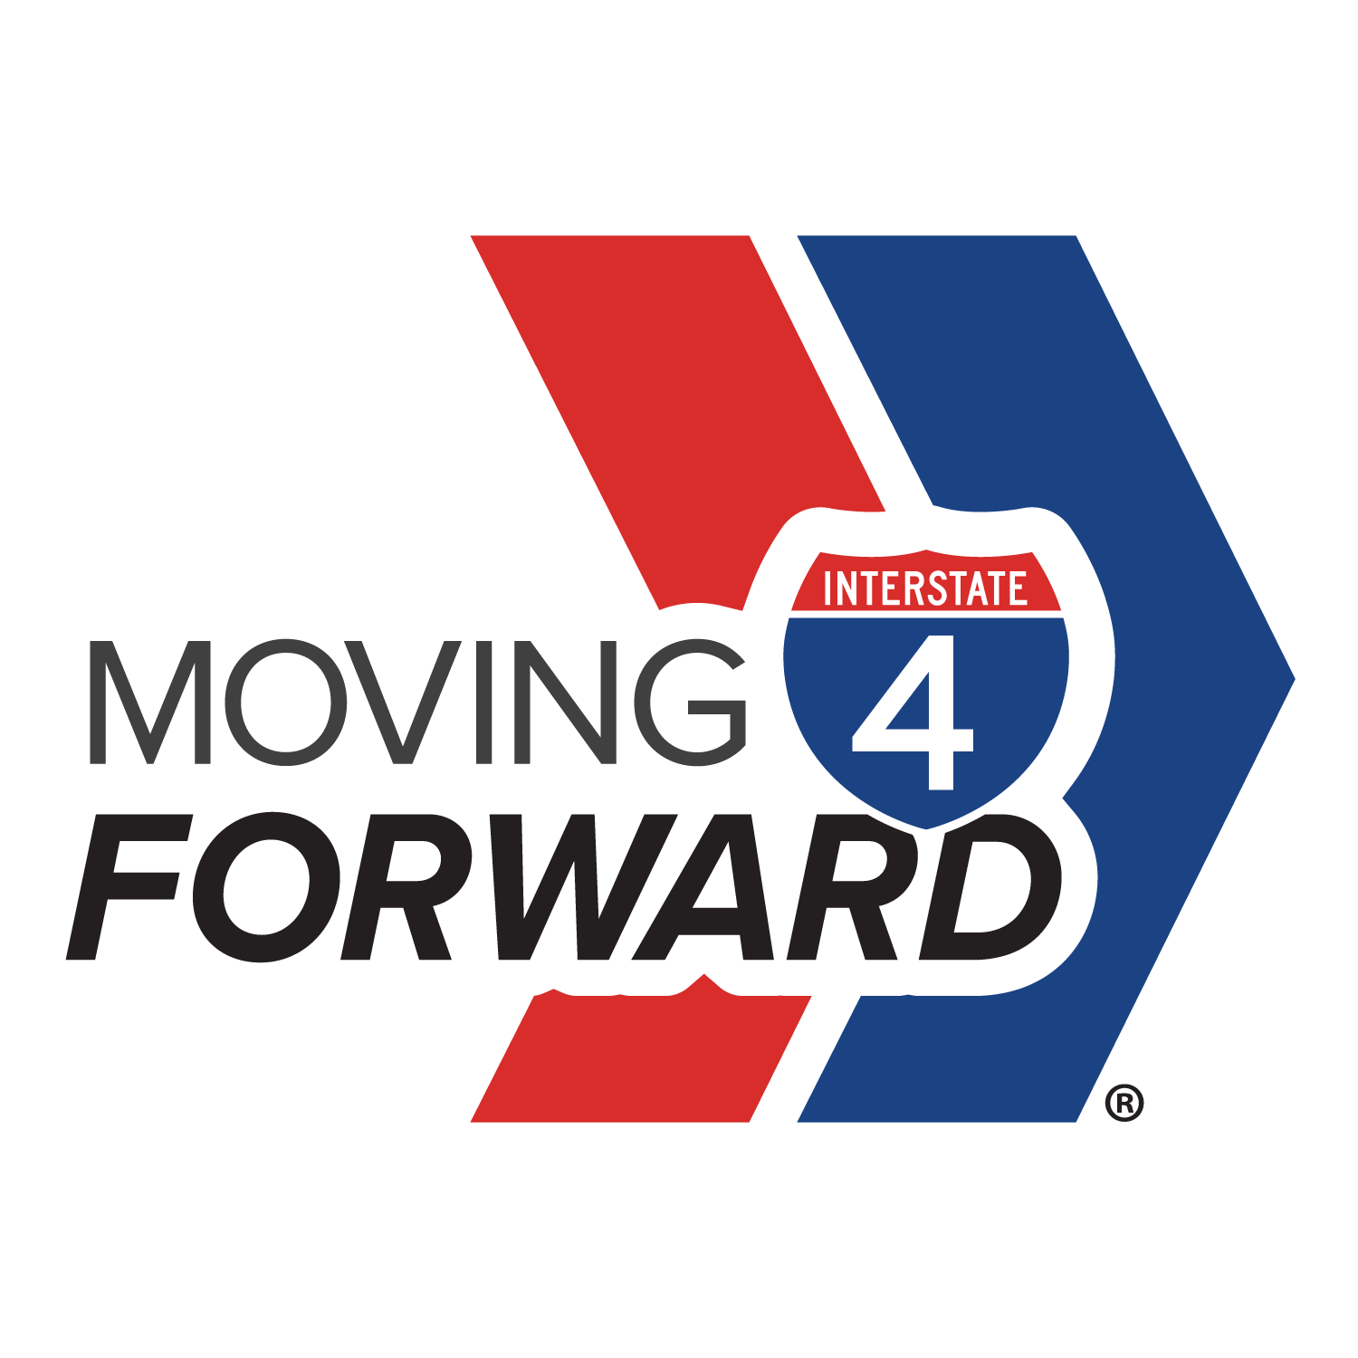


SPOTLIGHT 2: CASE STUDY PRESENTATION
FHWA DDSG Fall 2026 Meeting
FLORIDA DEPARTMENT OF TRANSPORTATION
Moving I-4 Forward
Connecting Project Knowledge and Delivery
Andrew Poszich, PE
Source: movingi4forward.com
Director of Digital Delivery| RS&H
Co-Presenting with Wally Ballou (Technical Account Manager, Bentely Systems)
Original presentation prepared for Bentley’s Year in Infrastructure Awards:
Jessica Chambers, VP, Digital Technologies and Solutions, RS&H
Samuel Worthy, PE, Infrastructure Digital Delivery Lead, RS&H
Ben Miller, PE, MI-4 Project Management Engineer, RS&H
Interstate 40 | Celebration, FL

Slide 12
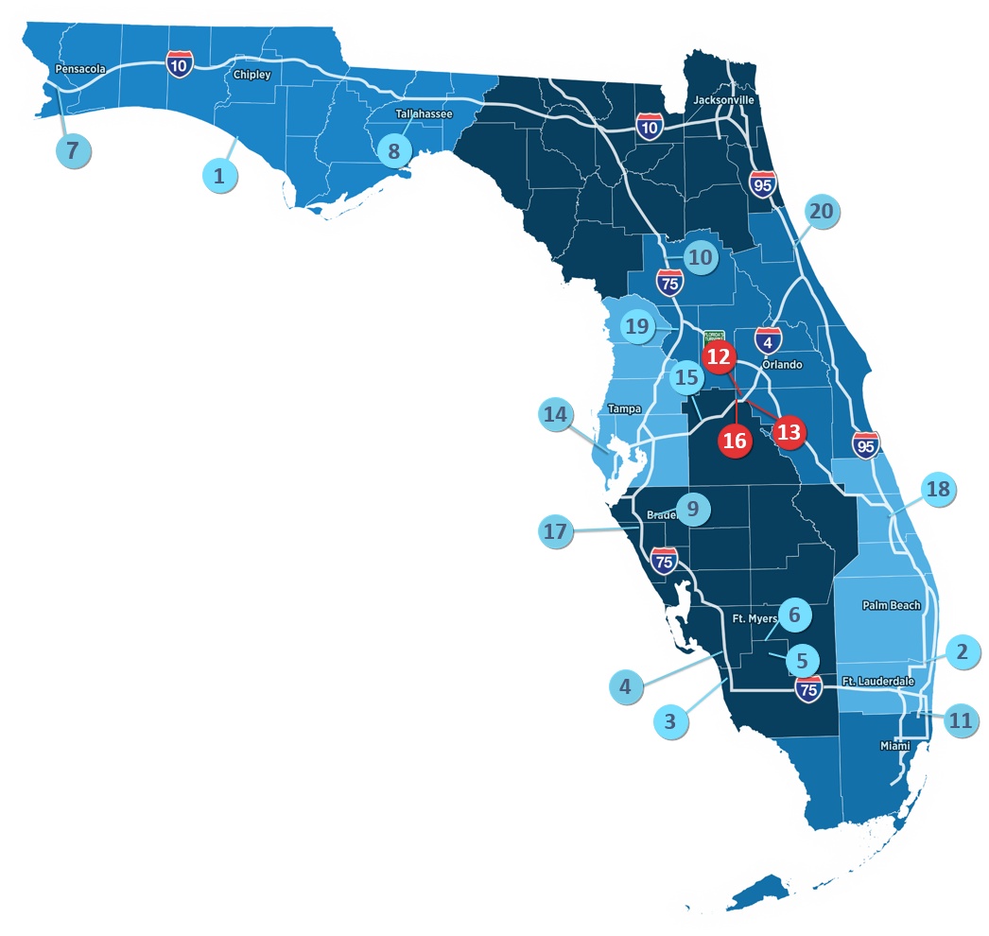
MI-4: The Corridor That Cannot Stand Still

Slide 13
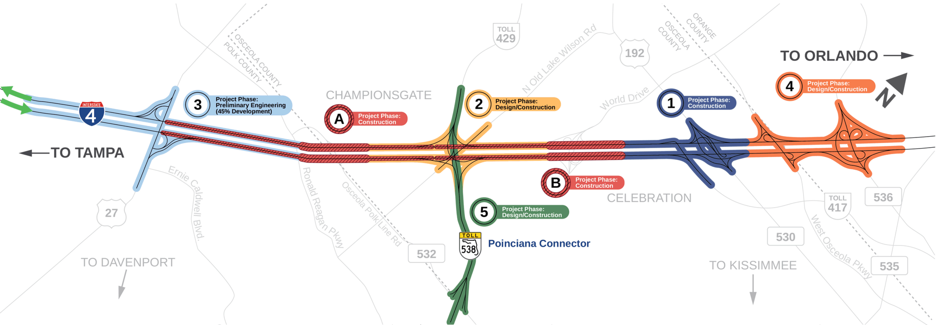
MI-4: The Corridor That Cannot Stand Still
Source: movingi4forward.com (Corridor Map)
The Public Need
$3.51 billion investment in Central Florida
14-mile corridor across Polk, Osceola,
and Orange counties
Expansion from 6 lanes to up to 12 lanes
Improve safety, connectivity, freight movement,
and regional connectivity
The Delivery Challenge
Multiple concurrent projects and delivery teams
Active traffic maintained during construction
Strict information and confidentiality requirements
Disconnected files, reviews, comments,
and decisions

Slide 14
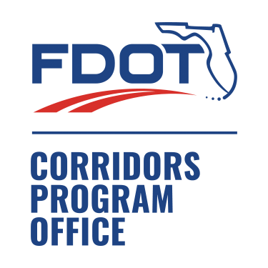
Graphic idea (program diagram):
FDOT / CPO at center → consultants → contractors → reviewers → field teams, all linked by a shared digital delivery framework.
Corridor Program Office (CPO):
Connecting the Program
Consultants
MI-4 CPO role (relating to Digital Delivery):
Digital delivery leadership within FDOT’s CPO
Common data environment and managed-workspace implementation
Federated design, review, and innovation workflows
Consistent governance across owners, consultants, and contractors
Field Teams
Contractors
Reviewers
One program framework. Multiple projects. Shared information.

Slide 15
From Disconnected Files to Connected Delivery
Managing The Flow Of Data And Information Using Bentley Infrastructure Cloud
PLAN
DESIGN
DELIVER
BUILD
Preliminary design (.dgn) coordinated in iModels with GIS data visualized over design data for context
Technical reviews, and alternatives analysis, assessed using Civil Tools in iModel Viewer
Manage deliverables, review, and comment resolution using custom forms and workflows
Connect field CEI staff to iModels, geolocated PDFs, and intelligent forms, dashboards for all field data
One Common Data Environment (CDE) acting as a single source of truth for all projects in the MI-4 Program

Slide 16
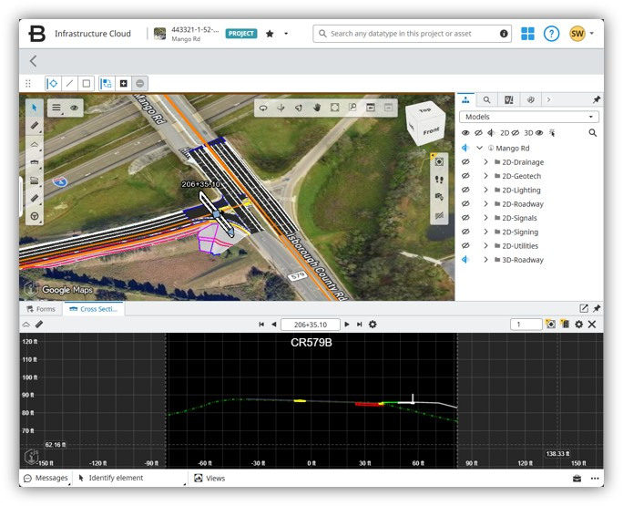
Technology Enablement:
Streamlining Decisions Before Construction
Models Became a Shared Decision Environment:
100% of roadway geometry developed using model-based workflows
Design models combined with survey, terrain, utilities, ROW, GIS, and reality data
Federated 2D and 3D reviews without native CAD software for every participant
Structured reviewer assignments, issues, dispositions, and auditable closeout
Earlier visibility into coordination, constructability, and environmental impacts
Result: Problems and impacts could be
evaluated while alternatives were still flexible.
Result Metrics:
158 users | 938 tracked review comments | 30% shorter average review cycle

Slide 17
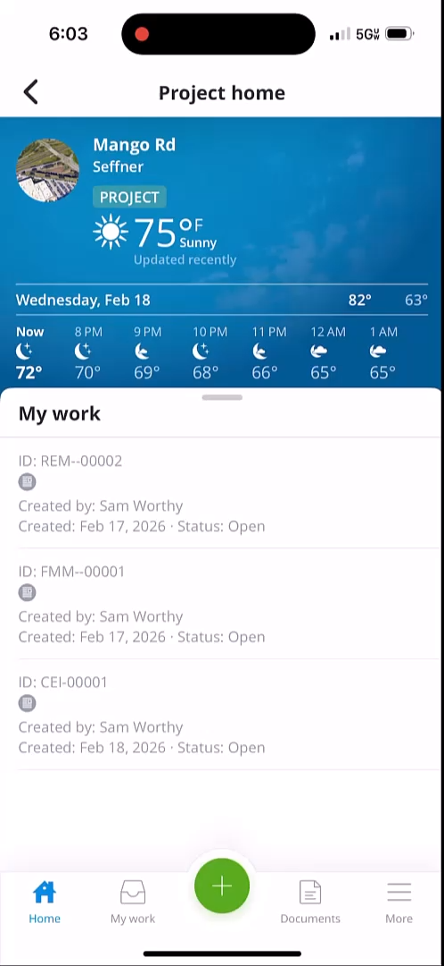
Connecting Data to the Field
Enabling Decisions Through Managing Information:
585 managed and geolocated plan sheets
Live access to plans and iModels in the field
Mobile forms, photos, field reviews, and redlines
Exportable records supporting contractor coordination
Less duplicate entry between site and office
Pilot Results:
40% less time to locate and validate current design information
60% less time to create field forms compared with office-based workflows

Slide 18
Measurable Value at a Program Scale
Community and Environmental Value
Program Controls
Delivery Efficiency
442 users across 30 organizations
95,000 files managed in ProjectWise
600+ GB centrally managed in ProjectWise
938 review comments tracked through structured workflows
469 staff hours saved across review and coordination
14,000 hours saved through controlled file management
30% estimated reduction in average design-review cycle time
14 miles of planned congestion-relief improvements
Improved corridor safety, connectivity, and resilience
Wetland impacts reduced from 99.12 to 57.12 acres
42% reduction in wetland impacts
Connected Data. Measurable Public Value.

Slide 19
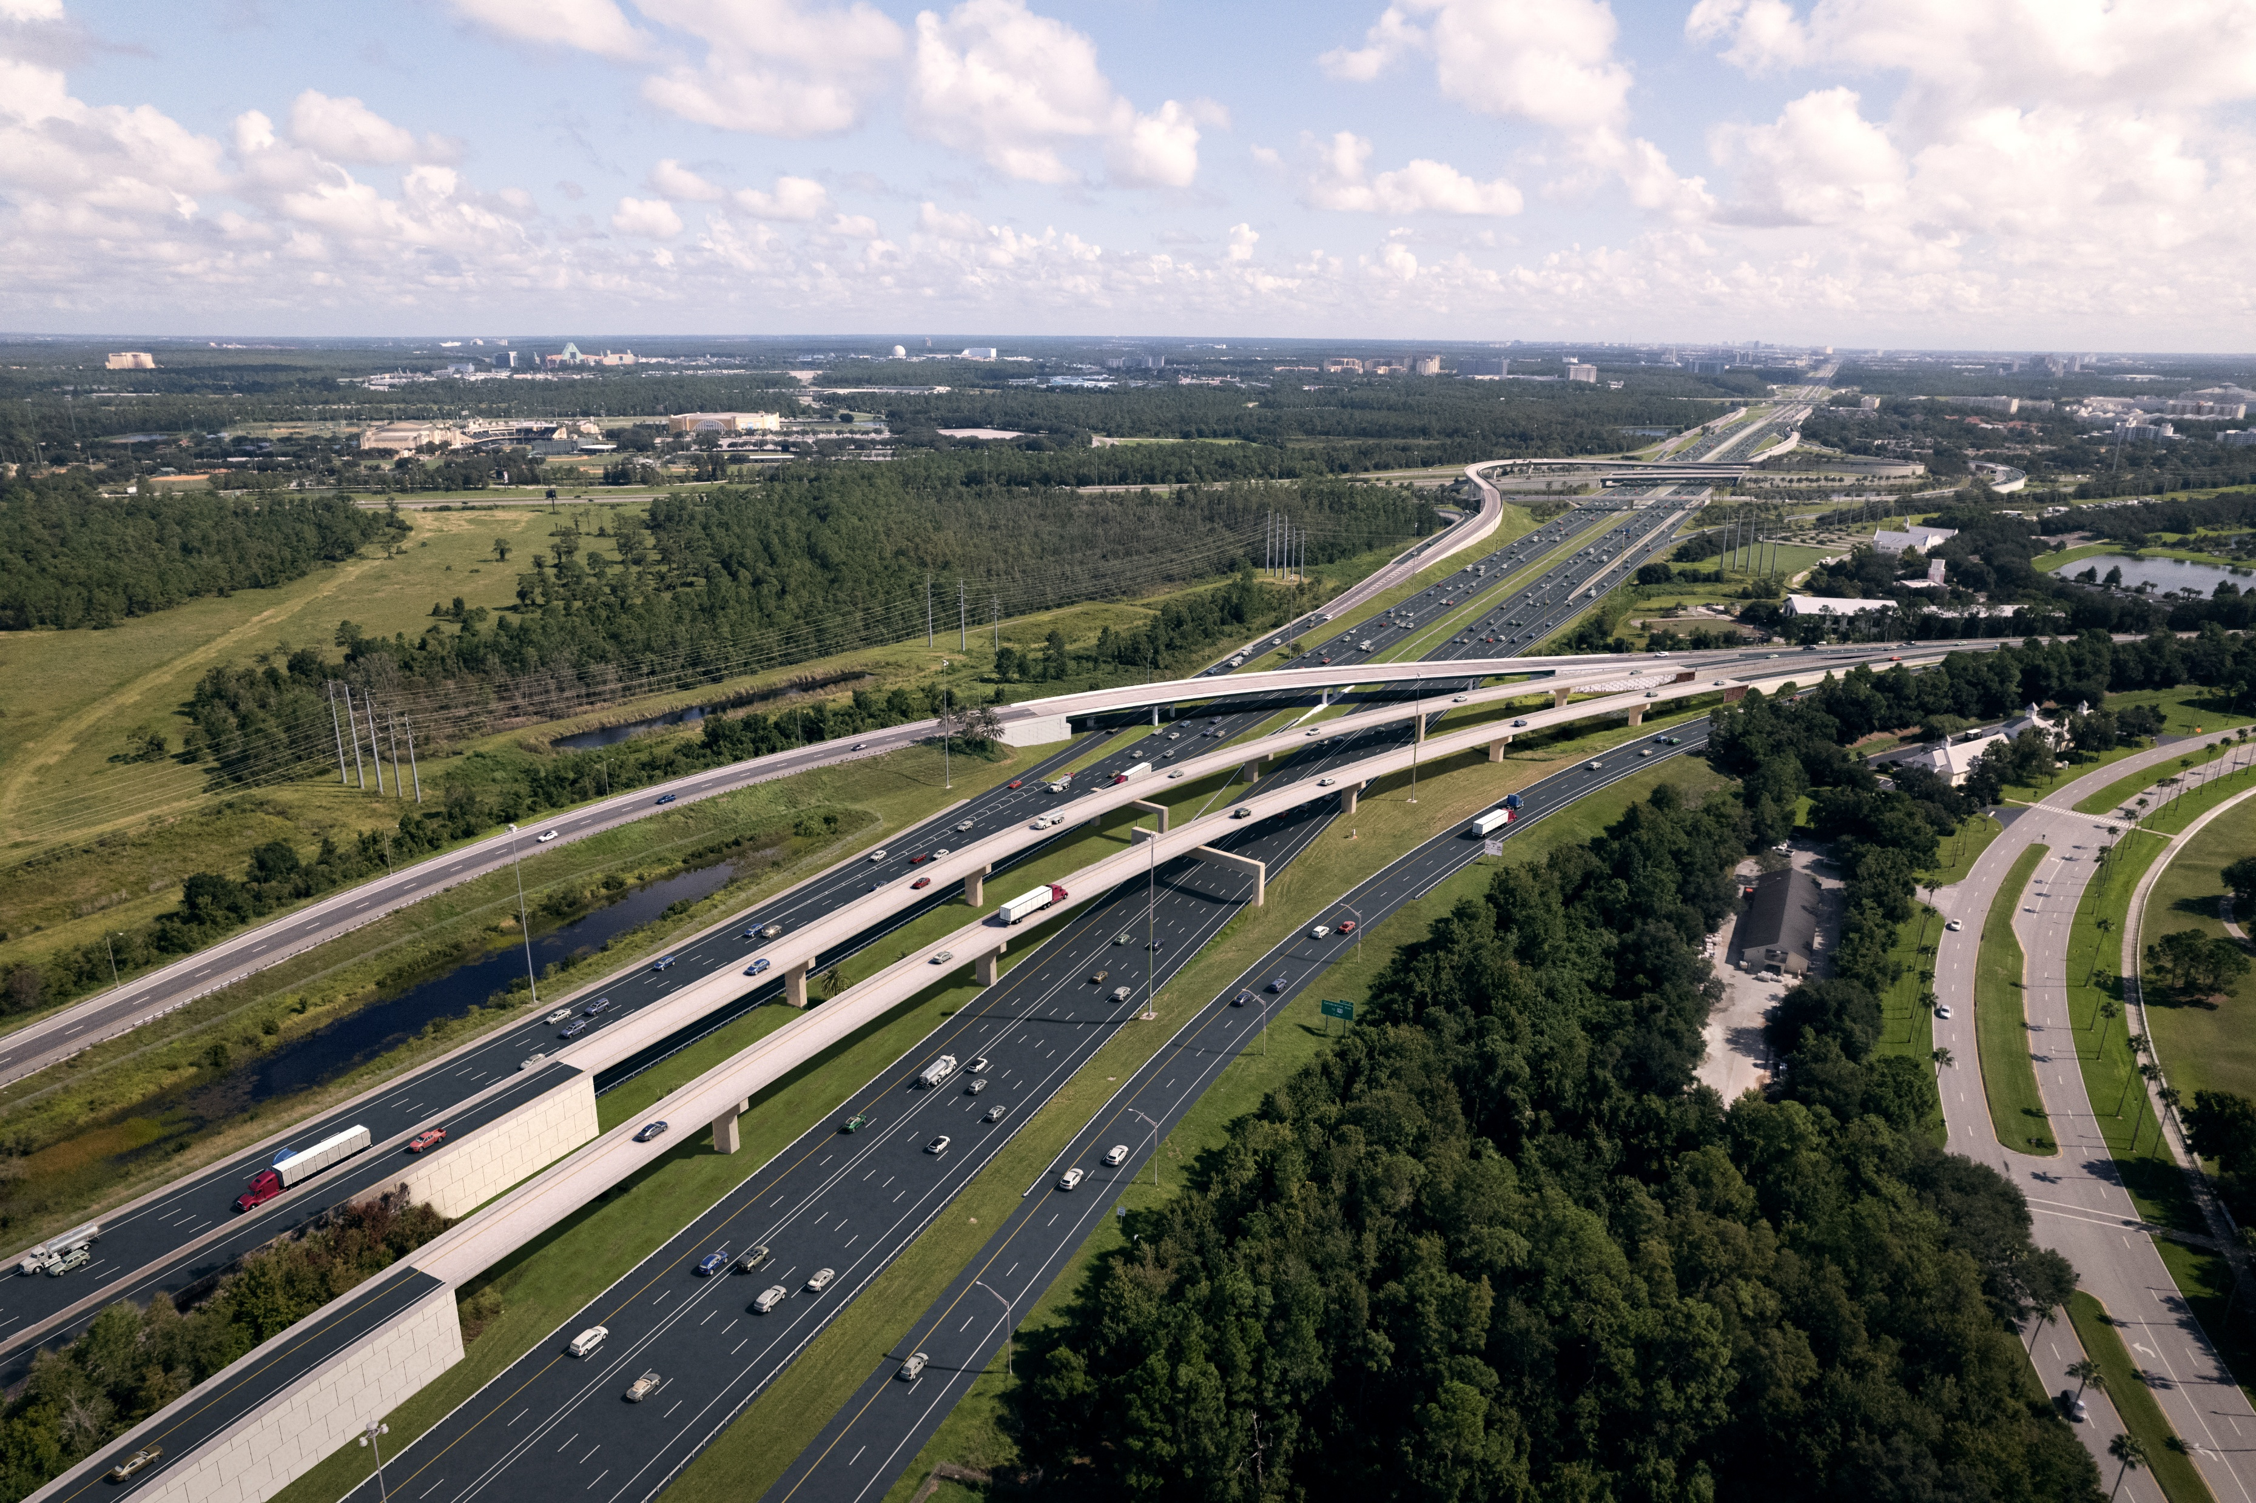
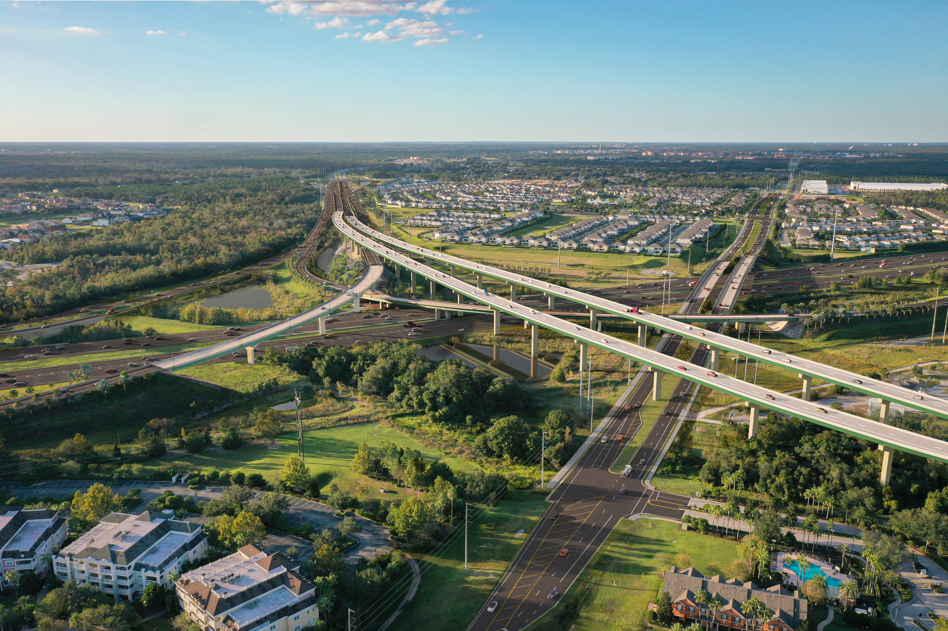
A Repeatable Model for Connected Program Delivery
What We Learned:
Technology creates value when paired with governance and repeatable workflows
Connected reviews turn comments into visible, accountable decisions
Earlier context leads to earlier risk identification and better alternatives
Field access extends the value of engineering data through delivery
Program-level standards allow innovation to scale beyond a single project
Design Review Decision Field Community
Technology does more than just connect files…
It connects people, decisions, and outcomes across programs.

Slide 20
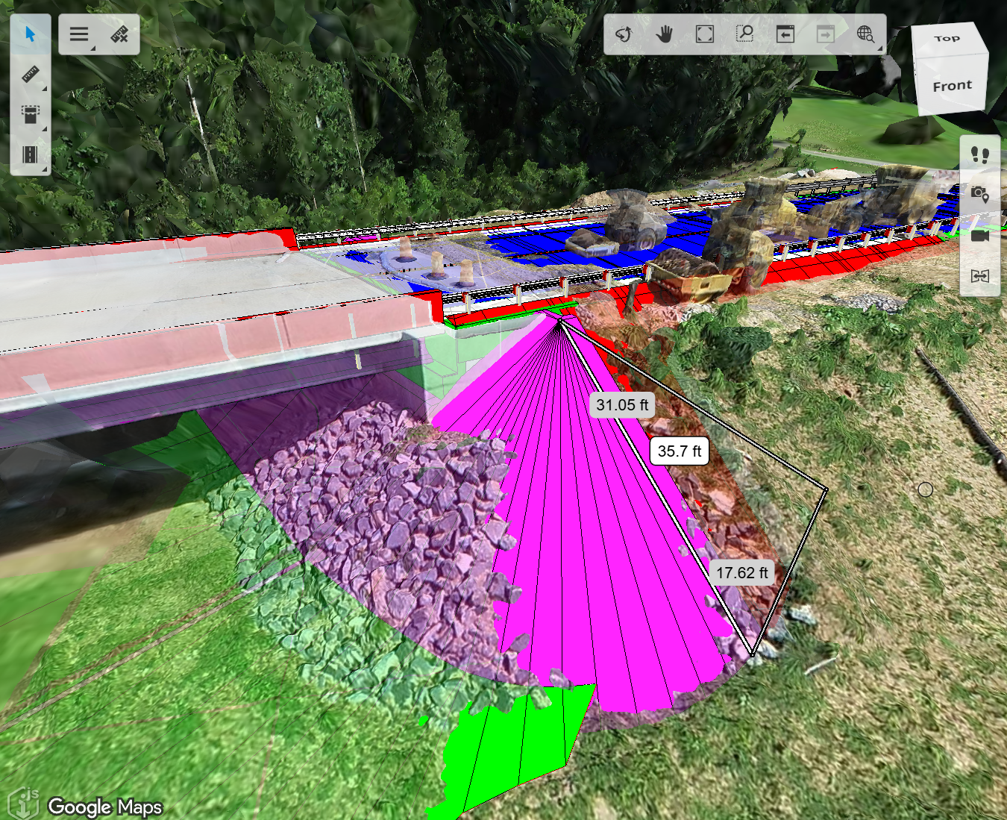
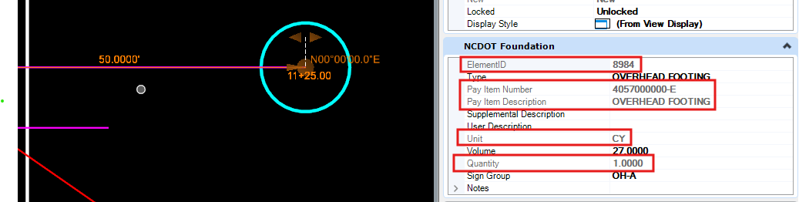
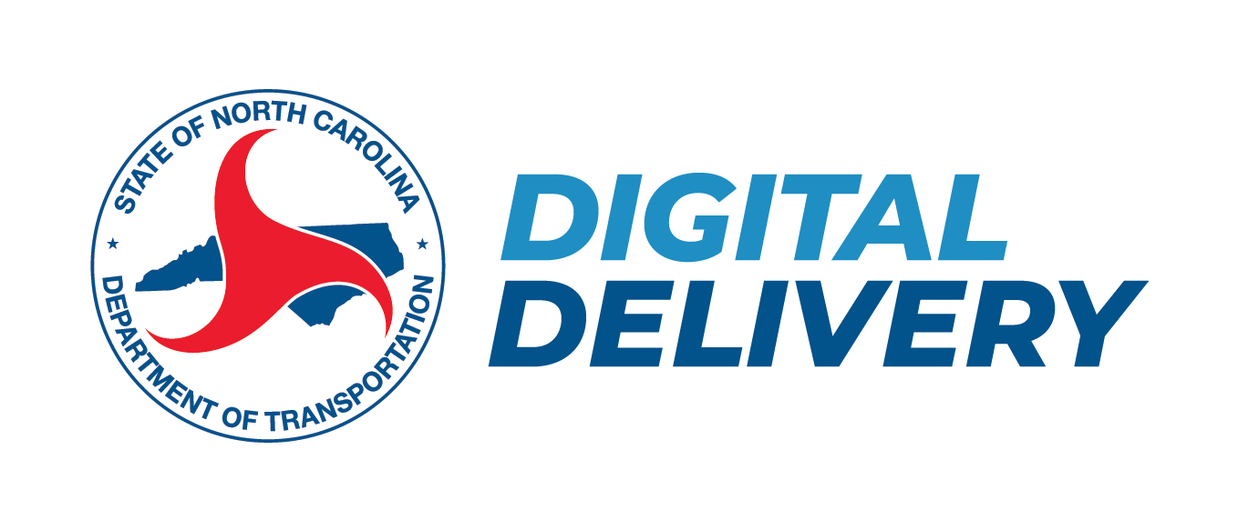





SPOTLIGHT 3: CASE STUDY PRESENTATION
FHWA DDSG Fall 2026 Meeting
NORTH CAROLINA DEPARTMENT OF TRANSPORTATION
NCDOT Digital Delivery Program
Leverage Item Types for Natural Workflows
Andrew Poszich, PE
Director of Digital Delivery| RS&H
Co-Presenting with Wally Ballou (Technical Account Manager, Bentely Systems)
Original presentation prepared for NCDOT with support from:
RS&H, GFT, Kimley-Horn, VHB, Michael Baker, Balfour Beatty
State Program| North Carolina

Slide 21

Item Types
Trusted, portable data — captured in the way you already design
NCDOT Digital Delivery Program · Vision Overview

Slide 22





One Source of Truth
Build the model once — everything flows from it.
PDF plans
Quantities
Model /
CADD Data
Reports
Single source of truth
Construction
Not five versions of the truth
— one, reused
Decisions

Slide 23
A SINGLE SOURCE OF TRUTH
Every deliverable derived from one authoritative dataset
When the design changes, the outputs change with it
What a decision-maker reviews
What a report totals
What a contractor builds
All tracing back to the same information
NCDOT DIGITAL DELIVERY

Slide 24
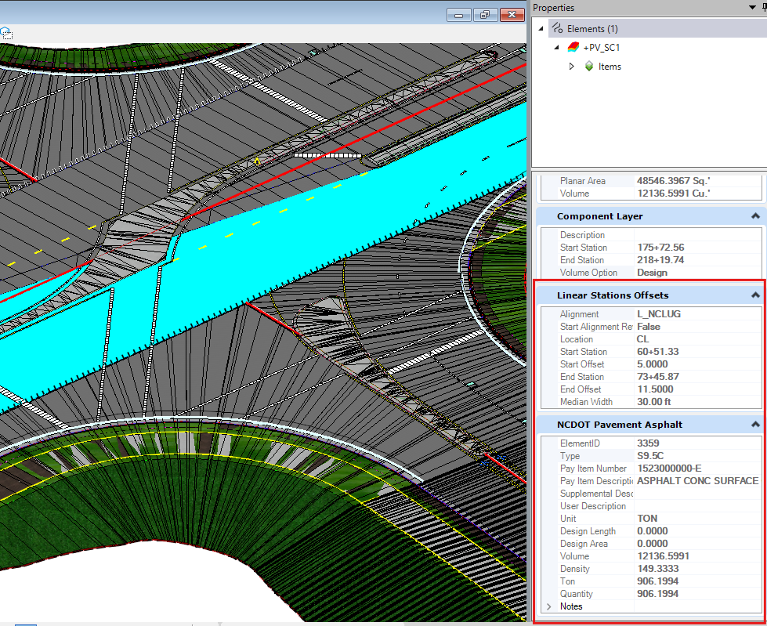



Designed Around Your Workflow
The tools fit the way you already work.
Design as you already do
Familiar tools. Established processes.
Data captured along the way
What downstream teams need,
gathered in the background.
Automate wherever we can
No added burden on the designer.

Slide 25

Two Pathways to a Pay Item
Same destination.
Automatic Pay Item Population
Applied as you design
Deferred Pay Item Selection
Assigned at takeoff

Slide 26
Automatic Pay Item Population
The pay item is applied as each element is created.
01
02
03
Configured Feature Definition or Element Template
Pay item applied automatically
Captured as you place elements
No additional steps. No interruption.

Slide 27
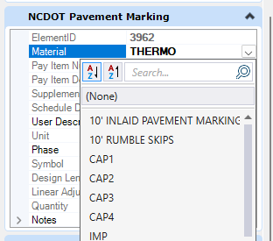
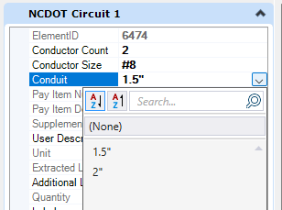
Deferred Pay Item Selection
When it is more practical to design first.
01
02
03
Design first, in your natural flow
Select or assign pay items later
At the point quantities are pulled
Your natural design flow is preserved.

Slide 28
THE GUIDING PRINCIPLE
Capture trusted, portable data as a natural product of good design
The people who use it downstream can rely on it
The people who create it are never slowed down
NCDOT DIGITAL DELIVERY

Slide 29



Four Things on Every Element
A minimum core — item types can carry a great deal more.
Unique
Identifier
Pay Item
Location
Calculated
Quantity
Element ID
Number & Description
Station / Offset
Number & Text

Slide 30
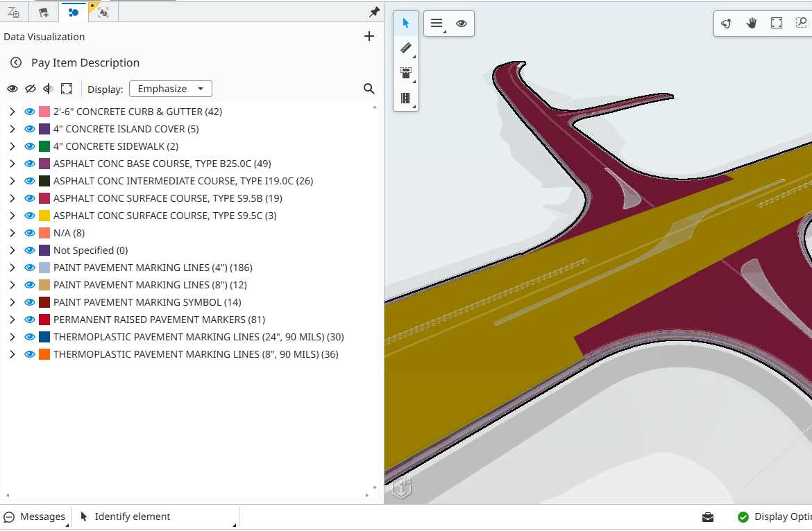


It Stays with the Element
Information persists as the design moves between tools and formats.
Design
Review
Asset Management
Construction
CARRIED THROUGH
IFC
iModels
Bentley
Autodesk
Esri
Trimble
Topcon

Slide 31
THE SAME RESULT, EITHER WAY
Elements already carry what quantities, reporting, construction, and asset management need
Without asking you to change how you design
NCDOT DIGITAL DELIVERY

Slide 32



A Foundation to Build On
A starting point, not a limit.
Extending automation
Capturing more information
Removing manual steps
Reaching further into the workflow
Added to the core set over time
Retiring effort needed today, not tomorrow
Item types grow with the program

Slide 33
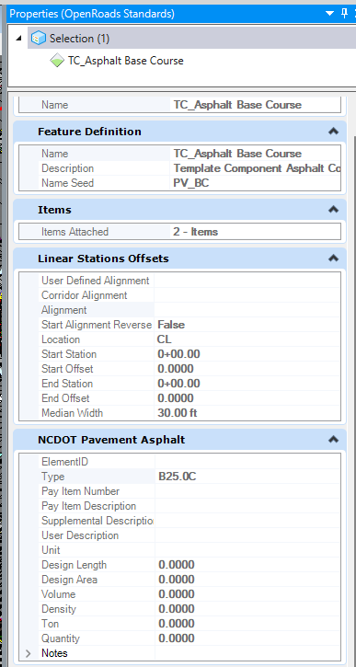
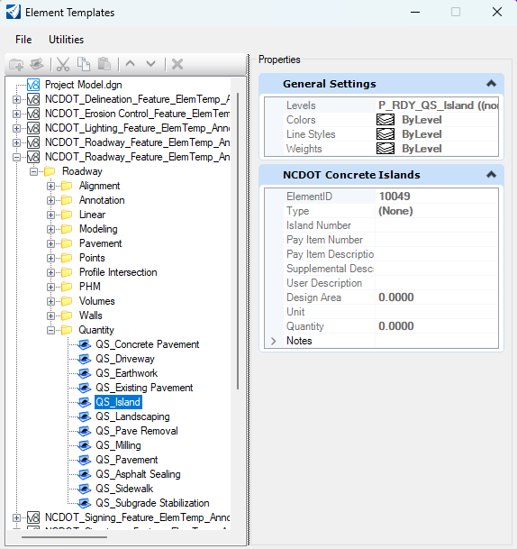
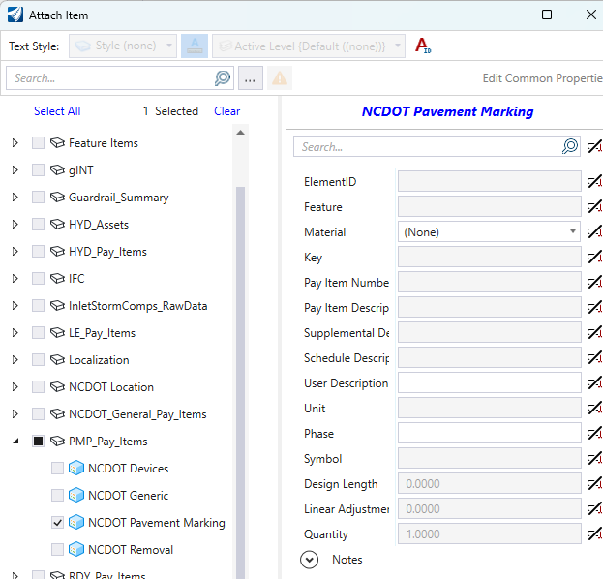
Communicating Progress
Implementation varies across disciplines
The system is designed to evolve over time
Feature Definition
Element Template
Manual Attachment

Slide 34
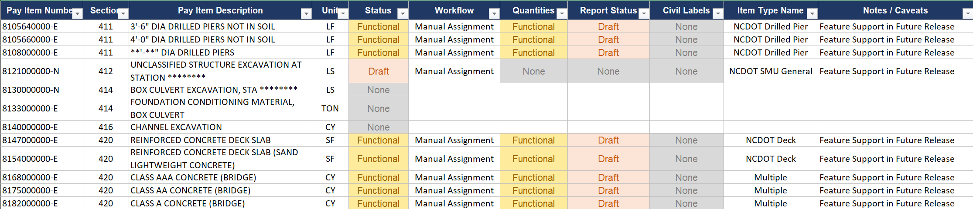
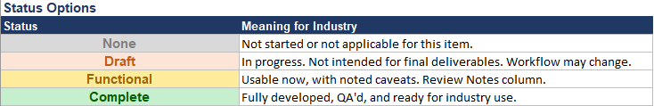
Communicating Progress
An ItemType Readiness Report is published to help designers know if a pay item is included in an item type, and where to look for it.

Slide 35

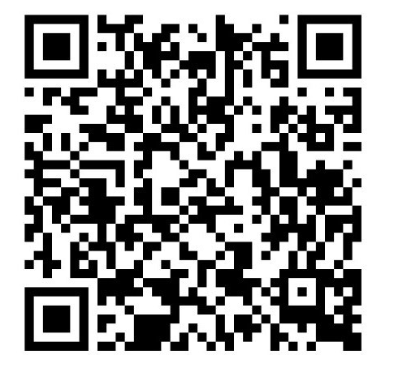
FHWA DDSG FALL 2026 MEETING | WORKSHOP BLOCK 1A
Tuesday, September 29, 2026 | Vienna, VA
Digital Delivery Technology Spotlight
Thank you!
TECHNOLOGY & SOLUTION PROVIDER
CONSULTANT & PROGRAM DELIVERY
Wally Ballou
Technical Account Manager | Bentley Systems
wally.ballou@bentley.com
Andrew Poszich, PE
Director of Digital Delivery | RS&H
Andrew.Poszich@rsandh.com
Let’s Connect!

