Slide 1
Iowa DOT ADCMS
Pilot Update
US 59 over Iowa 92 Bridge Replacement

Slide 2
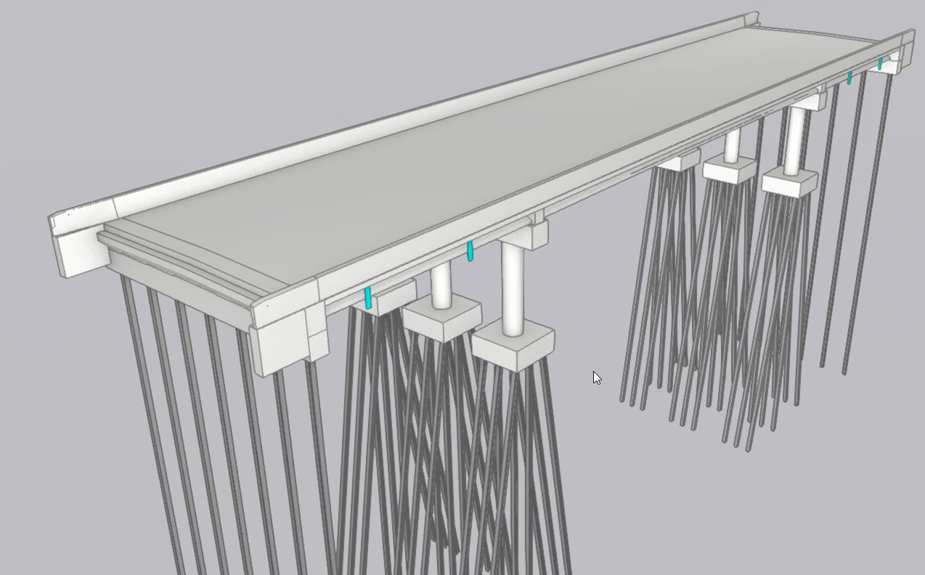
Pilot Project
The Bridge – US59 over IA92
199’-0” x 44’-0”
Three-Span Prestressed Beam
Multi-Column Piers
Integral Abutment
Zero Skew
No Aesthetics
No Staging

Slide 3
Project Overview
This project had two major objectives:
  Delivering a 3D BIM model using the IFC
    Allows us to access BIM models over the life of the asset (75+ years)
    Creates consistency in file type and data format
  Enhancing the experience with BIM in construction
    IFC offers solutions to past challenges
    Enhanced collaboration through construction
Notes:
IFC adopted by AASHTO in 2019

Slide 4

Enhancing BIM in Construction
How do we go from this…

Slide 5

Enhancing BIM in Construction
To this…

Slide 6


openBIM
Open data standard for project delivery, IFC
Left software choice open until contract awarding.
Contractor had voice in decision on field software to be used.

Slide 7
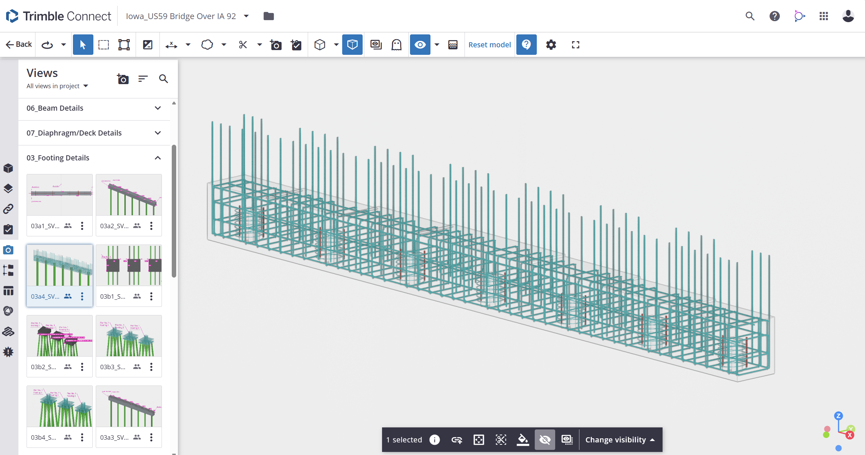
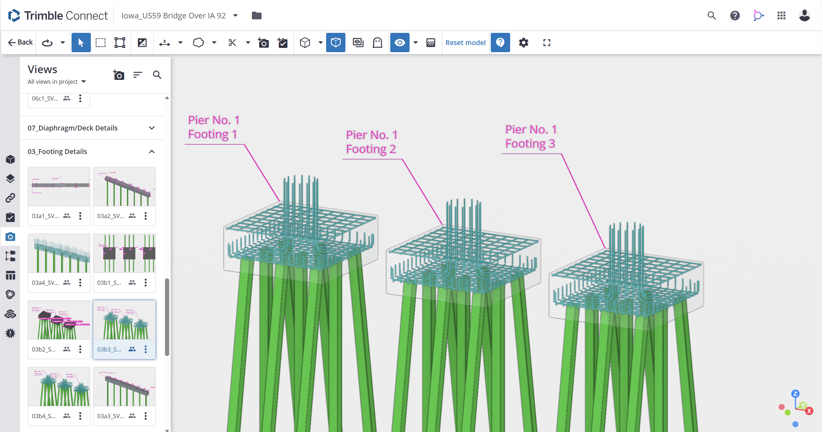
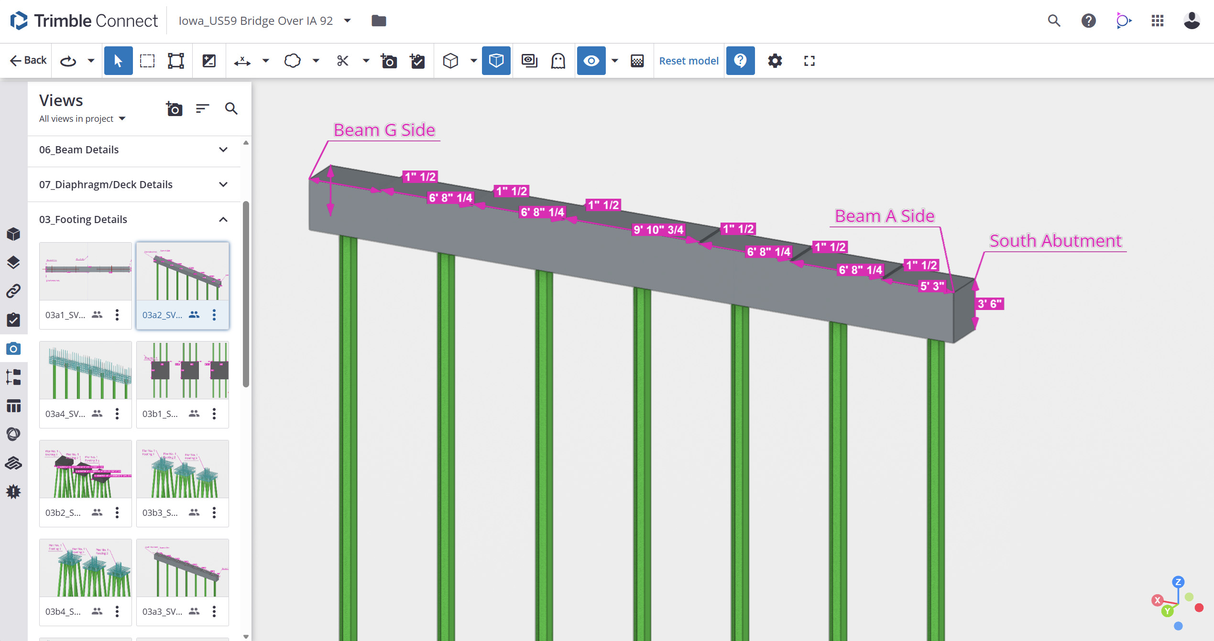
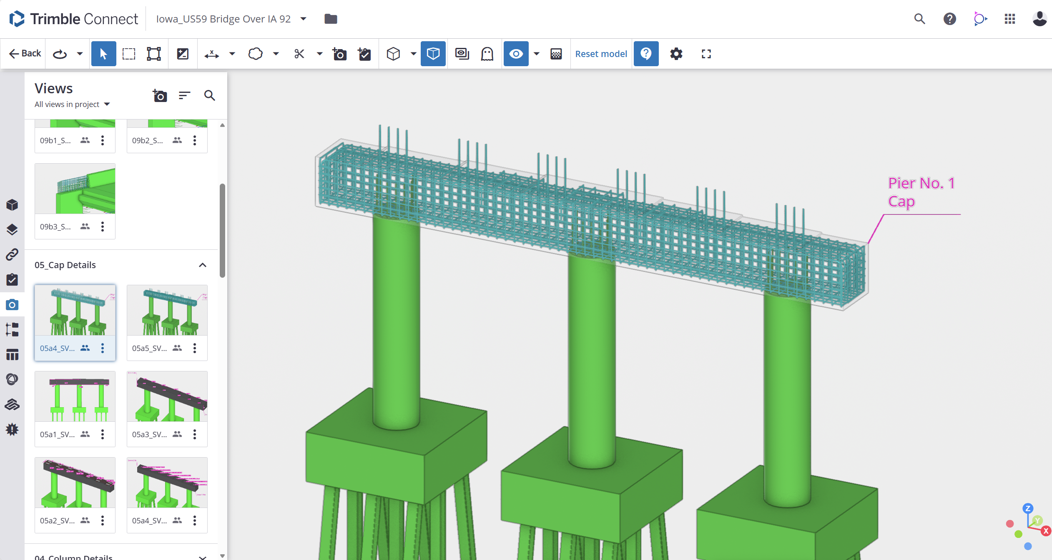

Slide 8
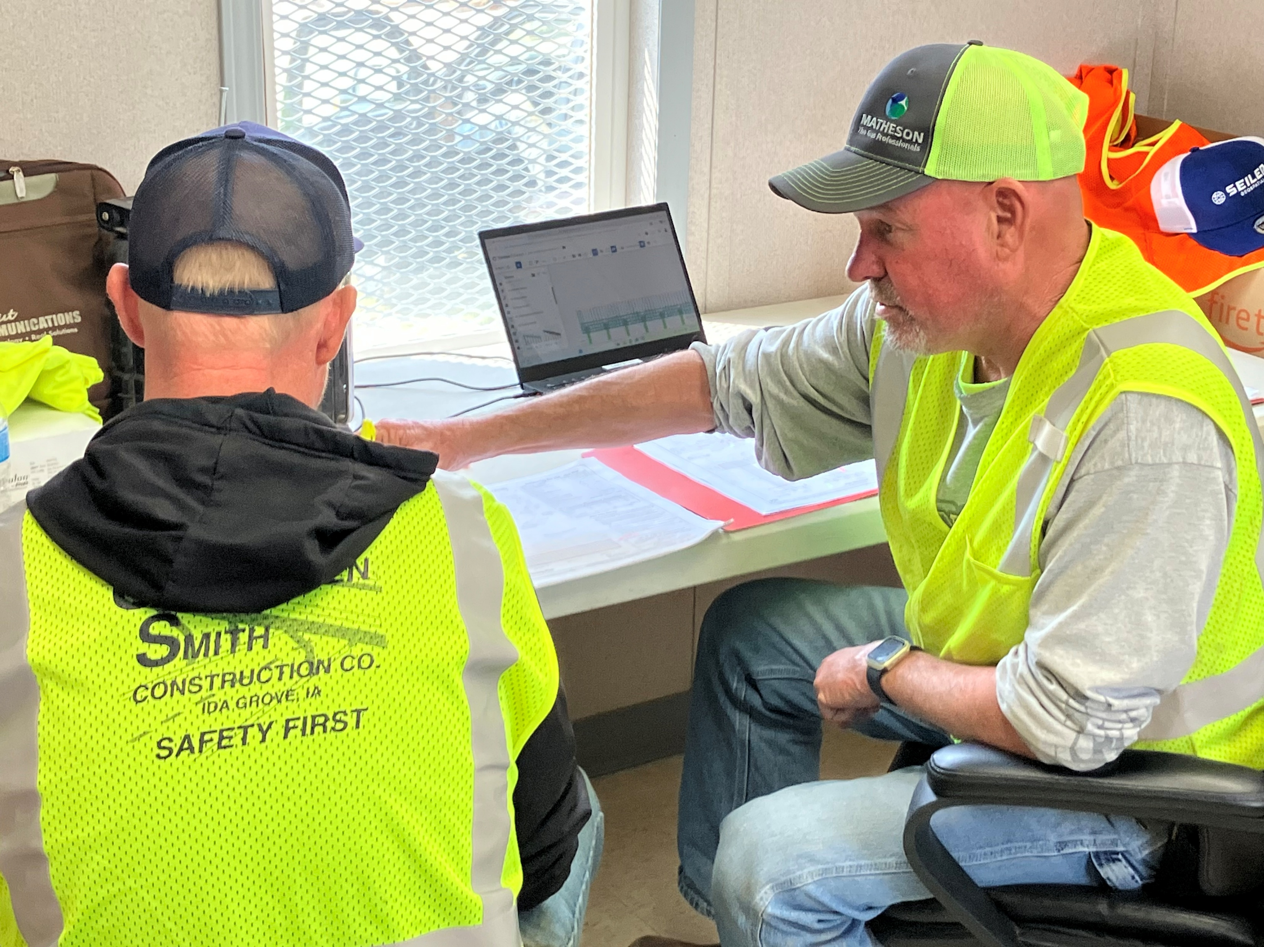
Model Use in Construction
Pre-bid meeting
Model Review Sessions
Weekly Construction Meetings
On-site software vendor support

Slide 9
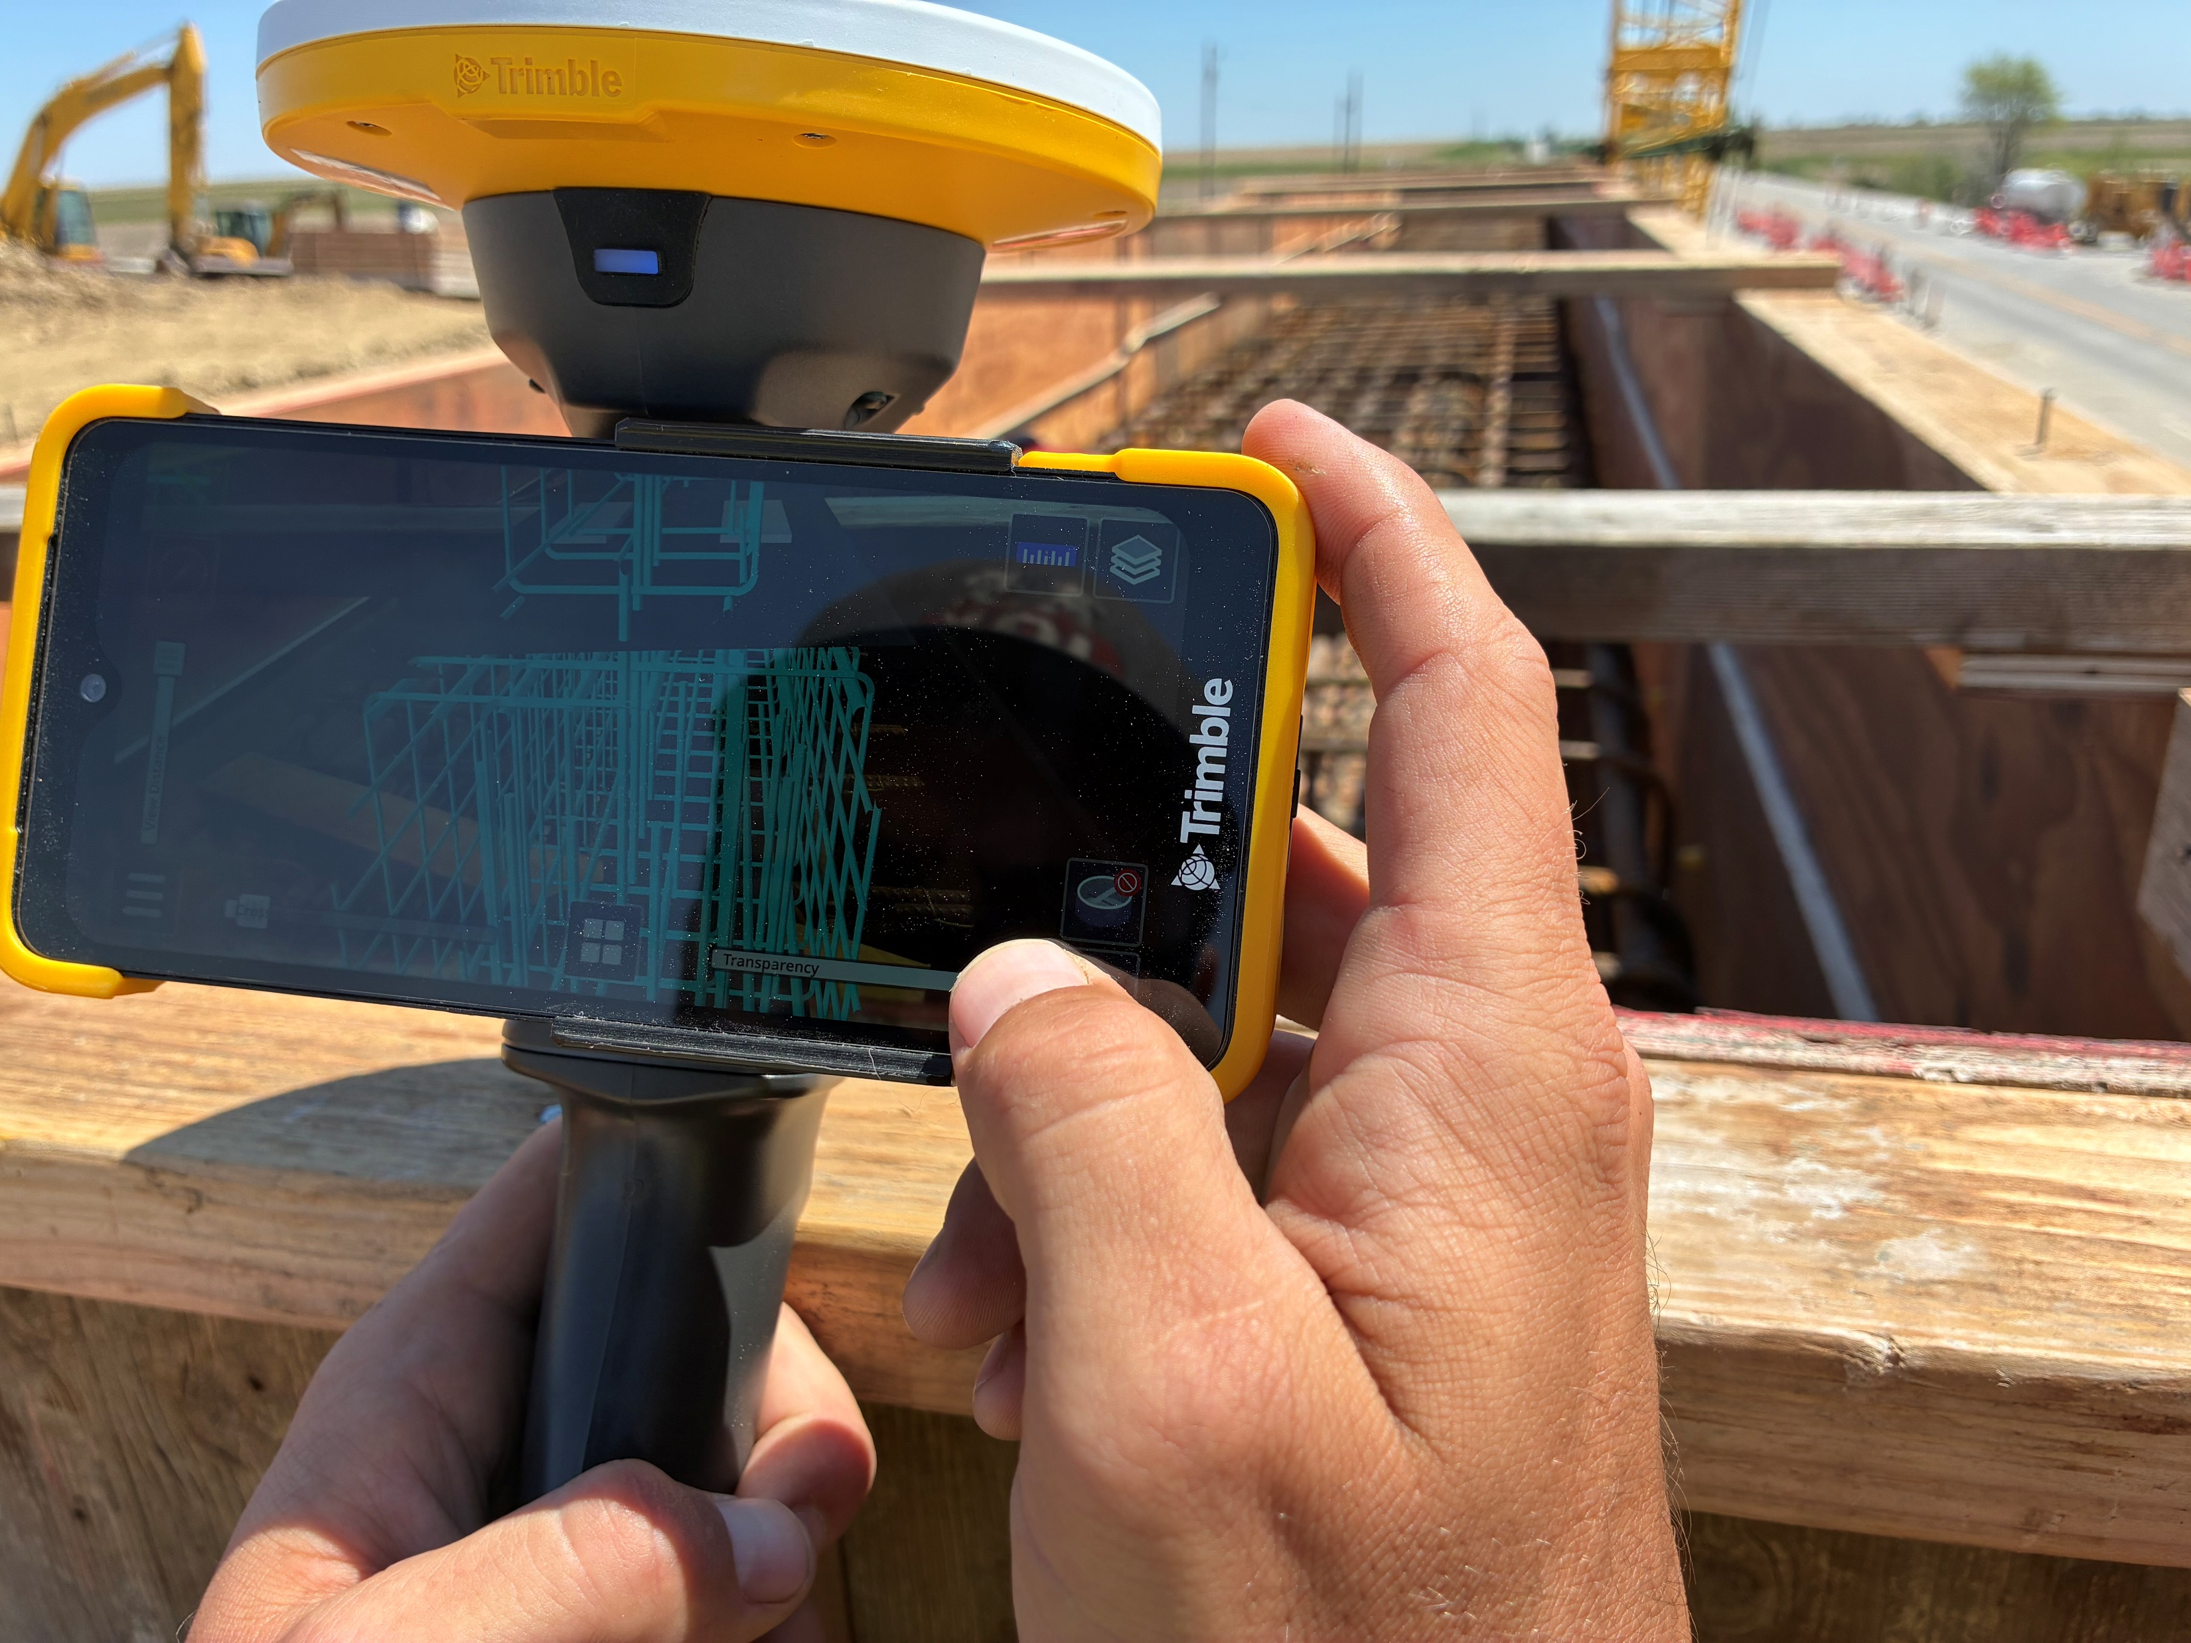
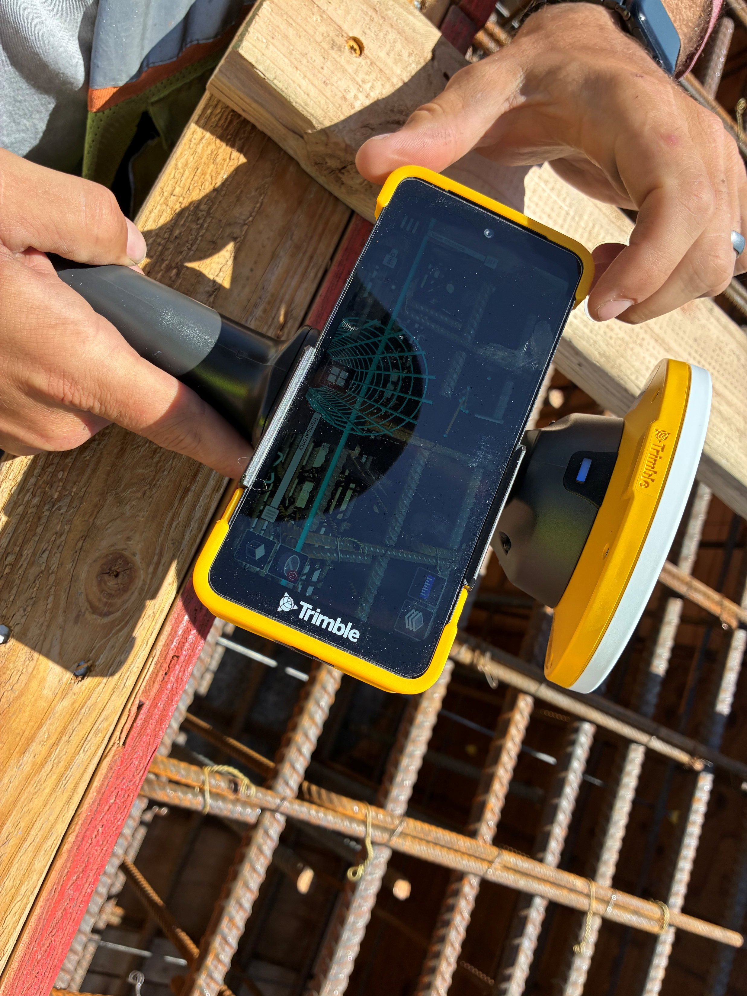
OpenBIM in Action
Notes:
Testing BIM model with AR hardware. Still issues with geosynchronization native from authoring software. Working on this right now.

Slide 10
Work yet to complete
Further integrating model with data fields to capture asset data.
  Automatic extraction of SNBI data from bridge model.
  Construction & Materials data into model to create digital as-built.

Slide 11
Contractor feedback
Generally positive. Field tools need work but office environment with mouse and keyboard very good.
Cannot be given model without standard views from Owner. Will take time to adjust to 3D model usage.
Hybrid approach helped them ease into the technology.

Slide 12
Lessons learned
Authoring software makes good models, post processing still needed for structured data.
Augmented reality has a purpose, but maybe only on very complex projects/designs.
3D models aid contractors and inexperienced staff with a complete vision.

Slide 13
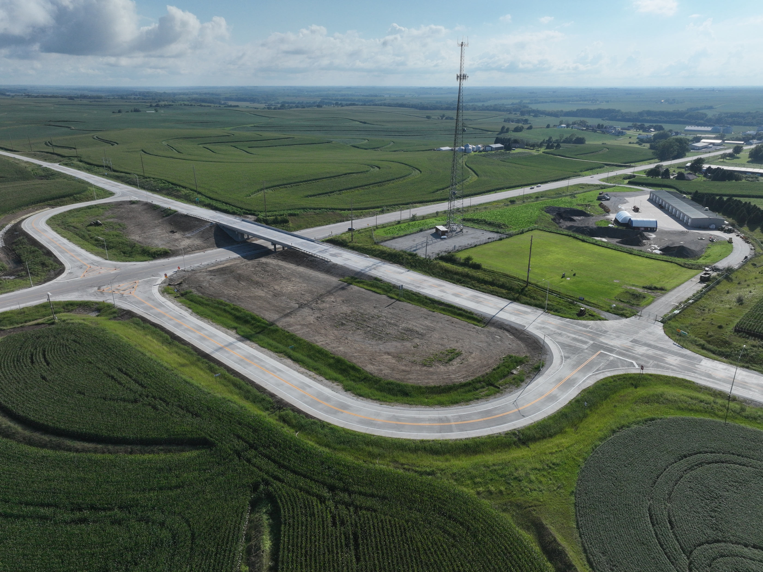
Status
Construction Complete and roadway open on time.
BIM model proved beneficial to construction and inspection.

Slide 14
THOMAS HAMSKI
Bridge BIM Engineer/Digital Delivery Co-lead
515-239-1918
Thomas.hamski@iowadot.us​
https://iowadot.gov/digital-delivery

