Slide 1
Iowa DOT Pilot
Software Experience
Iowa Digital Delivery

Slide 2













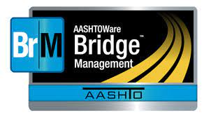











Survey
Design
Construction
Operations
Maintenance
Planning
Digital Delivery is not a single item.
There is NOT 1 App that Fits ALL Solutions
Not an endorsement of any software, merely representative of Iowa DOT’s usage.

Slide 3
Iowa Software Experience
Authoring software models well, needs improvement on data structure.
Field apps tend to work better in browsers but are important for off-line usage.

Slide 4
Delivering BIM Models in IFC
OpenBridge Modeler
(Concrete)
IFC 4x3 Deliverable
Third-Party Construction Software
ProStructures
(Rebar, Misc. Steel)
Notes:
Grant
Targeting LOD400 for most elements

Slide 5


Delivering BIM Models in IFC
?
Solution:
OpenBridge Modeler
(Concrete)
IFC 4x3 Deliverable
Bonsai
ProStructures
(Rebar, Misc. Steel)
?

Slide 6







Investigated Field Software Solutions
Software Evaluated for Project
Iowa DOT does not endorse any software. This list is only software that Iowa DOT had evaluated for this project and is not inclusive of all possible software.

Slide 7

Field Software Solutions Utilized
Iowa DOT does not endorse any software. This list is only software that Iowa DOT used on this project.

Slide 8
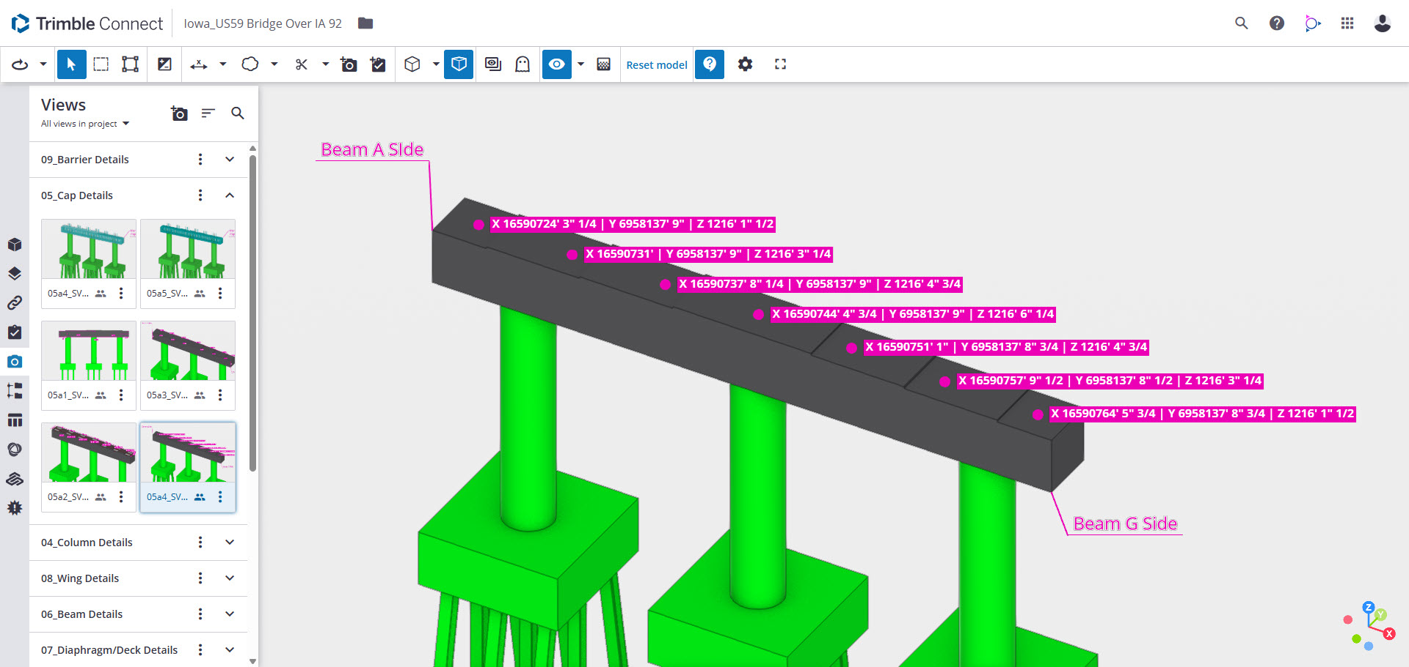
Still Some Quirks
Notes:
Foot-Inch dimensions are needed for most aspects of bridge construction but software makes elevations to be foot-inch as well when you would want decimal.

Slide 9
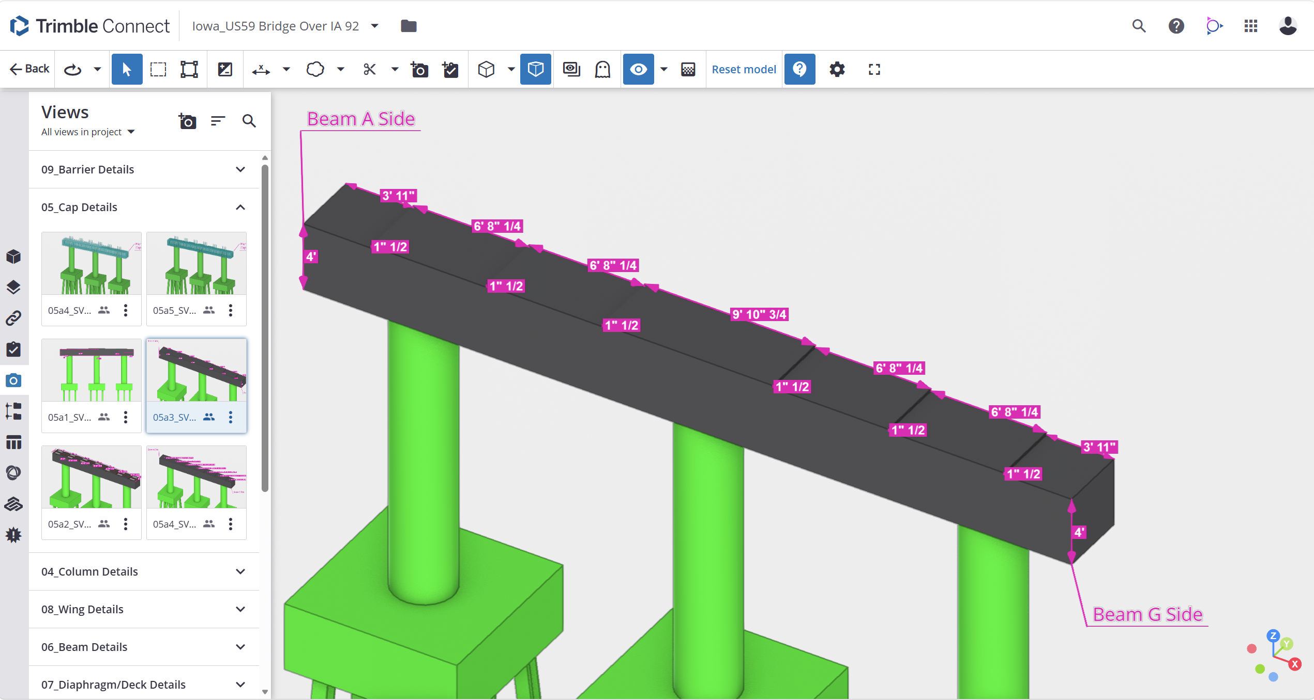
How We Simplified Some Quirks

Slide 10
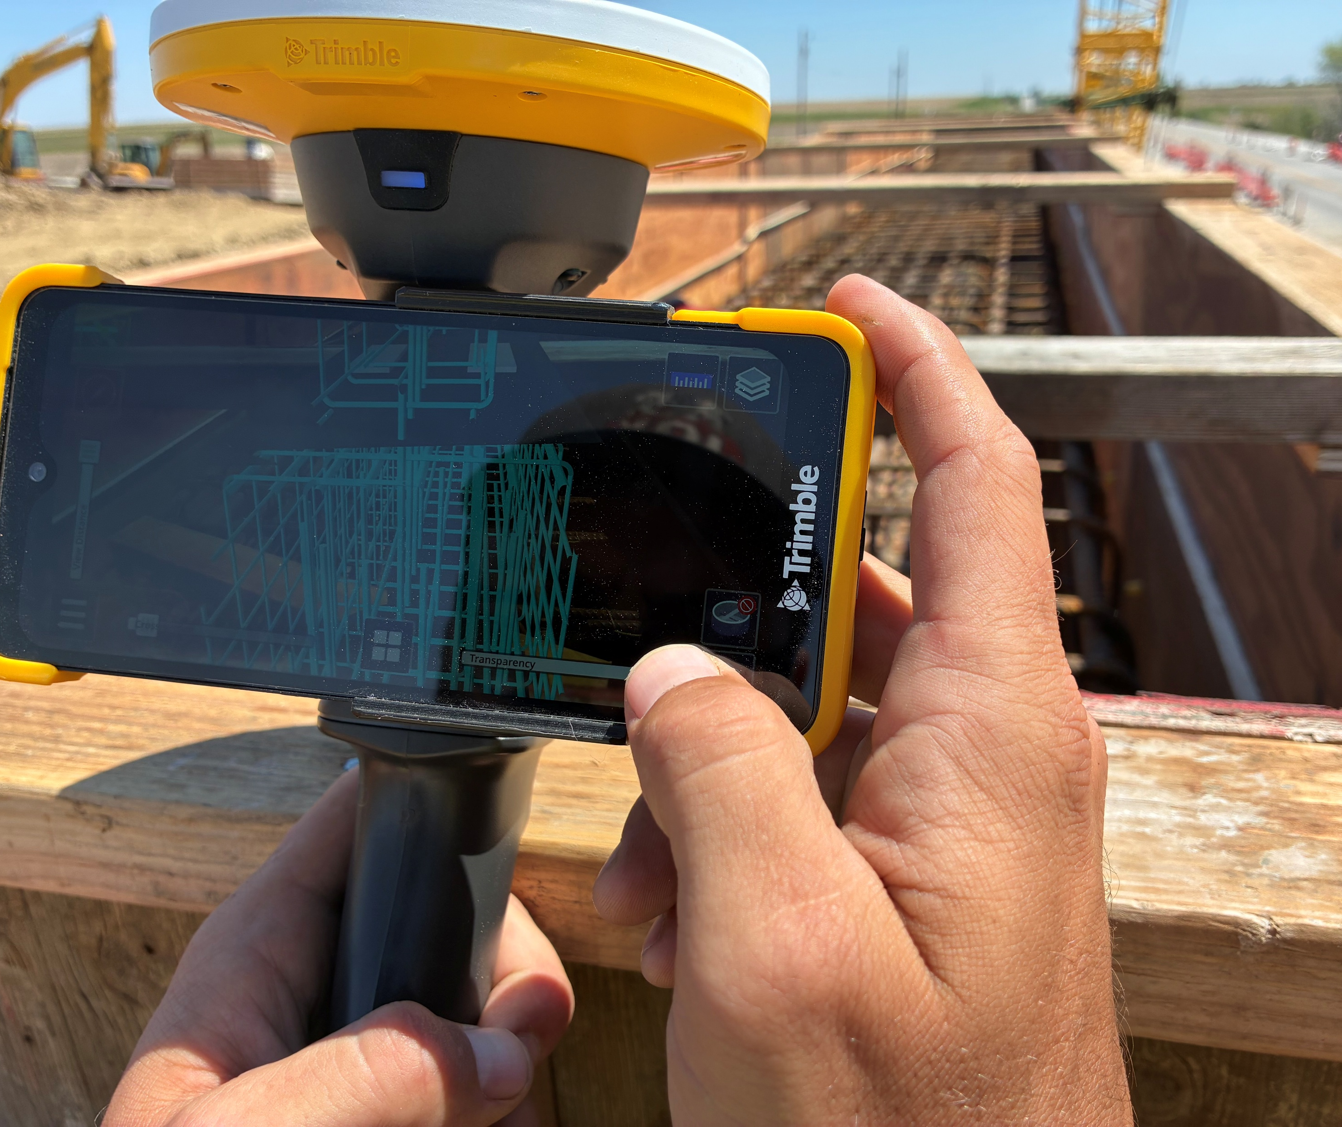
Augmented Reality
Geolocation of models can be tricky.
Use cases are better for inspectors.
By the time contrator is looking at constructed vs design model mistakes might have already been made.
Design vs field model needs to have nuance to field tolerances, could lead to inexperienced staff misidentifying mistakes.
Notes:
We never conclusively identified the root cause of the geospatial location issue within SiteVision, but I believe it has to do with SiteVision reading the entities that define geospatial location within an IFC 4.3 incorrectly. Trimble Connect read the same IFC file and located the model correctly so it gives me confidence that it’s a issue with the tool, not the model. The model also passes validation service and shows up correctly in other viewers correctly.
The solution that Seiler came up with was to import the IFC file into Trimble Business Center and export as a TrimBIM (.trb) file. This native Trimble file format put the bridge in the correct location but eroded some of the other components within the IFC file. The result was a file that went from ~60 MB to nearly a 1 Gig. This TrimBIM file was uploaded to a Trimble Connect project that Seiler hosted.

Slide 11
Conclusions
Field apps could be improved. Desktop with mouse and keyboard still are superior.
Making views on desktop to share to field apps is fine process
Making adjustments or measurements on mobile can be inaccurate and should maybe be sent to office for clarification, but this defeats the purpose of data at your finger tips.
Data in Design and Construction in Stationing vs Milepost in Maintenance and Operations needs better addressed.

Slide 12


BIM for Transportation in Iowa
Iowa has a long history moving towards digital means.
We have focused on incremental steps.
Federal Grants have helped us, but there is still work to be done.

Slide 13
THOMAS HAMSKI
Bridge BIM Engineer/Digital Delivery Co-lead
515-239-1918
Thomas.hamski@iowadot.us​
https://iowadot.gov/digital-delivery

