Slide 1
Open Source Software for IFC/BIM
FHWA DDSG Fall 2026 Meeting
September 30, 2026
Richard Brice, PE
Washington State Department of Transportation
Bridge and Structures Office

Slide 2
Outline
1
2
3
Open Source Software Defined
What “open source” means, how it differs from freeware and shareware, and programs you already use.
IFC Primer
What IFC is, how the specification is organized, and the 3 pillars every model is built on.
Open Source Software for IFC/BIM
IfcOpenShell and Bonsai in action: seven hands-on examples, plus other tools to explore.

Slide 3
Open-Source Software
Open-source software is made available to everyone under licensing terms and conditions that allow you to
  use the software for any purpose
  distribute the software to anyone, gratis or for a fee
  get a copy of the source code
  modify the software and distribute modified versions
  create new software based on the software
What’s the catch?
  All distributions of the software, including derivative works, are required to be under the same terms and conditions

Slide 4
Definitions
Public Domain
  Software that has been placed in the public domain. There is absolutely no ownership such as copyright, trademark, or patent. U.S. copyright law explicitly prohibits the federal government from copyrighting. This prohibition does not apply to States.
Freeware
  Software that is available at no monetary cost, but with one or more usage rights restricted such as source code being withheld, redistribution prohibited, and purpose of usage restricted (e.g. non-commercial use only).
Shareware
  Proprietary software that is provided to users on a limited free trial basis and pursuant to a license which restricts any commercial benefit or use of the software.
Proprietary
  Software licensed under exclusive legal right of the copyright holder with the intent that the licensee is given the right to use the software only under certain conditions.
Open Source
  Software made available with its source code and licensed in such a way that the copyright holder grants rights to study, modify, distribute the software to anyone for any purpose, and create derivative works from the software.

Slide 5
Common Open-Source Programs
Linux — The world’s most widely used open‑source operating system (servers, Android, cloud).
Firefox — Open‑source web browser known for privacy and extensibility.
VLC Media Player — Plays almost any audio/video format; fully open source.
GIMP — Open‑source image editor similar to Photoshop.
Blender — Industry‑grade 3D modeling and animation suite (and foundation for Bonsai).
LibreOffice — Open‑source alternative to Microsoft Office.
Audacity — Popular audio editing software.
Android — The core OS is open source (AOSP).
WordPress — Powers ~40% of websites; fully open source.
Python — Open‑source programming language used everywhere from AI to automation.
Git — Open‑source version control system used by developers worldwide.
PostgreSQL — Enterprise‑grade open‑source database.

Slide 6

IFC Primer
What is IFC?
  Industry Foundation Classes
  International and open standard for structuring and exchanging digital information about built assets
  It is an ISO Standard Data Schema (ISO 16739)
Do I need to understand IFC?
  In a perfect world, the details are internalized in software
  Model viewers expose the IFC details
  IDS specifications “speak” IFC
  Not all project members need to know IFC, but some will
Where do I find the IFC specification?
  https://standards.buildingsmart.org/IFC/DEV/IFC4_3/HTML/

Slide 7
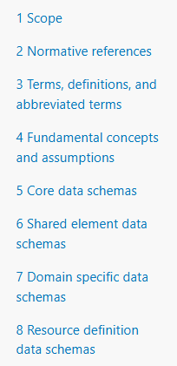
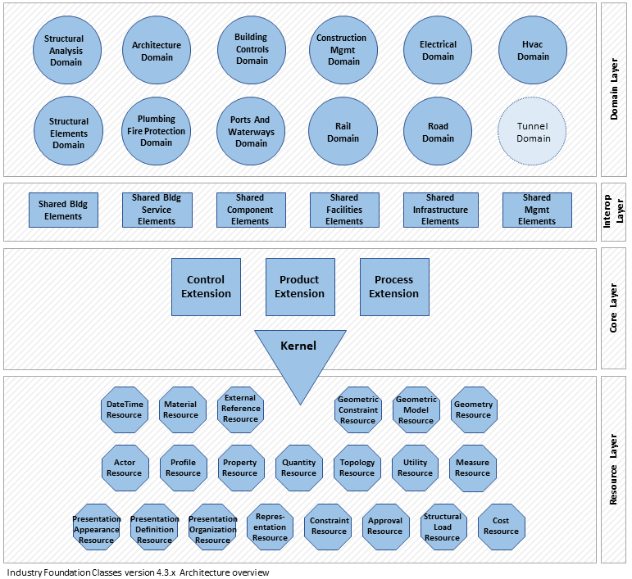
Tips for understanding the Specification
8 Chapters
4 Layers
Chapter 7
Chapter 6
Chapter 5
Chapter 8
Notes:
The IFC specification has 8 chapters. Chapters 4 – 8 are probably the most important.
Chapter 4 provides the fundamental concepts – it illustrates how the different parts and pieces fit together to form the IFC model
Chapters 5 – 8 document the different layers of the IFC schema

Slide 8
4 Layers of the IFC Specification
Domain layer
Discipline-specific entities built on the rest — e.g., IfcBridge, IfcRoad
Chapter 7
Interoperability layer
Shared entities used for exchange across disciplines — e.g., IfcWall
Chapter 6
Core layer
The Kernel; the most general entities, each with a GlobalId
Chapter 5
Resource layer
Reusable building blocks with no identity of their own — e.g., points, curves, extruded solids
Chapter 8
Notes:
Core layer – rooted entities (they have GlobalId’s) – provides the fundamental constructs of an IFC model
Resource layer – points, curves, extruded solids – can’t exist on its own
Interoperability layer – Things that are shared across disciplines - A common example is an IfcWall – walls are shared across buildings and infrastructure
Domain layer – The things that are specific to their domain - like IfcBridge or IfcRoad

Slide 9
The 3 Pillars of IFC
THE KERNEL — defined in the Core layer, it establishes the 3 pillars
OBJECTS
The things being modeled
RELATIONSHIPS
How objects relate to other objects, spatial containers, tasks, and schedules
PROPERTIES
The information that defines the objects
EXTENSIONS — the pillars applied to three kinds of information
Control
Rules, costs, and constraints
Process
Tasks and procedures
Product
Tangible built elements — the most common extension
Notes:
The kernel defines the 3-pillars of IFC
Objects are the things being modeled
Relationships define how the objects relate to things like other objects, spatial containers, tasks and schedules
Properties are the information that define the objects
These pillars are then applied to 3 kernel extensions
The Product extension is the most common because it deals with the real-world physical entities
Control and Process extensions are for more advanced work like defining resource and time constraints, tasks, procedures, costs, and schedules.

Slide 10
The 3 Pillars in Action
OBJECTS
What is it?
PROPERTIES
What do we know about it?
RELATIONSHIPS
How is it connected?
Example 4 – Clash Detection
Clash sets are built by entity type: IfcReinforcingBar vs. IfcPile (DRIVEN), IfcTendon vs. IfcReinforcingBar
Example 1 – Extract Bar List
Read the rebar property set for every bar
Example 2 – Fix Bar Length
Bulk-edit property values through a spreadsheet
Example 3 – IDS & BCF
Check that every bar has a bend shape
Example 5 – IFC Graph
Walk the model: project → site → alignment → bridge → bridge part
Examples 6 & 7 – Scripting and IFC Lite – use all three pillars at once
Notes:
Before we get into the tools, let's connect the primer to what's coming.
Remember the three pillars: objects, properties, and relationships. Every example you're about to see is working with one of them.
Objects answer 'what is it?' Clash detection in Example 4 picks what to compare by entity type - reinforcing bars against driven piles, tendons against rebar. Those are domain layer entities from the 4 layers slide.
Properties answer 'what do we know about it?' Examples 1 through 3 are all about property sets - reading them into a bar list, bulk-editing them through a spreadsheet, and checking them with IDS.
Relationships answer 'how is it connected?' The IFC Graph in Example 5 shows the model as nodes and edges - project, site, alignment, bridge, bridge part.
Scripting and IFC Lite put all three together.

Slide 11
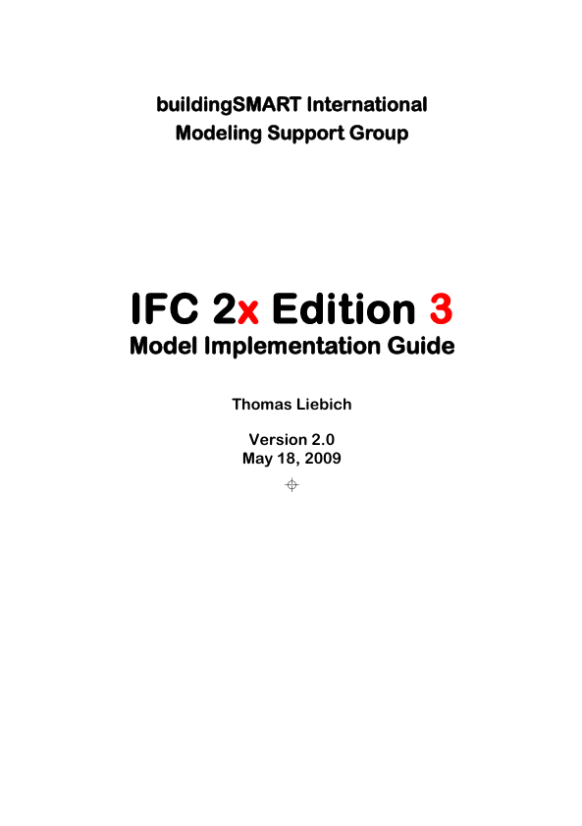

Where to get more Information
IFC 2x3 Model Implementation Guide - https://standards.buildingsmart.org/documents/Implementation/IFC2x_Model_Implementation_Guide_V2-0b.pdf
buildingSMART Norge: IFC for beginners – and beyond
https://buildingsmart.no/en/standards/publications-and-guides
Notes:
Reading the IFC specification is the authoritative source of information but it can be overly technical.
Here are a few resources that are helpful
IFC 2x3 Model Implementation guide isn’t the best place to start, but once you understand the basics and want more detailed information, it’s a go-to guide
The IFC for Beginners document is new from Norwegian chapter of buildingSMART. I haven’t read it cover to cover, but from a quick skimming, it’s a good place to start

Slide 12

Where to get more Information
Interoperability
An Introduction to IFC and buildingSMART Standards, Integrating Infrastructure Modeling
Bernd Domer, Rachele A. Bernardello
Chapters
Introduction
Digital representation of built assets: general concepts
The IfcBuiltElement example
Visual representation of the IFC structure
Organization of IFC
buildingSMART specifications for interoperability
IFC for infrastructure
IFC for roads
IFC for bridges
https://press.uchicago.edu/ucp/books/book/distributed/I/bo196817665.html
Notes:
This book, “Interoperability” is a good resource – especially since it focuses on infrastructure, roads, and bridges
The downside is you need to pay for this book.
This is not an endorsement – its information – this book exists and I found it to be useful.

Slide 13
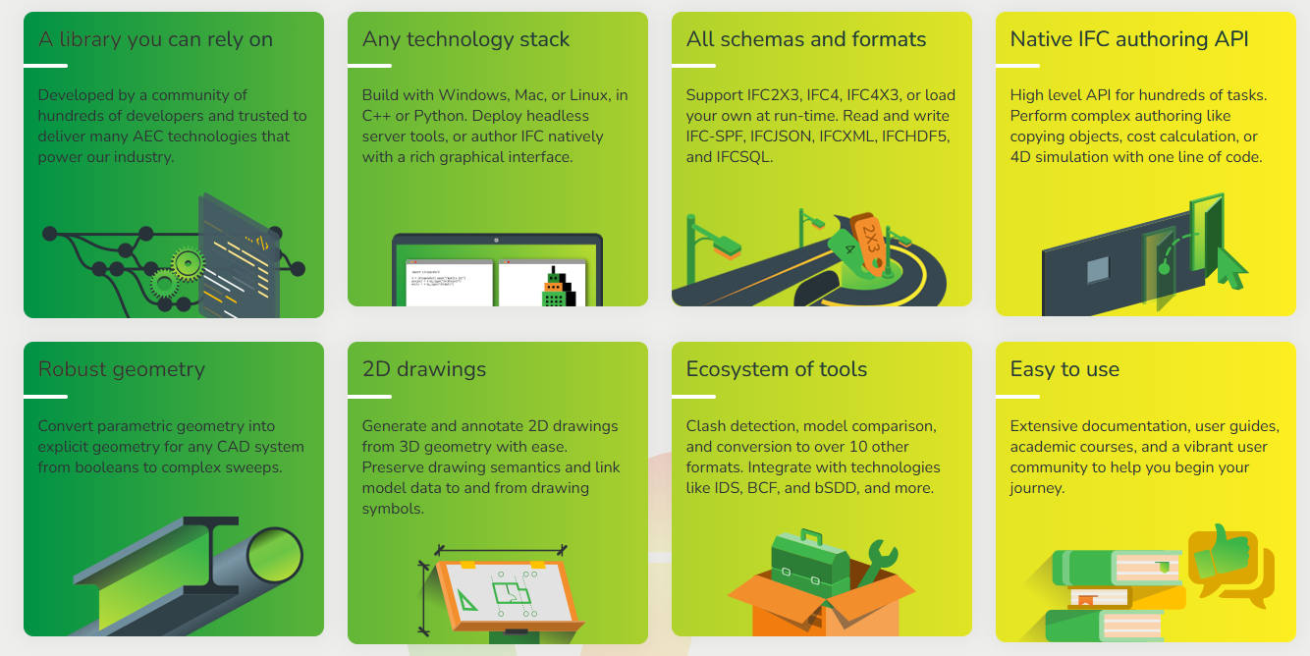
IfcOpenShell Toolkit
ifcopenshell.org
Notes:
Now we are going to explore several open source tools for IFC and BIM.
I’m most familiar with IfcOpenShell and Blender/Bonsai so that’s where we are going to spend most of our time, though we will hit some tools.
For full disclosure, I’m not an expert in every aspect of every one of these tools – I’m sharing what I know - we can figure out the rest together.

Slide 14
Key Tools
Tool | Purpose | Best Use Case
IfcOpenShell Core | IFC read/write engine | Custom BIM software, servers
IfcOpenShell‑Python | Python API | Automation, scripting
ifcopenshell.geom | Geometry compilation | Viewers, GIS, analysis
IfcConvert | IFC → many formats | Web/GLB/OBJ export
IfcQuery | Query & inspect | QA, data extraction
IfcEdit | Modify IFC | Automated editing
IfcDiff | Compare IFCs | Change detection
IfcPatch | Fix IFC models | Bulk model cleanup
IfcClash | Clash detection | Coordination
IfcCSV | CSV I/O | Bulk data extraction and edits
IfcTester | IDS validation | Compliance
IfcMCP | AI editing | Experimental workflows
Notes:
The IfcOpenShell toolkit and geometry engine is like a Swiss-army knife of IFC tools. It has many tools accessible programmatically if you like to code, through command-line interface programs, and are integrated into Blender/Bonsai
The key tools are listed

Slide 15
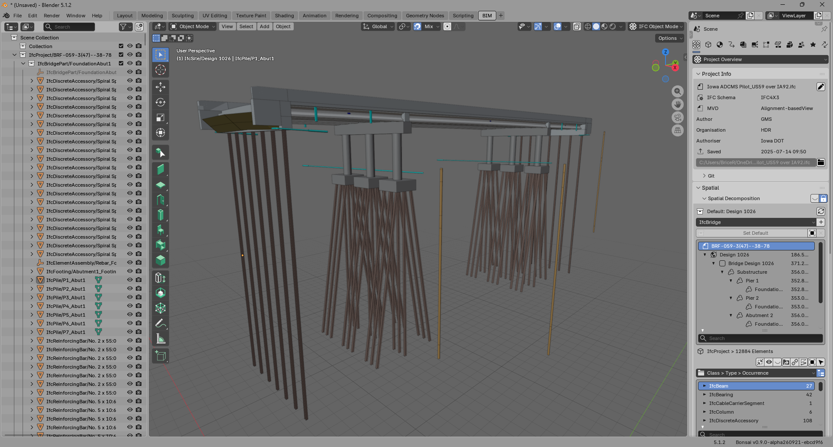
Bonsai
bonsaibim.org
Robust model viewer
Spatial Breakdown Structure
Inspect/Edit Properties
Cost and schedule
Work plans
Quality Control
  Purge data
  IDS checking
  Model Differences
  Bulk Edits/Patching
  Clash Detection
  BCF
  Import/Export with Spreadsheet Data
Notes:
Bonsai is a plug-in to the Blender graphical design program. It turns Blender into a fully capable BIM modeling platform. The model creation capabilities through the UI are primarily for buildings now, but serious work is being done to bring a UX for infrastructure projects to the tool. However, as a model viewer it works great for infrastructure models.

Slide 16
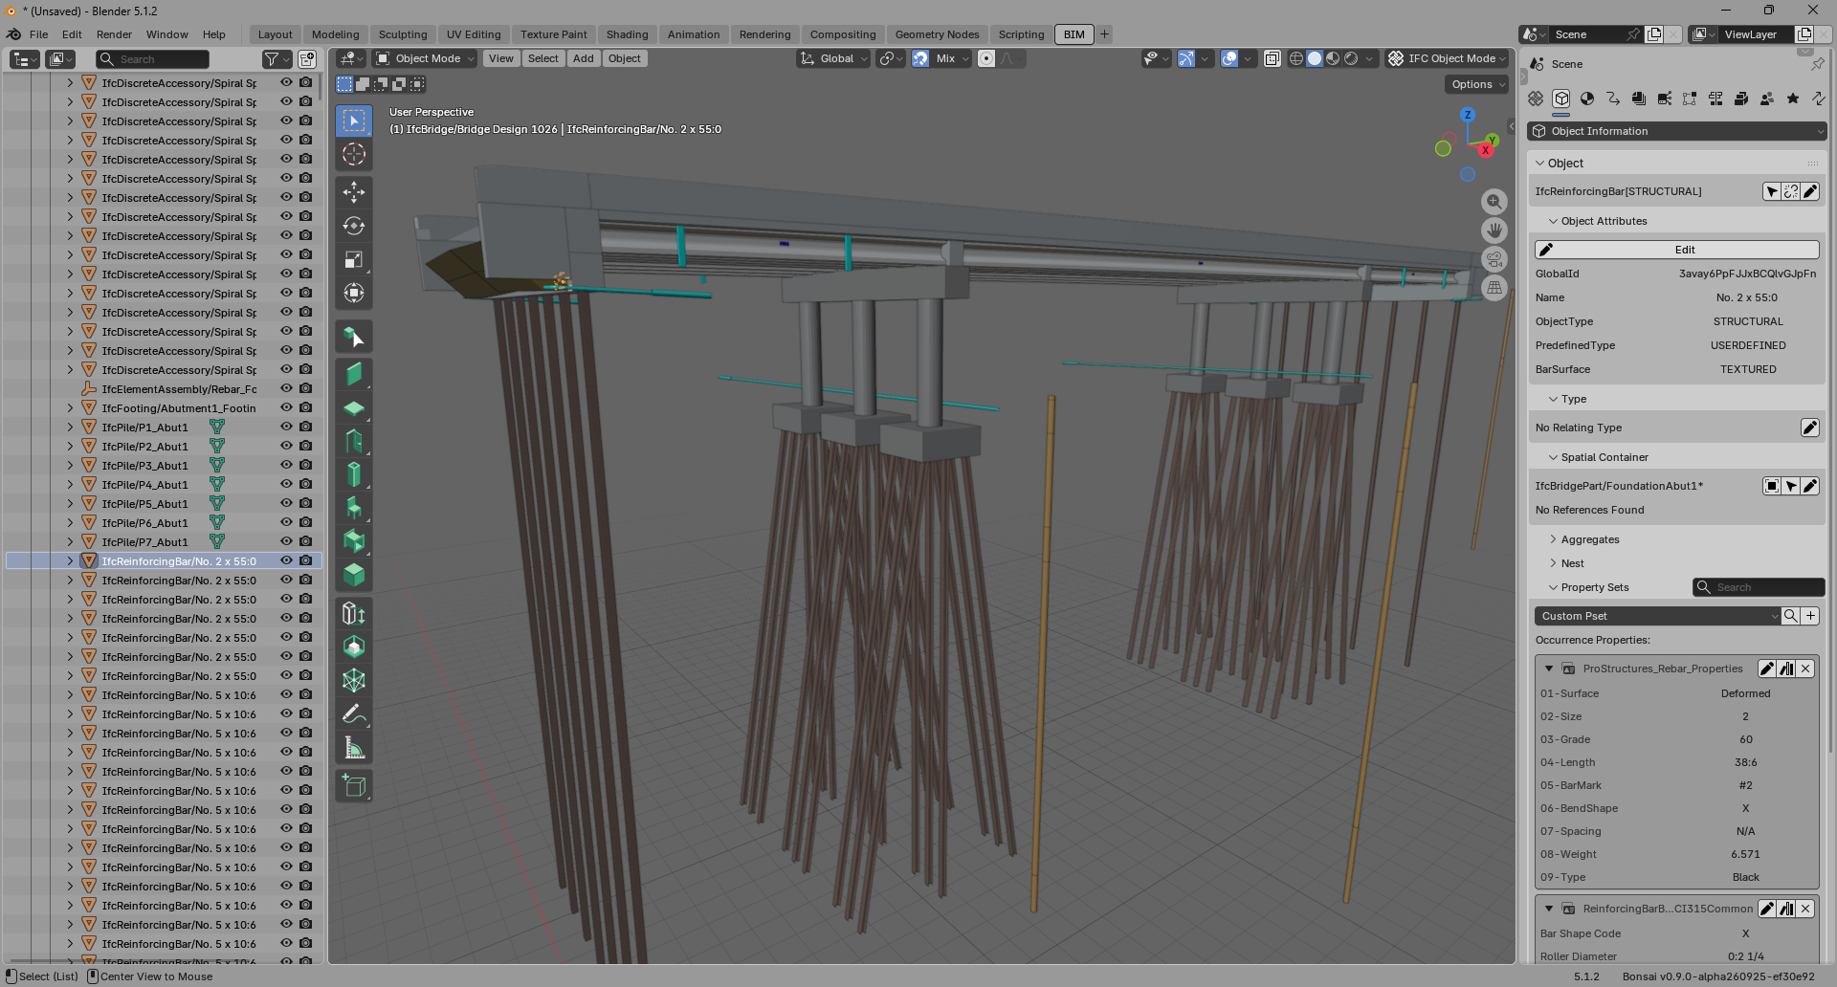
Example 1 – Extract Bar List
1
3
2
4
Notes:
This model is the Iowa ADCMS Grant Project – 3 span precast concrete girder bridge
There is a lot of rebar in this model – I want a summary of it.
Load the IFC model for the Iowa ADCMS Grant Project
Select a piece of rebar
Select the Object Information tab (the cube icon)
Review the ProStructures_Rebar_Properties property set.

Slide 17
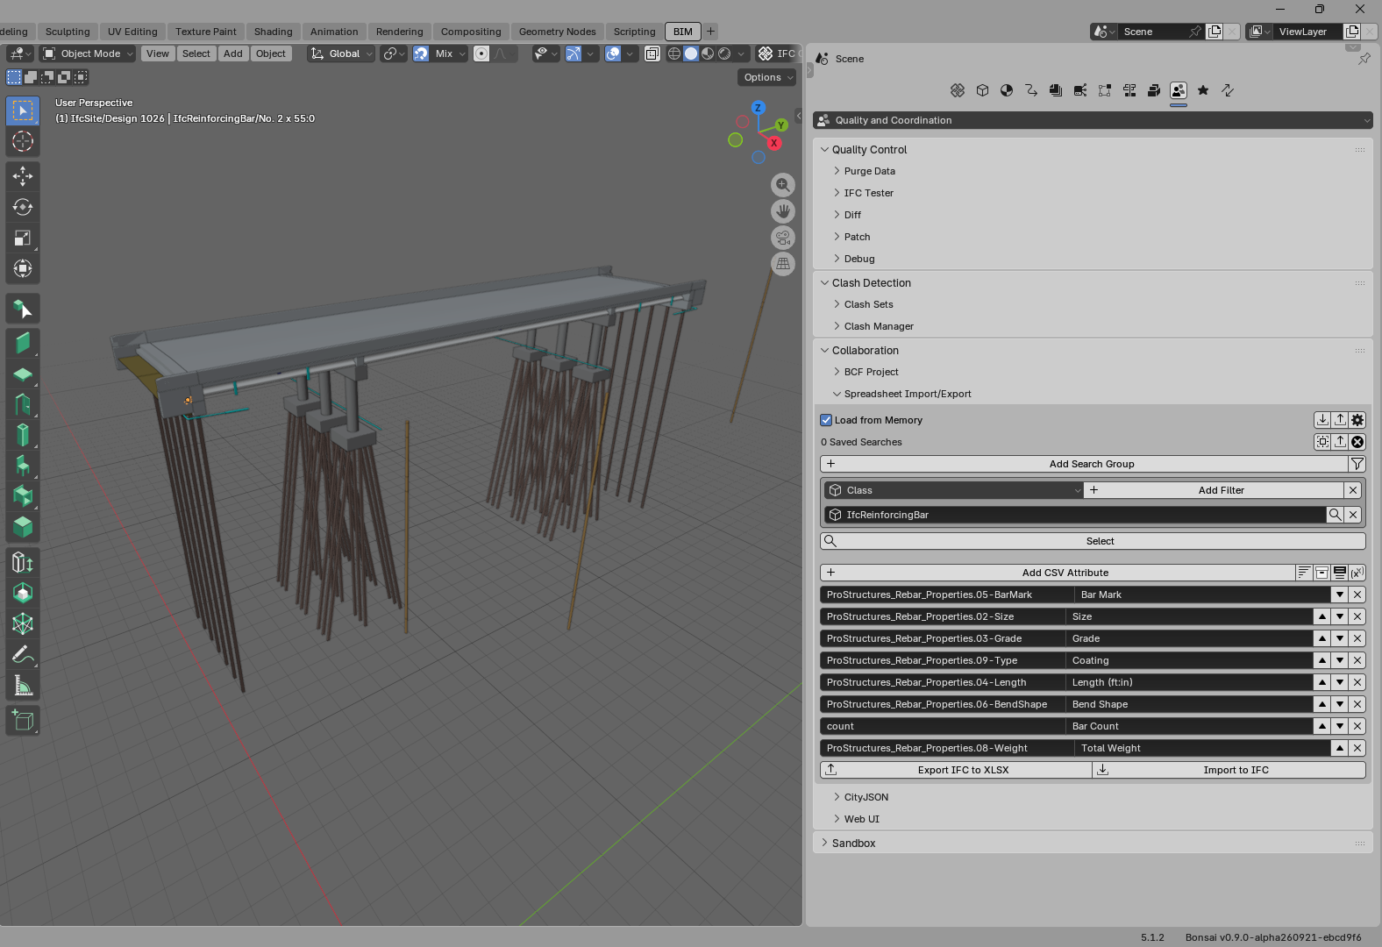
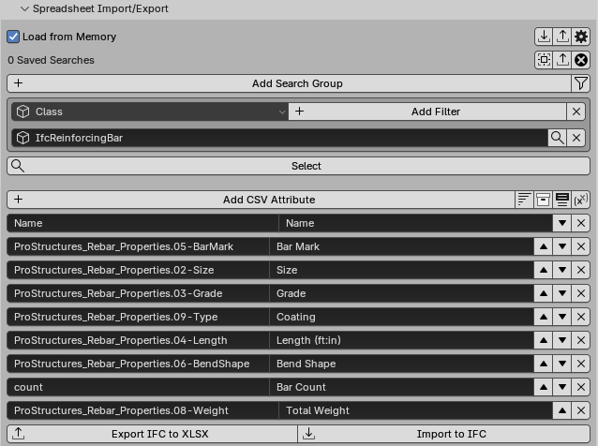
Example 1 – Extract Bar List (cont.)
1
2
3
4
5
6
Notes:
It would take forever to click on bar and review its properties. Let’s generate a bar list or bar schedule.
Select Quality and Coordination
Under Collaboration, expand the Spreadsheet Import/Export tool
Select “Load from Memory” to use the in-memory model
Add a Search group to filter entities of the IfcReinforcingBar class
Add attributes and properties to put into the CSV file.
Press Export IFC to XLSX (this is controlled by the Output format setting under the gear icon)

Slide 18
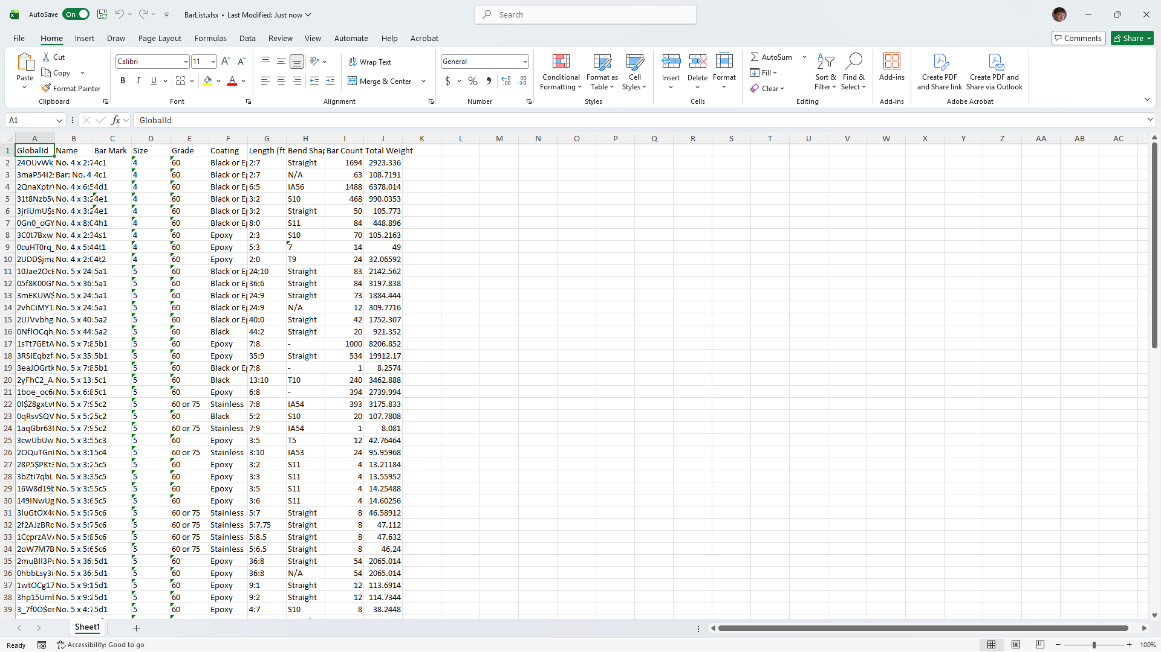
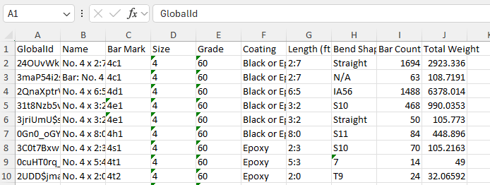
Example 1 – Extract Bar List (cont.)
Notes:
We can review the exported bar list in Excel.
From here you can do additional analysis of the data with Excel, share the data with others, whatever you need.
Instead of a bar schedule, bending data could be exported and sent to the shop floor for production (assuming property QA/QC has been done).
This is a simply example but the possibilities are endless – the model just needs to contain the information you need (which is why we are developing national data standards in the TPFs)

Slide 19
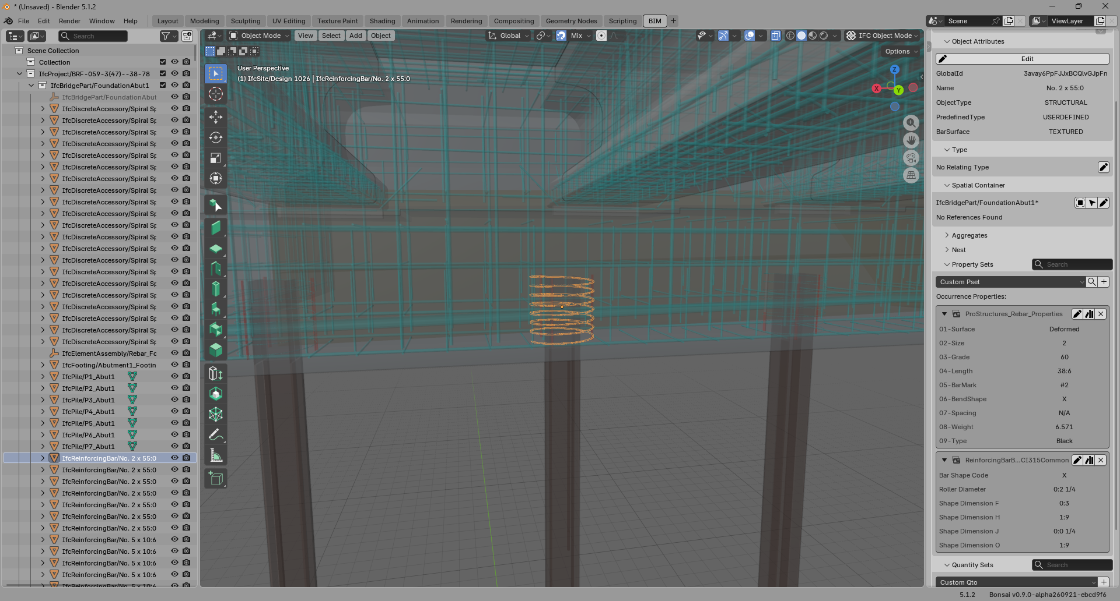
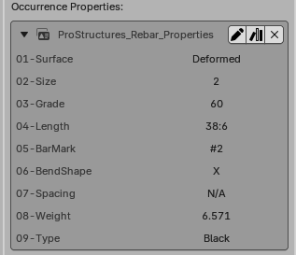
Example 2 – Fix Bar Length
Notes:
Notice that the length properties are a text string in the format “ft:in” – A downstream process needs to have bar lengths as decimal values.
We could change the values one at a time, but there are over 11,000 bars in this model.
The spreadsheet exporter is also a data importer.
The key is the entity GlobalId.

Slide 20
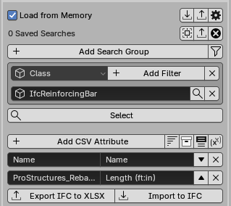
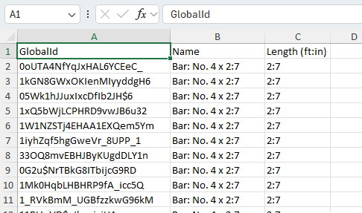
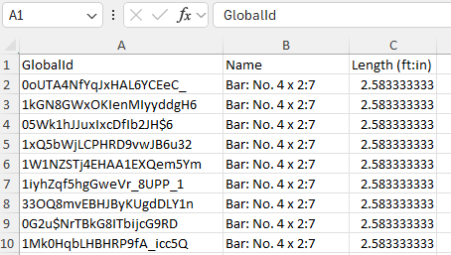
Example 2 – Fix Bar Length (cont.)
1
2
Excel: =LEFT(C2,FIND(":",C2)-1) + MID(C2,FIND(":",C2)+1,99)/12
Notes:
Using the same technique as before, export all the bar lengths to Excel
Revise the bar lengths to decimal values. Use the Excel formula to put the decimal values in Column D, then cut and paste the values to Column C.
Save the revised data.
Notice that the exported data includes the GlobalId – this is how the new data is going to be matched up with the IfcReinforcingBar entities in the model.

Slide 21
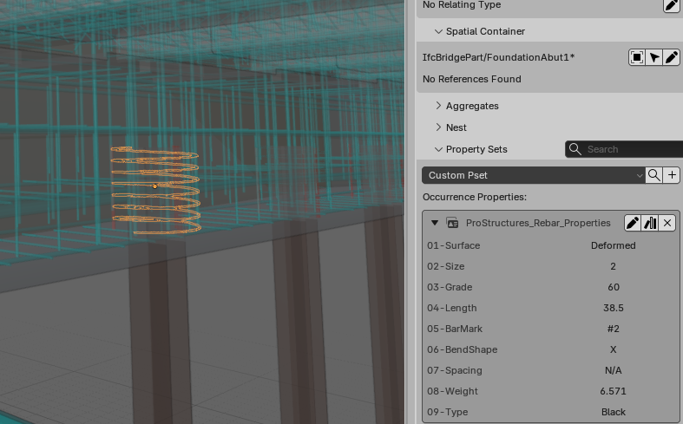
Example 2 – Fix Bar Length (cont.)
1
2
Notes:
Import to the revised data into the model using the “Import to IFC” button. Select the revised spreadsheet
Inspect a bar. Notice that the 04-Length property is now a decimal value
Pro-tip: This isn’t actually correct. The IFC model uses “meter” as the length measure. A certified IFC application will read this as 38.5 meter. Be careful with units – they matter.

Slide 22
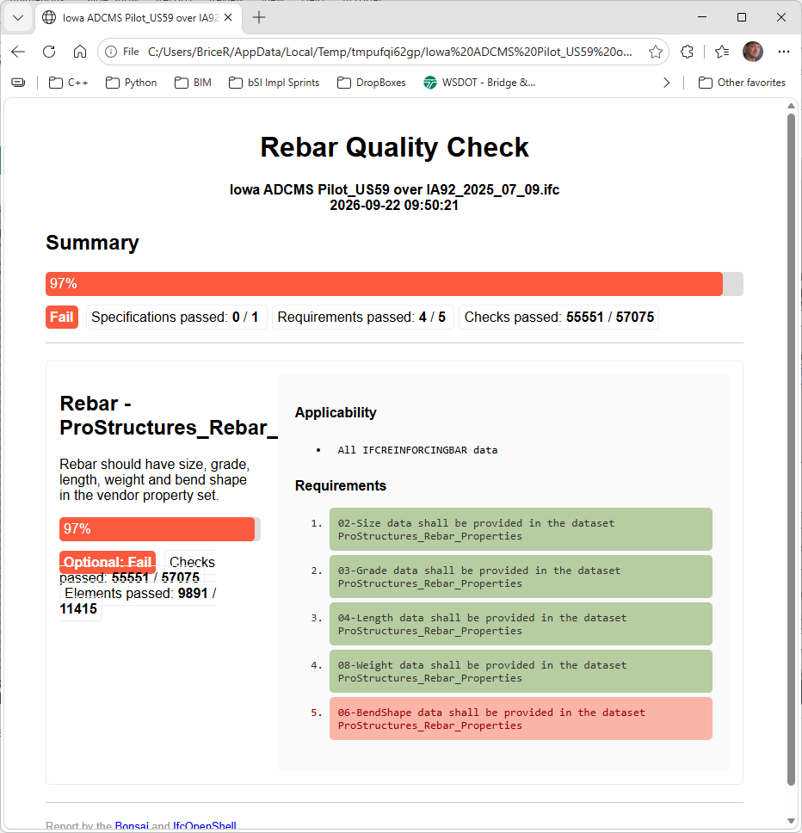
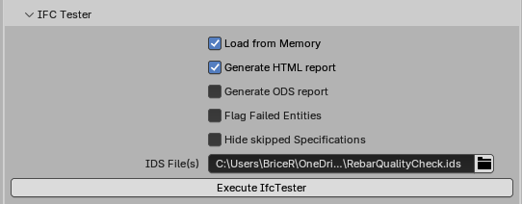
Example 3 – IDS & BCF
5
1
2
3
4
Notes:
Most everyone has seen the IFC Tester example before for running an IDS file
That’s because most IDS checkers are pay to use – this one is open source so its free
Open a model, Select the IFC Tester tool
Load the model in memory & generate HTML report
Select your IDS files
Execute IfcTester
Test results in a nice web browser report.
For this example I created a quick “Rebar Quality Check” IDS that confirms all IfcReinforcingBar have the 02-Size, 03-Grade, 04-Length, 05-Weight, and 06-BendShape properties of the Prostructures_Rebar_Properties pset.
This is usually where most demos of IDS checking stop – lets go further

Slide 23
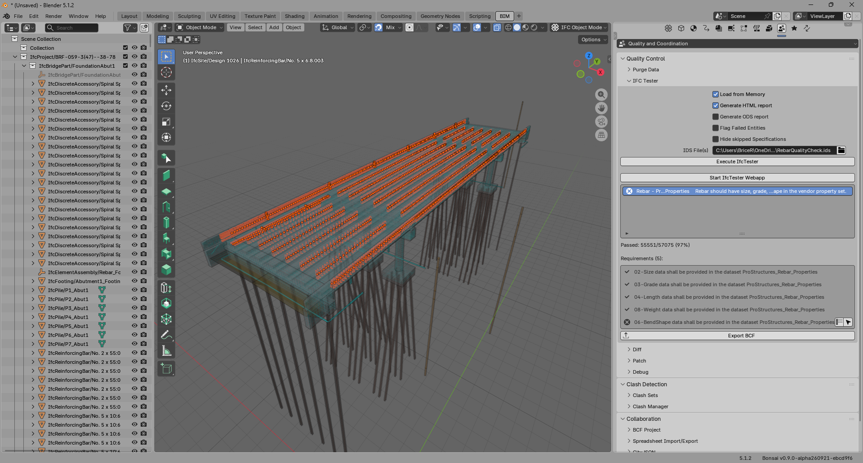
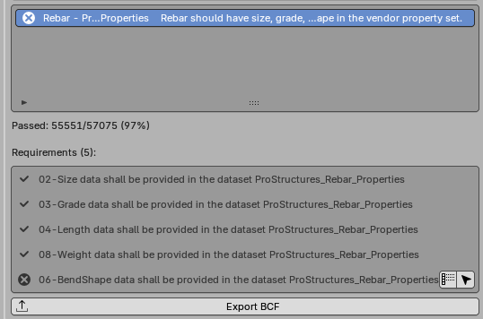
Example 3 – IDS & BCF (cont.)
1
2
Notes:
Even though the IDS is trivial, we can go deeper with the IFC Tester tool and talk about model error resolution workflows with BCF.
Within the model, we can see the failing requirements and select all the bars that are failing.
This isn’t our model, so we need to communicate the issues back to the model owner. That’s the job of BCF.
Press the Export BCF button to create the BCF report.
Send the BCF file to the model owner (email, CDE, or some other agreed upon mechanism)

Slide 24
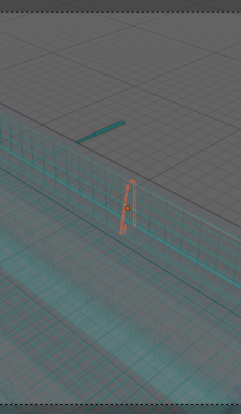
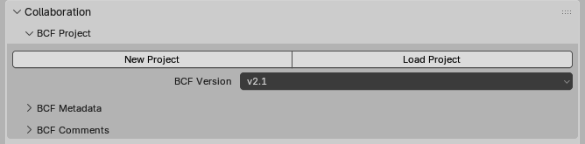
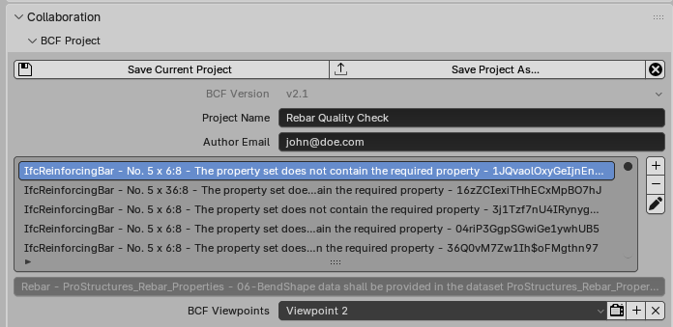
Example 3 – IDS & BCF (cont.)
1
3
2
Notes:
Model owner opens the model in Bonsai (or any other BCF tool) and load the BCF project file
The IfcReinforcingBar entities that failed the IDS check are listed
Select a bar then activate the BCF Viewpoint to see the exact bar that is problematic

Slide 25
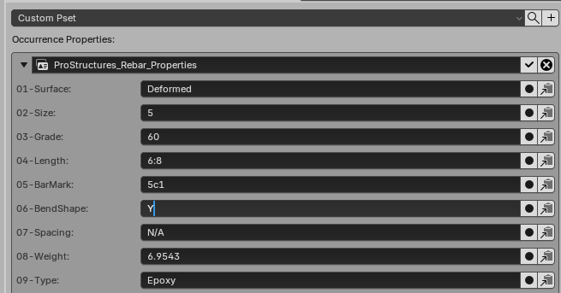
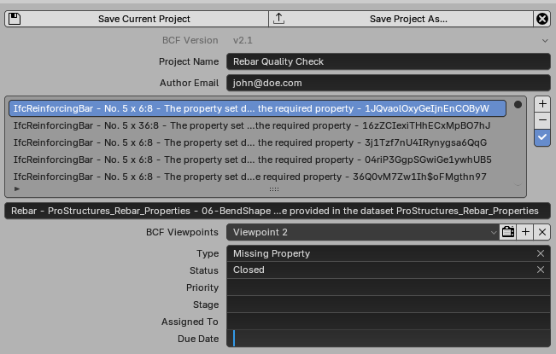
Example 3 – IDS & BCF (cont.)
5
1
2
Notes:
The model owner needs to resolve the issue. In this case, the 06-BendShape property is missing.
Select the Object Information tab and edit the property set. I’m using a dummy value of “Y” for this example.
Go back to the BCF input and mark the issue as resolved.
Make all the remaining model edits – OK, clearly this isn’t the best way to do it in this case, the previous Spreadsheet approach would be easier, but this is an example.
Save the model
Save the BCF project
Send the BCF report and the updated model back to the reviewer
The reviewer can read through the BCF information and run the model against the IDS file again.

Slide 26
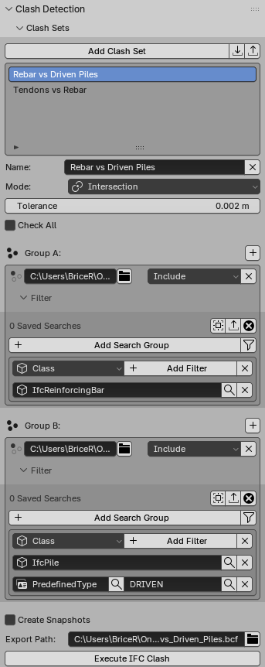
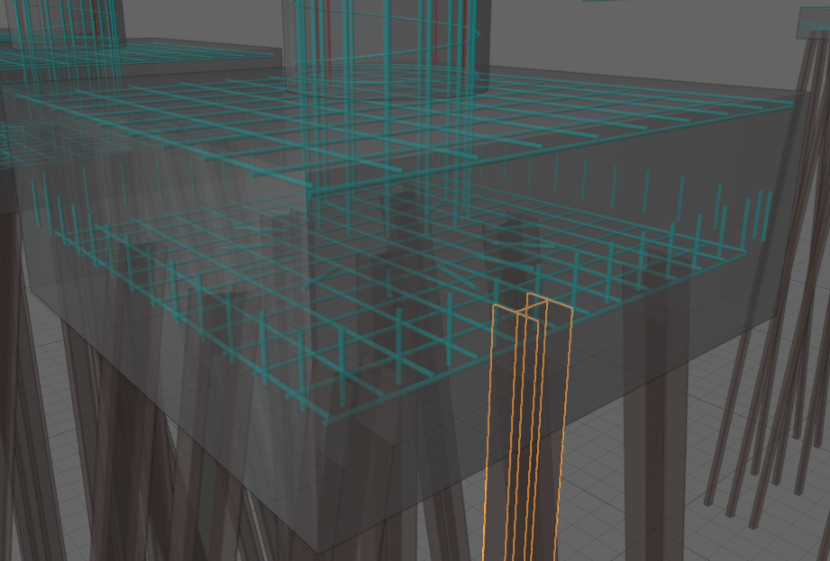
Example 4 – Clash Detection
1
2
3
4
Notes:
Clash detection is feature supported by the Bonsai tool, using the IfcOpenShell toolkit as the backing.
Define a Clash Set, in this case Rebar vs Driven Piles.
Group A objects are compared with Group B objects
In this example, IfcReinforcingBars are Group A and IfcPile with predefined type DRIVEN are Group B
Define Group A
Define Group B
Press the Execute IFC Clash button. Pro-tip: Hold down the ALT key when you press the button for a high level quick search.
There are no Rebar/Pile clashes in this model

Slide 27
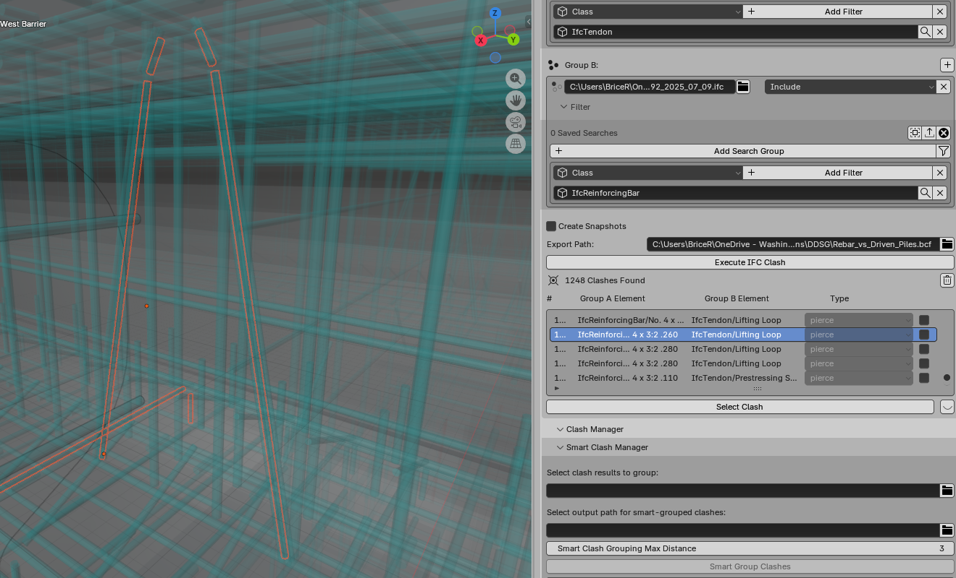
Example 4 – Clash Detection (cont.)
1
2
3
4
Notes:
Here is a different Clash Set looking for IfcTendon and IfcReinforcingBar clashes
Several are found
The one shown is a lifting loop and a rebar piercing one another.
Define Group A - IfcTendon
Define Group B - IfcReinforcingBar
Execute IFC Clash
Select the clash record and press the “Select Clash” button to see the clash in the 3D viewport
The clash information can be saved as a BCF Project

Slide 28
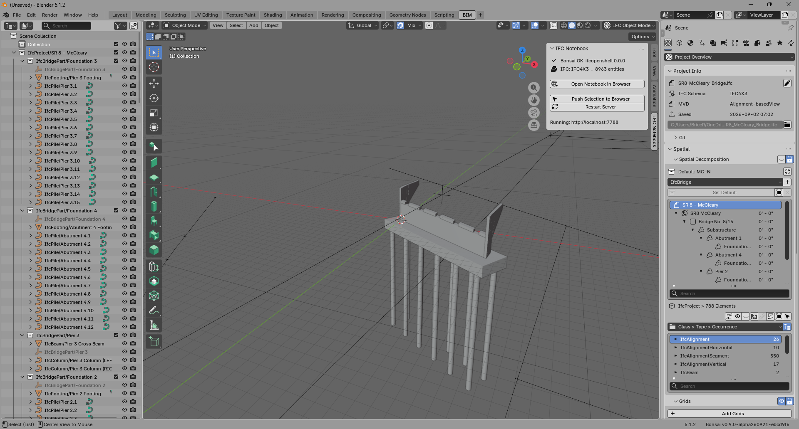
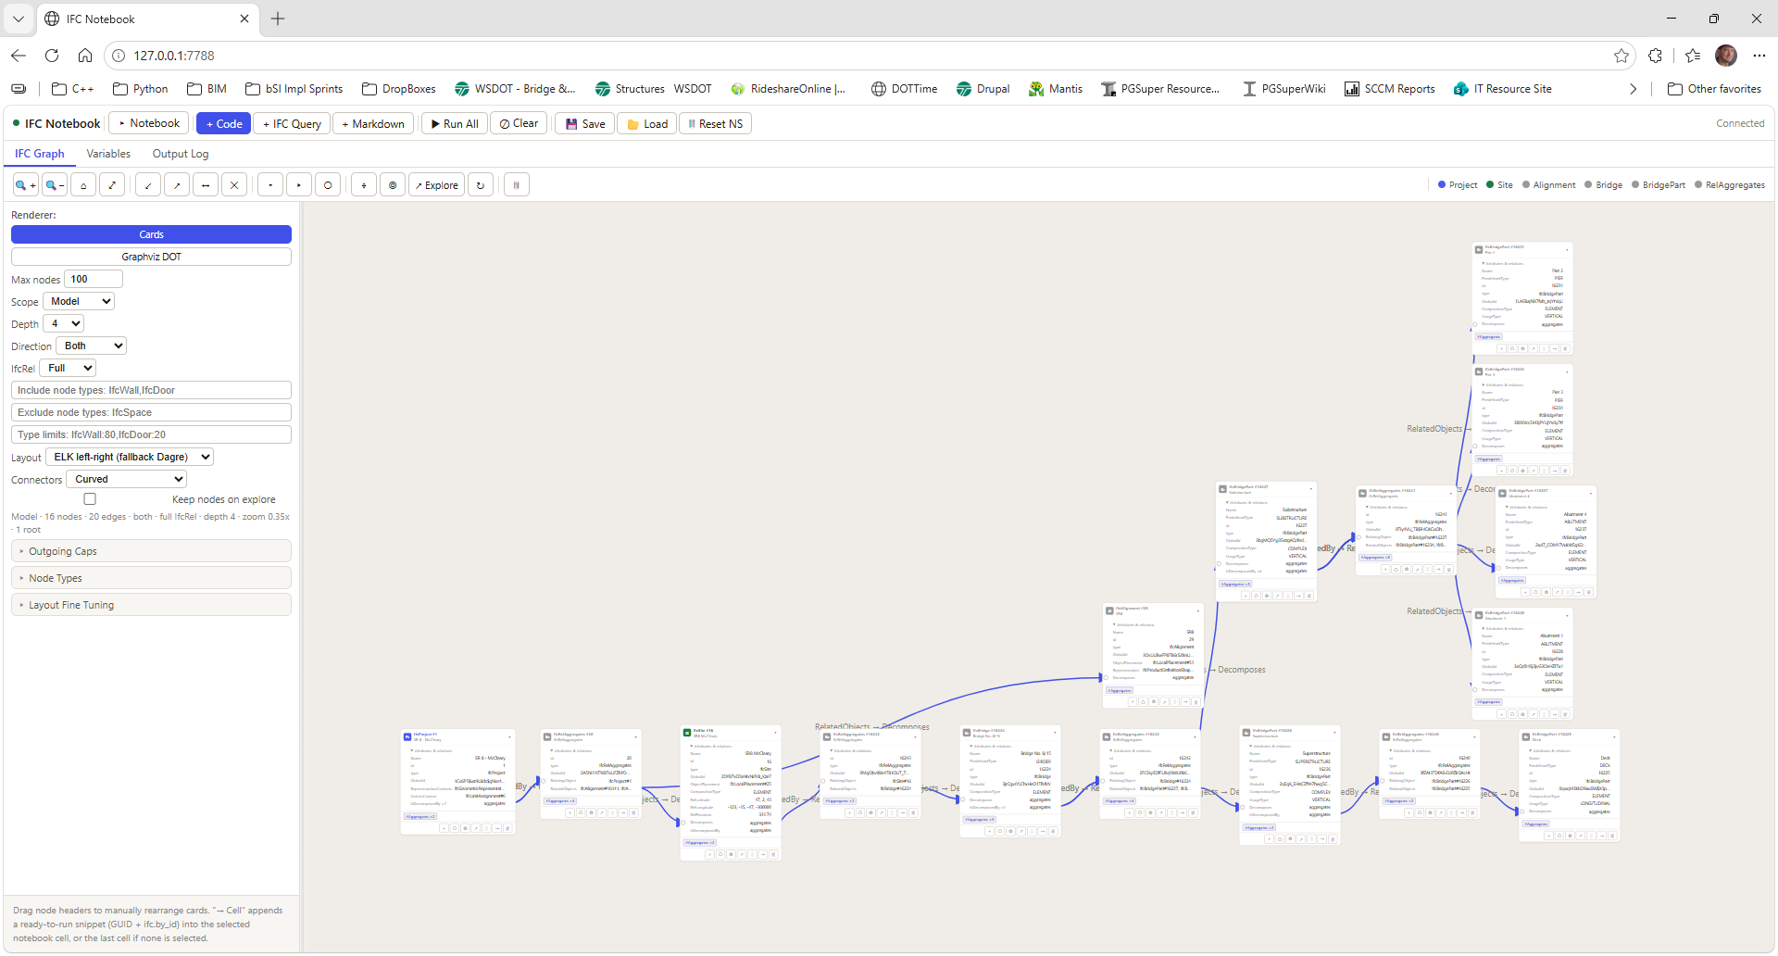
Example 5 – IFC Graph
github.com/jakob-beetz/bonsaiNotebook
Notes:
Now for something completely different -
An IFC file is a “directed, heterogeneous graph of entity instances”. Beyond that, the math/computer science/graph theory definition is for another day.
An IFC model is a graph of nodes and edges. The bonsaiNotebook tool is a nice way to visualize and interact with the graph and understand the structure of your IFC file.
You can pan and zoom. Show nodes at different depths in the tree. Investigate relationships and entity attributes.
You can look at your entire model at once or dig into subsets.

Slide 29
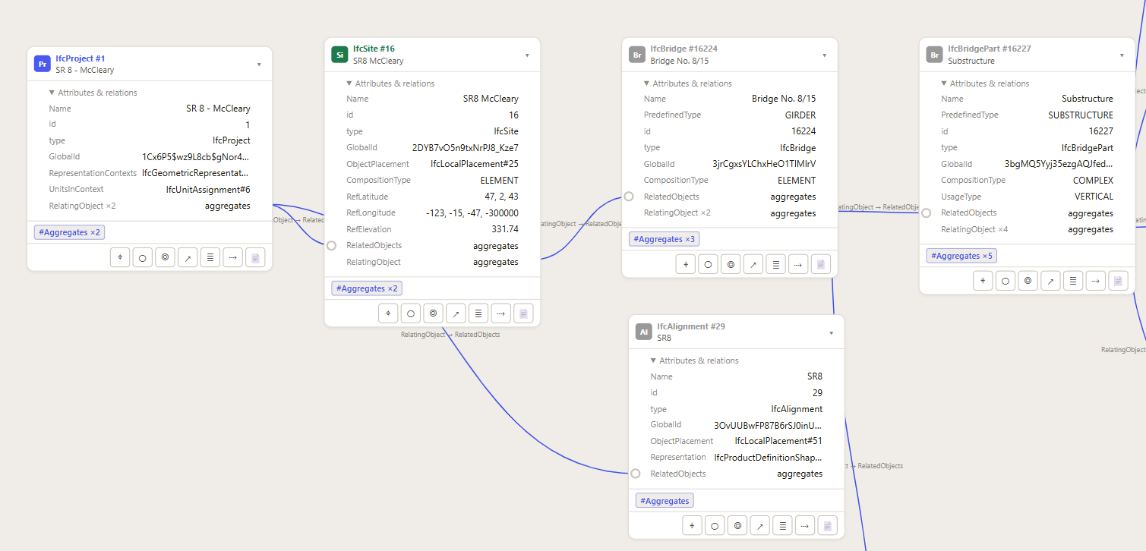
Example 5 – IFC Graph (cont.)
Notes:
Here is a zoomed in view where you can see the project, site, alignment, bridge a bridge part, and the connections between them.

Slide 30
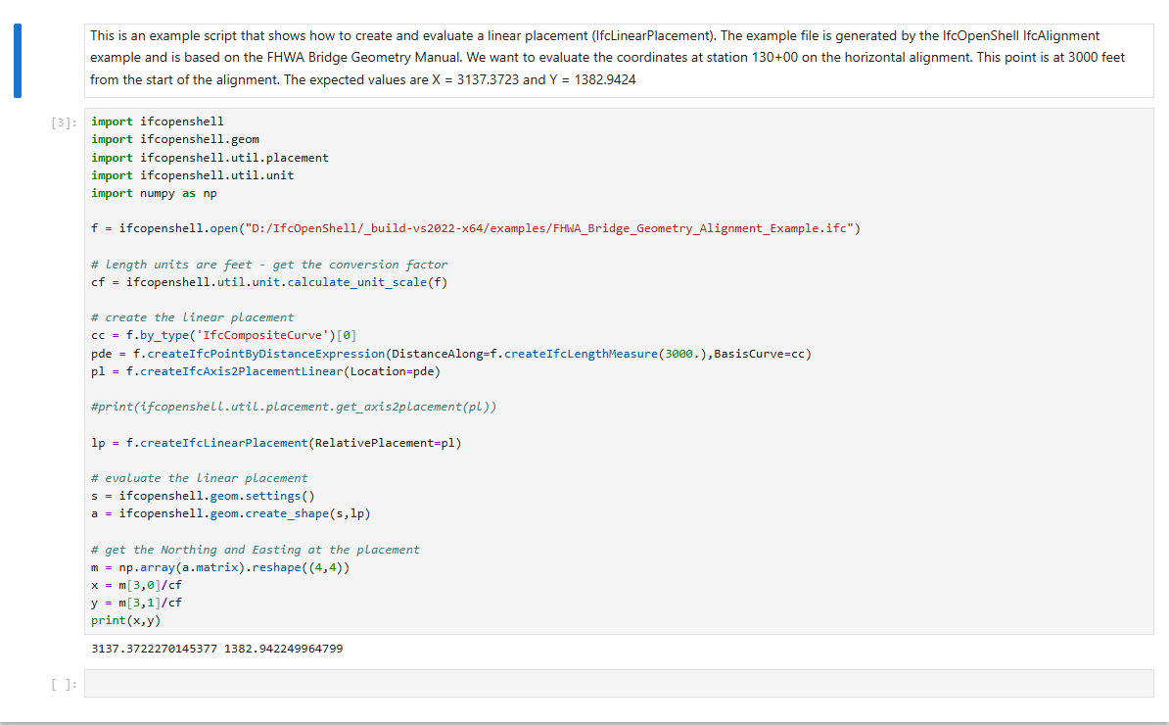
Example 6 – Scripting with IfcOpenShell
Notes:
IfcOpenShell has a full-featured Python API for creating, manipulating, and querying IFC models and geometry.
The tools previously discussed are available through this API so you can do IDS checking, BCF resolution, Clash Detection, and more programmatically
This is an example script written in a Jupyter Notebook that
loads an IFC model containing an alignment
creates an IfcLinearPlacement entity along an alignment
evaluates the linear placement to extract the resulting Northing/Easting coordinate
Pro-tip: A lot of AI agents are really good at writing scripts with IfcOpenShell. Give the agent your IFC model and tell it what you want to do, it can develop a fully documented Notebook for you.

Slide 31
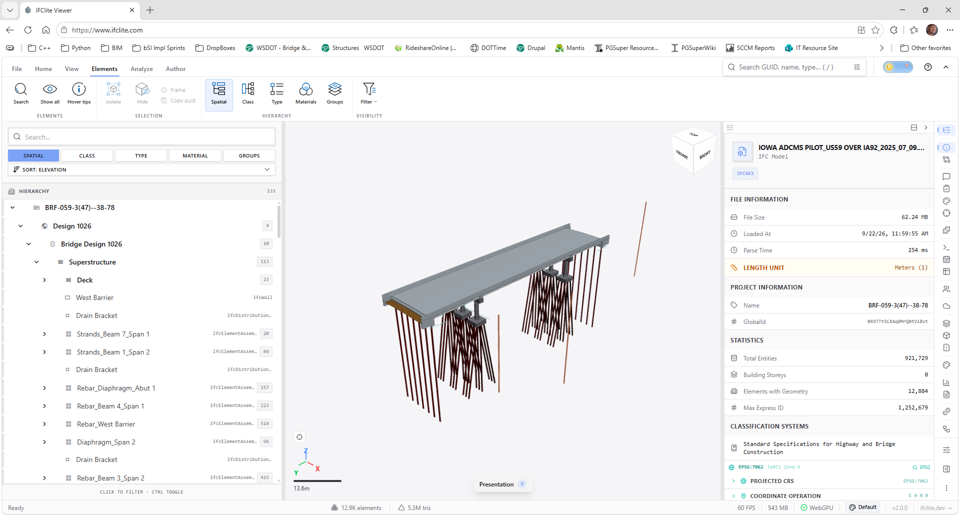
Example 7 – IFC Lite
Web app: ifclite.com · Source: github.com/LTplus-AG/ifc-lite
Notes:
An IFC tool I recently discovered is IFC Lite. I can’t tell you everything about this tool, but it is open-source, it runs in a browser, its super fast and from first impressions it is awesome.
The BIM for Bridges TPF team did a demo with this model where they told the built-in AI agent a start and end date and asked it to generate a plausible construction schedule.
Within minutes they had a schedule and an animated visualization of “expected” construction activities.

Slide 32
Other Open Source IFC/BIM Tools
Modelling
  Bonsai (bonsaibim.org) — Full IFC authoring inside Blender.
  FreeCAD (freecad.org) — General CAD app with a native BIM workbench.
Libraries
  IfcOpenShell (ifcopenshell.org) — The engine behind Bonsai.
  xBIM (docs.xbim.net) — .NET toolkit for reading, creating, and validating IFC.
  web-ifc (github.com/ThatOpen/engine_web-ifc) — WASM parser powering many browser viewers.
Web Viewers
  web-ifc-viewer (github.com/ThatOpen/web-ifc-viewer) — Three.js viewer with clipping planes and 2D plans.
  Open IFC Viewer (openifcviewer.com) — Single-file, client-side viewer with BCF support.
  BIMCamel (bimcamel.com) — Free online toolbox: viewer, IDS checks, clash, and more.
Collaboration
  BIMserver (bimserver.org) — Model server for versioning and querying IFC projects.
  Speckle (speckle.systems) — Open data platform connecting Revit, Rhino, IFC, and more.

Slide 33
Key Takeaways
1
2
3
Open standards
IFC (ISO 16739), IDS, and BCF are open buildingSMART standards. Your data isn’t locked inside anyone’s software.
Open tools
IfcOpenShell, Bonsai, IFC Lite, and more are free to use, share, and modify — no license needed to open, check, or fix a model.
Start small, then automate
Explore in Bonsai or IFC Lite. When a task repeats, script it with IfcOpenShell Python — the same tools, no clicking required.
Questions?
Richard Brice, PE · WSDOT Bridge and Structures Office
Notes:
To wrap up, three things to take home.
First, open standards. IFC is an ISO standard, and IDS and BCF - which we used for model checking and issue tracking - are open buildingSMART standards too. Your data isn't locked inside anyone’s software.
Second, open tools. IfcOpenShell, Bonsai, IFC Lite, and the others on the previous slide are free to use, share, and modify. You don't need a vendor license to open, inspect, check, or fix a model.
Third, start small. Open a model in Bonsai or IFC Lite and look around. When you find yourself doing the same thing over and over, that's the time to script it with IfcOpenShell.
With that, I'm happy to take questions.

